Slide 1
PaymentWorks Vendor Management Portal
Presented by
Emily Hermon

Slide 2
What is PaymentWorks?
Vendor Onboarding
Vendor Maintenance
Payment Status
Vendor Profiles

Slide 3
Who is involved in the PaymentWorks onboarding process?
Department – initiates vendor invitation
Accounts Payable – reviews and approves vendor invitation and registration
Vendor – completes a questionnaire to provide business information, updates when necessary
PaymentWorks – provides technical support for vendors

Slide 4
Who should be invited to PaymentWorks?
All individuals and entities who are to be paid through Accounts Payable EXCEPT…
Current faculty, staff, and students who are being paid for something connected to their work or studies at Kent State
Prospective employees and students who are being reimbursed for travel expenses related to interviews or campus visit
Individuals and entities whose payments will be charged in full to agency indexes
Individuals and entities who are being sent refunds for such things as conference fees, rental space, etc.

Slide 5
When should vendors be invited to PaymentWorks?
Goal
Vendor completes PaymentWorks onboarding process before goods are purchased/services are provided
Required
Vendor completes PaymentWorks onboarding process before department submits payment request to Accounts Payable
April 15, 2020
Payment requests submitted for vendors that have not completed PaymentWorks onboarding process will be returned to requesters

Slide 6
What are the benefits of using PaymentWorks?
Security
Information provided in a secure environment
Vendor is responsible for safeguarding its login info
Compliance
TIN verification
Sanction list alerts
EEOC, ADA, etc.

Slide 7
What are the benefits of using PaymentWorks?
Improved information gathering
Reduction in vendor setup time
Vendors (and you!) can check payment status
Departments can view vendor profile information (tax status, credit card acceptance, etc.)

Slide 8
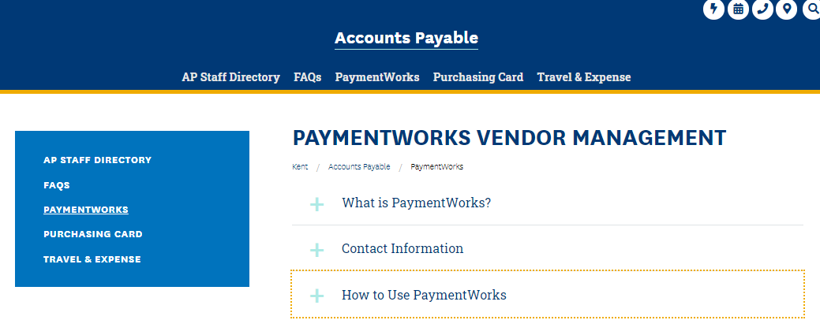
PaymentWorks Resources
www.kent.edu/accountspayable/vendor-management

Slide 9
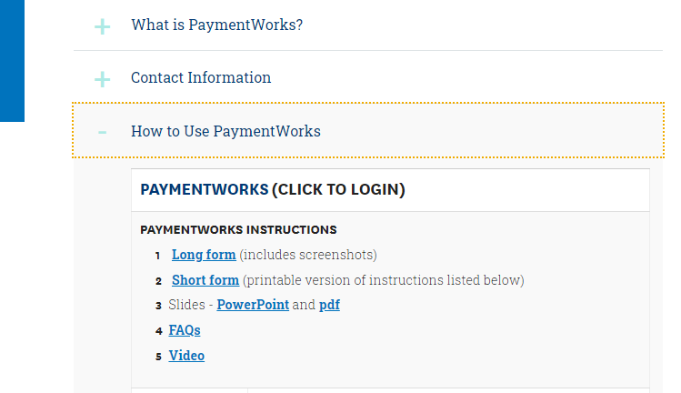
PaymentWorks Resources
www.kent.edu/accountspayable/vendor-management
Link is also on Flashline in Employee Workflows section

Slide 10
Has my vendor completed the PaymentWorks onboarding process?
Login to PaymentWorks
Click on Setup and Manage Supplier Portal.
Click on the Suppliers tab.
Search for your vendor using the gray search section on the left.
Vendors that have a green dot in the CONNECTED column have completed the PaymentWorks onboarding process.
If your vendor has not completed the PaymentWorks onboarding process, check to see if they have been invited to register.

Slide 11
Has my vendor been invited to PaymentWorks?
Within PaymentWorks, go to Vendor Master Updates.
Click on the New Vendors tab.
Search for your vendor using the gray search section on the left.
Vendors that appear in the search results have been invited to register.
If your vendor does not appear in the search results, you must invite them.

Slide 12
How do I invite a vendor to PaymentWorks?
Click on the Send Invitation button that is beneath the gray search section.
Complete the Invite New Vendor form.
Company/Individual Name – vendor’s name
Contact E-mail – vendor’s contact email address
Initiator Phone – your phone number
Reason for Inviting the Supplier – pick one
Independent Contractor - complete only for independent contractors
Description of Goods and Services – brief description
Personalized Message – 280-character max (includes spaces)
Click Send.

Slide 13
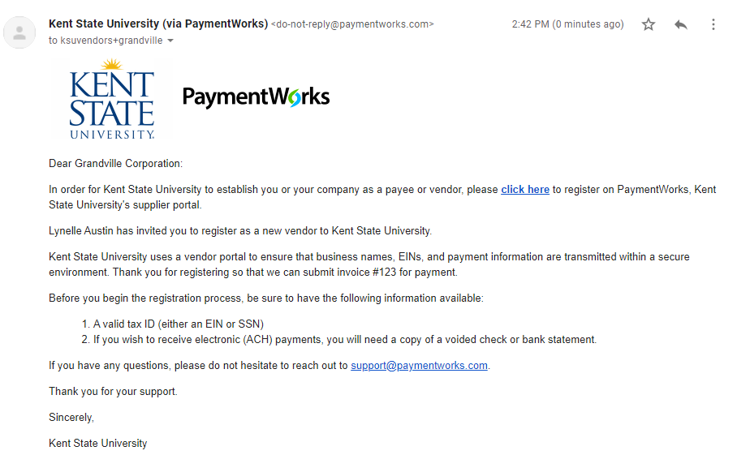
What does the invitation email that the vendor receives look like?
Your personalized message

Slide 14
How do I check the status of my invitation and my vendor’s registration?
Search for your vendor using the gray search section on the left.
As your invitation and the vendor's registration are processed, the statuses listed in the Invitation, Vendor Account, and New Vendor Registration columns will change.
Once your vendor has completed the PaymentWorks onboarding process, their vendor number will appear in the New Vendor Registration column. You can then initiate a purchase or payment request for the vendor. List the vendor number on your payment request.

Slide 15
How do I view payments in PaymentWorks?
Navigate to the Setup and Manage Portal section and click on the Invoices tab.
Search for your vendor using the gray search section on the left.
Invoices that have been keyed will appear, along with a status:
Approved – Invoice has been keyed and will be processed on the date that is in the Scheduled Pay Date column.
Paid
Invoice has been paid as of the date listed in the Actual Pay Date column.
Click on Paid invoices to view check numbers (Payment Document #.)

Slide 16
How do I view a vendor’s profile in PaymentWorks?
Navigate to Vendor Master Updates and then click on the Vendor Profiles tab.
Search for your vendor using the box in the upper right.
The vendor profile that appears will have two tabs:
Company Info – Name, address, tax classification, etc.
Paid – KSU-specific questions such as whether the vendor accepts credit cards and whether it charges a fee for credit card payments.

Slide 17
Thank You!
Contact us with your questions
Emily Hermon – x28649, ehermon@kent.edu
Barb Biltz – x28644, bbiltz@kent.edu

Slide 18
Thank You.
www.kent.edu

