Slide 2
University Budget Fundamentals
Presented by the University Budget Office

Slide 3
UBO Mission
The mission of the University Budget Office is to provide timely and accurate analysis of financial data for Kent State University. This information allows the university to maximize its management of resources and achieve strategic goals and priorities.

Slide 4
University Budget Office
The University Budget Office (UBO) is primarily responsible for the following:
Facilitating and overseeing the annual operating budget development process.
Assessing and monitoring fiscal performance.
Forecasting revenue and expenditures.
Providing analysis and ad hoc reports to meet special requests.

Slide 5
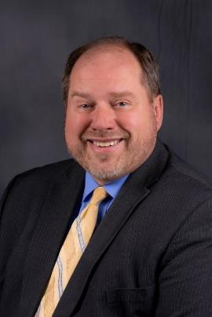
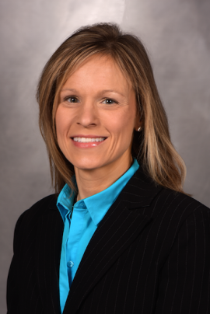
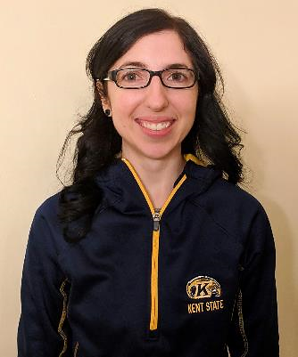
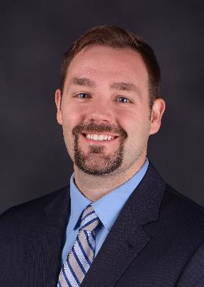
Meet the Team!
Michael Johnson
Associate Vice President
Jennifer Piatt
Executive Director
Academic Budget
Management
Kara Dolansky
Associate Director
Academic Budget
Management
Cindy Celaschi
Senior Budget Analyst
Carmen Roberts
Senior Budget Analyst
Learn more about the UBO staff at kent.edu/budget/administrative-staff

Slide 6
Areas of Responsibility
Michael Johnson
Provide leadership, vision, direction and coordination of the university budgeting process. Supervise and monitor the budget to actual financial activity throughout the year.
Jennifer Piatt
Provide oversight of personnel actions; general operations; budget preparation and management; RCM consultation; and expenditure monitoring for Academic Affairs units.
Kara Dolansky
Regional Campus Budgets; RCM budget and forecasting database; Budget Revisions; Workflow and Approval Queues.
Cindy Celaschi
Quarterly Forecasting; Performance Report; Financial Analysis Report; Budget to GAAP; SSI Calculation; RCM YE/Carryover; Financial Modeling.
Carmen Roberts
PRAs, Process Budget Revisions; Zero Based Budget Files; Spreadsheet Budgeting; Tuition Survey.

Slide 7
University Budget Overview

Slide 8
University Fiscal Cycle
July: Budget loaded and RCM true-up
October: 1st quarter reforecast
November/December: SSI reconciliation
January: High-level expense analytics and assumptions
February/March: 2nd quarter reforecast
April: 3rd quarter reforecast and discussion of budget priorities
May: Budget presented to Board of Trustees*
June: 4th quarter; Budget upload into Banner
* The FY22 Budget will be presented to BOT in September 2021

Slide 9
University Budget Structure
University Budget
Kent Campus
Educational and General
Support Divisions (12)
Academic Affairs
Finance and Administration
Diversity, Equity and Inclusion
Enrollment Management
General Counsel
Human Resources
Philanthropy and Alumni Engagement
Office of the President
Information Technology
Research and Sponsored Programs
Student Affairs
University Relations
Scholarships and Other University Accounts
RCM Centers (9)
Arts and Sciences
Architecture and Environmental Design
Aero and Engineering
Arts
Business and Administration
Communications Information
Education, Health, and Human Services
Nursing
Public Health
Auxiliaries (12)
Airport
Flash Tech Center
Flashcard
Ice Arena
Intercollegiate Athletics
Kent Student Center
Parking Services
Recreation Services
Residence Services
Transportation Services
University Dining Services
University Health Services
College of Podiatric Medicine (CPM)
Regional Campuses (7)
Ashtabula
East Liverpool
Geauga and TAC
Salem
Stark
Trumbull
Tuscarawas
Aux – Stark Conference Center
Aux – Performing Arts Center
Revised 12/10/2020

Slide 10
Operating Budget
Revenues
Enrollment
Tuition and Fees
State Share of Instruction (SSI)
Auxiliaries
Investment Income
Expenses
Salaries and Wages
Benefits
Scholarships
Operations
Other

Slide 11
Fiscal Year 2021 Budgeted Unrestricted Revenues
Total
Revenues
$595,150,639

Slide 12
Types of Funding
Unrestricted Funds: operating sources.
Educational & General; Auxiliary Enterprises
Restricted Funds: grants from external sources for operations.
Educational & General; Auxiliary Enterprises
Loan Funds: operate on a revolving basis to provide loans to students.
Endowment Funds: funds received with specific donor or grantor-imposed restrictions.
Plant Funds: capital expenses including debt service.

Slide 13
Kent State University Historical State Share of Instruction (SSI)
Highlights
As a result of degree and course completion performance, coupled with recent increases in state appropriations, SSI has steadily increased over the past eight fiscal years, from 17% to 23% of operating revenue.
Note: Revenues includes all campuses, auxiliaries, unrestricted and restricted funds. Sources of revenues include tuition and fees, state appropriations, investment gains and losses, sales and services, grants and contracts.

Slide 14
Fiscal Year 2021 Budgeted Unrestricted Expenditures

Slide 15
Budget Structure and Campus Units

Slide 16
Responsibility Center Management
On July 1, 2009, Kent State changed its budget allocation process to a Responsibility Center Management (RCM) model.
RCM is a decentralized approach to budgeting which transfers revenues to areas experiencing growth and encourages entrepreneurial activities, e.g., new programs and services.
This budget model enables the university to build on its success by making it easier to invest in our academic programs and services.
More information can be found on the UBO website at kent.edu/budget/responsibility-center-management

Slide 17
RCM Expenses By College

Slide 18
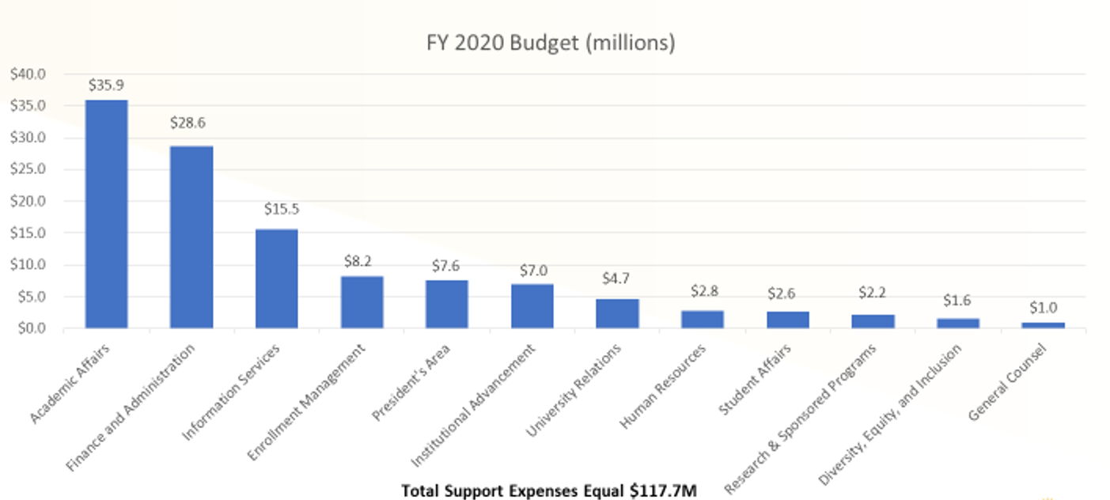
Expenses By Division (excluding Central Admin)

Slide 19
Pop Question!

Slide 20
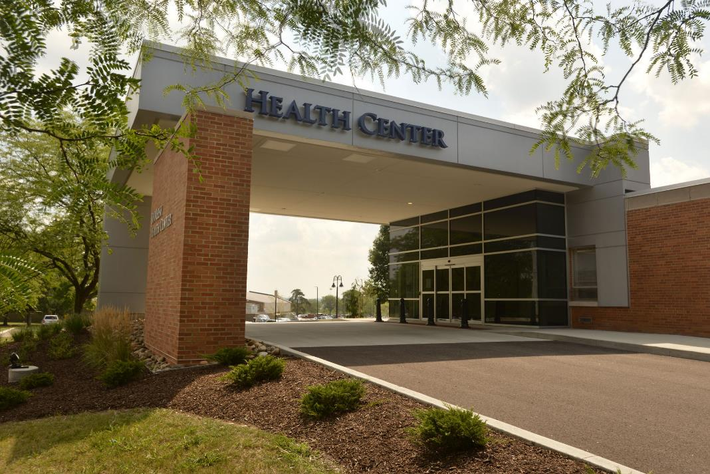
Pop Question!

Slide 21
Expenses By Auxiliary (Before Transfers)
Total Auxiliary Expenses (Before Transfers) $80M

Slide 22
Pop Question!

Slide 23
Pop Question!

Slide 24
Revenues By Regional Campus

Slide 25
Where do I fit in and how do I contribute?

Slide 26
Your Role in the Broader Kent State Financial Picture
Review your unit's financial data and keep it up-to-date.
Cognos reports available on the 5th working day of the month.
Perform annual position clean-up.
Notify UBO of vacant/unused positions for deactivation.
Review unit budgets and adjust based on priorities, funding and spending.
Submit changes to UBO via budget revisions.
Forecast for your area.

Slide 27
Services Provided by the UBO
Provide financial data and reports to the university.
Provide insight on budget functions and university financial policy.
Financial Modeling.
Facilitate agreements within the university system or agreements with outside entities.
Provide financial training.

Slide 28
Budget Listservs and Financial Trainings
Contact the University Budget Office to be added to the appropriate budget listserv.
Email UBO at university_budget@kent.edu
Banner Finance Training Guides
www.kent.edu/controller/banner-finance-training-guides
University Budget Office Trainings
www.kent.edu/budget/financial-training

Slide 29
Contact Us
Website: www.kent.edu/budget
Office Location: Suite 224, Schwartz Center on the Kent campus.
Email: university_budget@kent.edu
Phone: 330-672-3750

Slide 30
Thank You.
www.kent.edu

