Slide 1
Efficient and Effective Management and
Analytics Over Spatial-Social Networks
Halie Eckert (heckert1@kent.edu), Andrew Hughes (ahughe34@kent.edu), and Lorenzo Bair (gbair2@kent.edu)
Advisor: Dr. Xiang Lian
Department of Computer Science
Kent State University

Slide 2
Background and Our Goal
Location-based social networks have gained popularity
Physical location as well as other relationships between users
Closeness on road networks.
Our goal is to take these spatial-social networks and create a system to analyze/visualize them

Slide 3
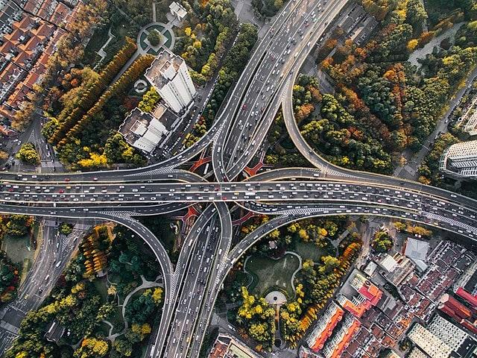
The Importance
The capabilities of social networks are inhibited when user geography and relationships’ aren’t considered
Study user behavior, targeted advertising, friend recommendations, machine learning, AI, etc.

Slide 4
Building the System
Python 3.8 - versatile and fast
Main Libraries: Tkinter, NumPy, MatPlotLib, Scikit-learn
User Keywords
Plot shared keywords
Physical Relationships
Users Logins
Coordinates
Plot relationships
Interactive GUI to visualize datasets
Road Network Edges
Users plotted on map
Summary map

Slide 5
Data Model
Road network dataset: 2 .npy files
Nodes - ID, Latitude, Longitude
Edges - Start Node ID, End ID Node ID
Social network datasets: 3 .json files
User Login Location - ID, Latitude, Longitude
Relationships - Start User ID, End User ID, Relationship Weight
Keywords - Keyword, List of User IDs Associated
Real road network and social networks
Synthetic generated keywords. Between 0 and 10 random keywords assigned to users
Example of the location file

Slide 6
Challenges
Methods
Due to size, loading and displaying may be slow
Too many user location points to accurately display
Looping over datasets takes too long
Uses Multithreading to perform tasks asynchronously
Display times were recorded to track performance
Features a summary graph displaying supernodes
Makes use of alternative methods of modifying data
Allows for basic user customization to display data more effectively

Slide 7
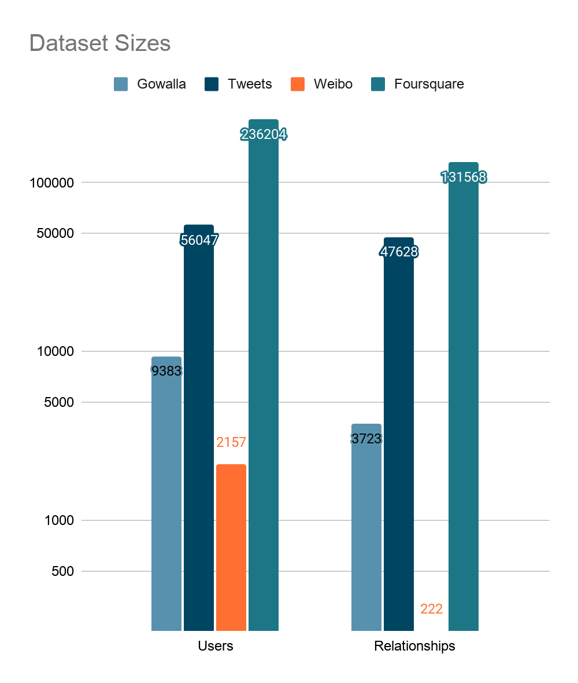
Statistics
Gowalla
9,383 Users
3,723 Relations
Foursquare
236,204 Users
131,568 Relations
Weibo
2,157 Users
222 Relations
California
21,048 Nodes
21,693 Edges
Tweets
56,047 Users
47,628 Relations

Slide 8
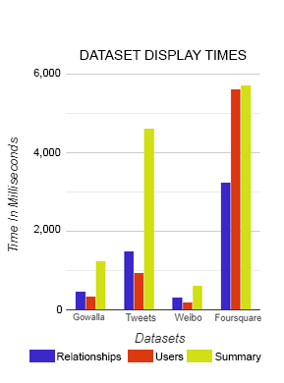
Results
Four social networks available:
Gowalla, Tweets, Weibo, and Foursquare.
The California road network is used
Program initialization takes ~2,128 ms
Loading times increase as dataset sizes increases
System works for larger datasets,
but due to language/library limitations,
will be slower.

Slide 9
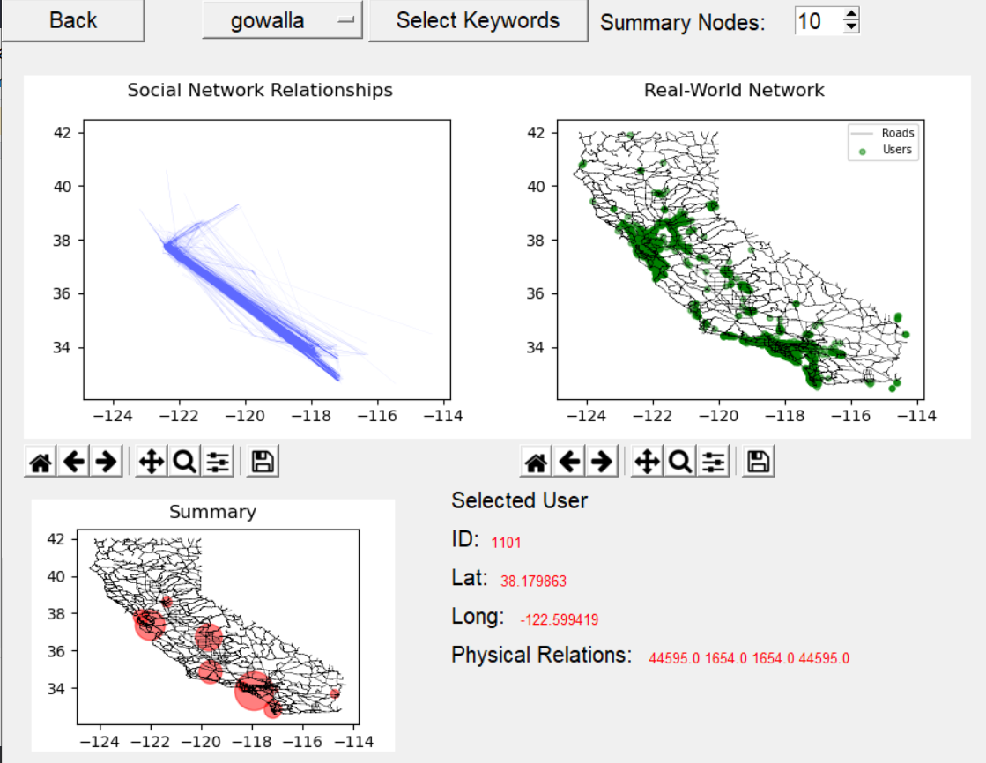
Conclusion and Reflections
Notes:
System successfully displays the necessary info overlaid on California
The system should allow for smaller and larger datasets
A more detailed GUI would have made the system more user friendly
Removing duplicate data and reformatting the datasets may have made task faster

Slide 10
Acknowledgement
Thank you to Kent State University and the Choose Ohio First program for the funding and opportunities that it provides to students such as ourselves to be able to explore research work such as this.

Slide 11
References
Li, Guoliang et al., “Efficient Location-Aware Influence Maximization”. In ACM SIGMOD, 2014. http://dbgroup.cs.tsinghua.edu.cn/ligl/laim/.
Li, Feifei et al., "On Trip Planning Queries in Spatial Databases". In SSTD, 2005. www.cs.utah.edu/~lifeifei/SpatialDataset.htm.

