Slide 1
How to Control a Robot
Presenter: Danny McCrea
Advisor: Dr. Jong-Hoon Kim

Slide 2
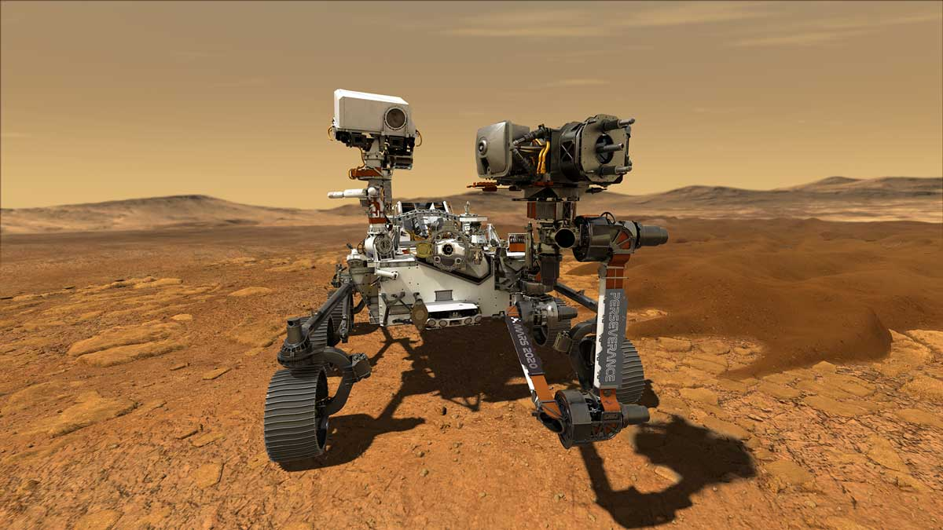
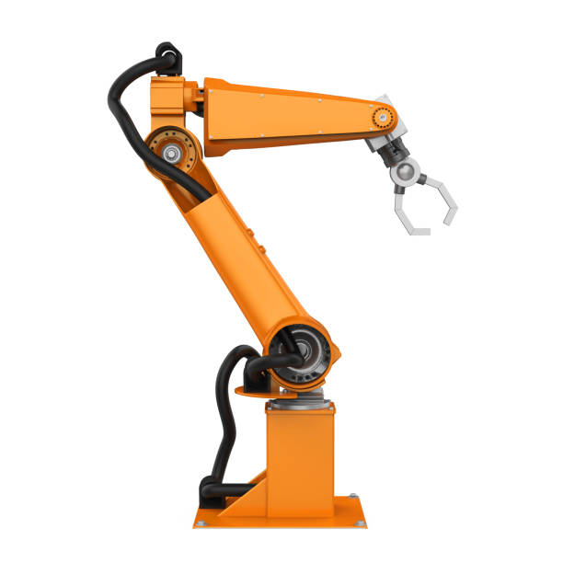
What is a Robot?
Human Being
Perseverance Rover
Robot Vacuums
Surgery
Pharmacy
Manufacturing

Slide 3
What Defines a robot?
Inputs-Start/Stop
Outputs
Communication
Software
Automated Operation

Slide 4
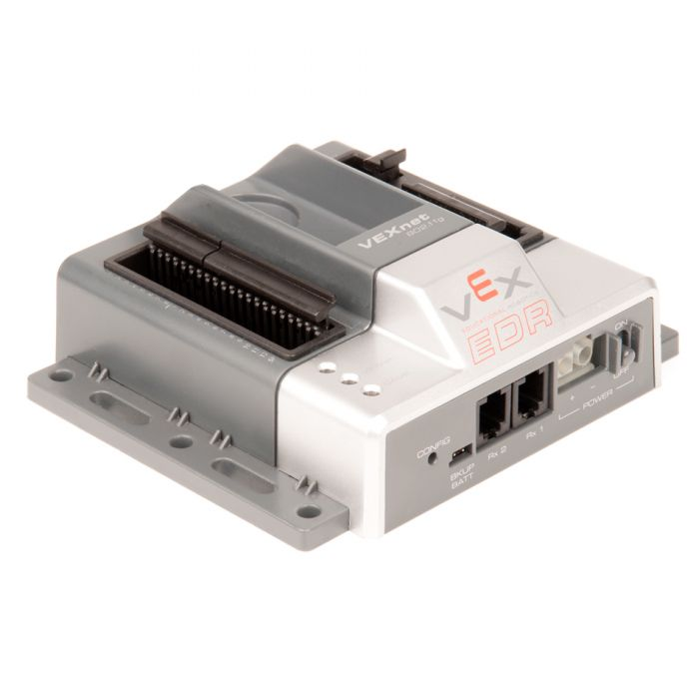
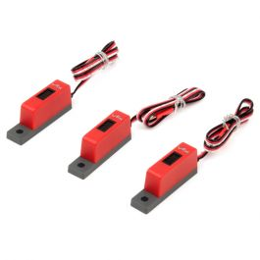
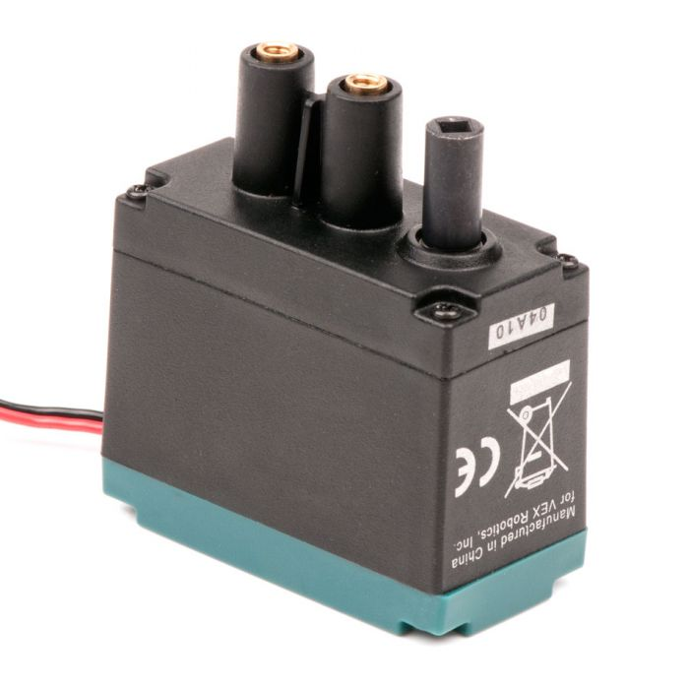
Robot Equipment

Slide 5
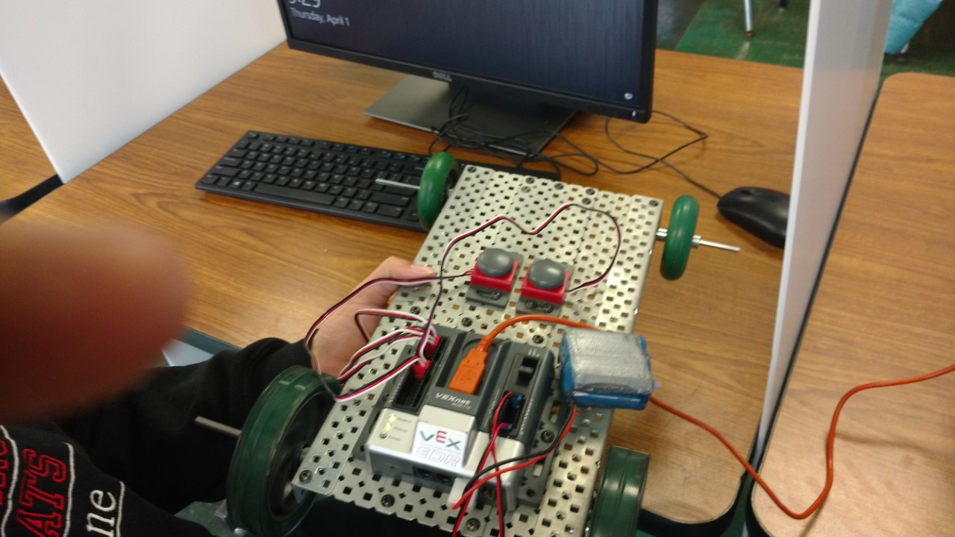
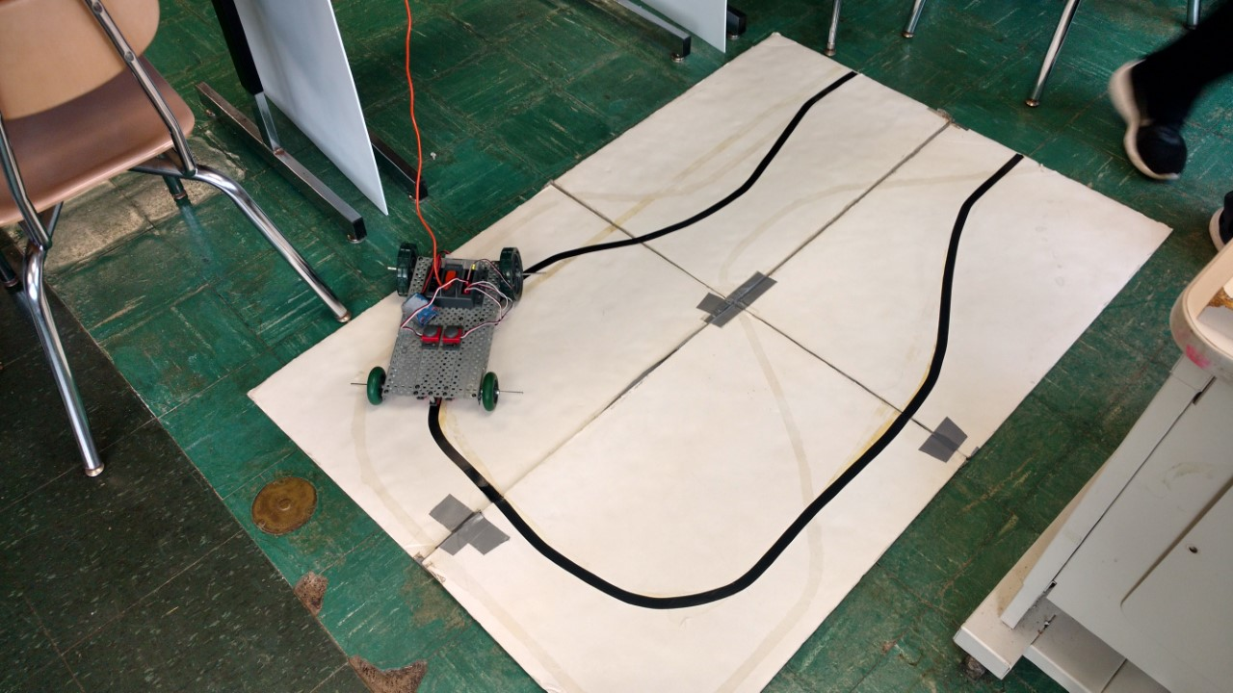
Robot Equipment

Slide 6
Inputs/Outputs
Vex Micro-Controller
Programmable Controller Logic
Digital or Analog
Line Followers(3)
Capacitive, Inductive, or Camera
0-10v equates to 0-32767 in a 16bit processor
Calibrate/Scaling
Example: 0-120 mph
120/32767= resolution
Resolution data

Slide 7
Software
Cortex
C++
Transmit information-Communication
Devicenet, Controlnet, or EthernetIP
HMI
Output devices-Motors and servos
Feedback devices-resolvers and encoders
Calibration Mode
Safety Monitoring-receiving information from a sensor

Slide 8
Questions?

