Slide 1
EULER CIRCUITS & THE KONIGSBERG BRIDGE PROBLEM
ADVISED BY DR. FEODOR DRAGAN
PRESENTED BY GINO CHIUDIONI & EDDIE LAMPERT

Slide 2
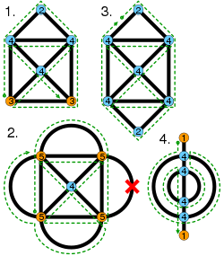
AS EASY AS DRAWING LINES
Elementary concept
Drawing shapes without lifting pencil
Drawing shapes without retracing
1
4
1
2
3
2
3

Slide 3
VERTICES AND EDGES
A vertex is a connection of one or more edges
Two edges crossing doesn’t equal a vertex
Referred to as multi-graphs
The foundations of Euler Paths and Circuits

Slide 4
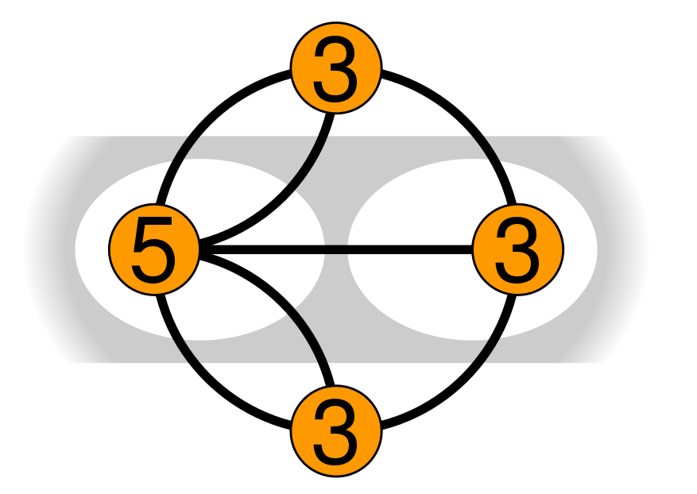
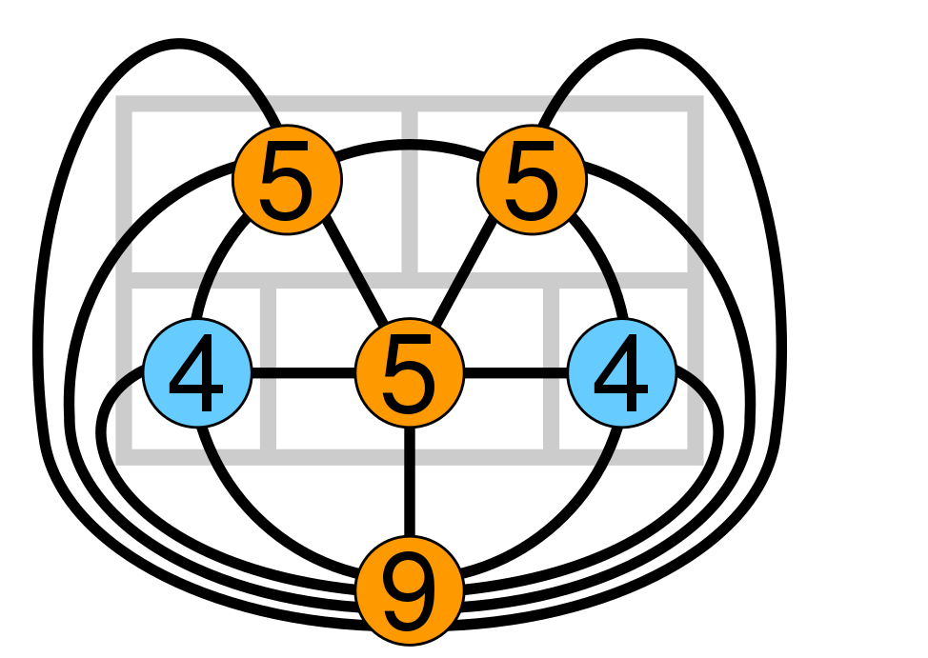
MULTI-GRAPH EXAMPLES

Slide 5
EULERIAN OR NOT?
EULER PATH
EULER CIRCUIT
Visits every edge once
Exactly two vertices with odd degree
Ends at different vertices
Endpoints must be odd
Visits every edge once
Begins and ends at same vertex
Every vertex must have an even degree

Slide 6
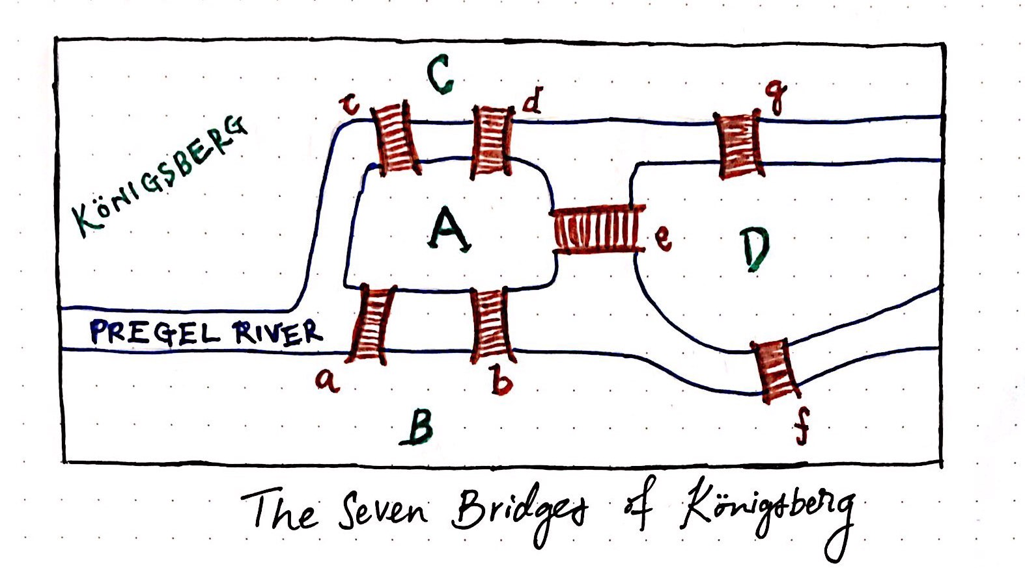

Slide 7
MORE ABOUT THE BRIDGE PROBLEM
The Konigsberg Bridge Problem is where the Euler circuit and path originated from.
There were 4 pieces of land (which would end up being vertices) and five bridges or edges.
“Solved” by Leonhard Euler.
Asked if it was possible to move through every bridge while only crossing each bridge once.
Since every vertex had an odd number of edges, it was impossible to cross every bridge one time.

Slide 8
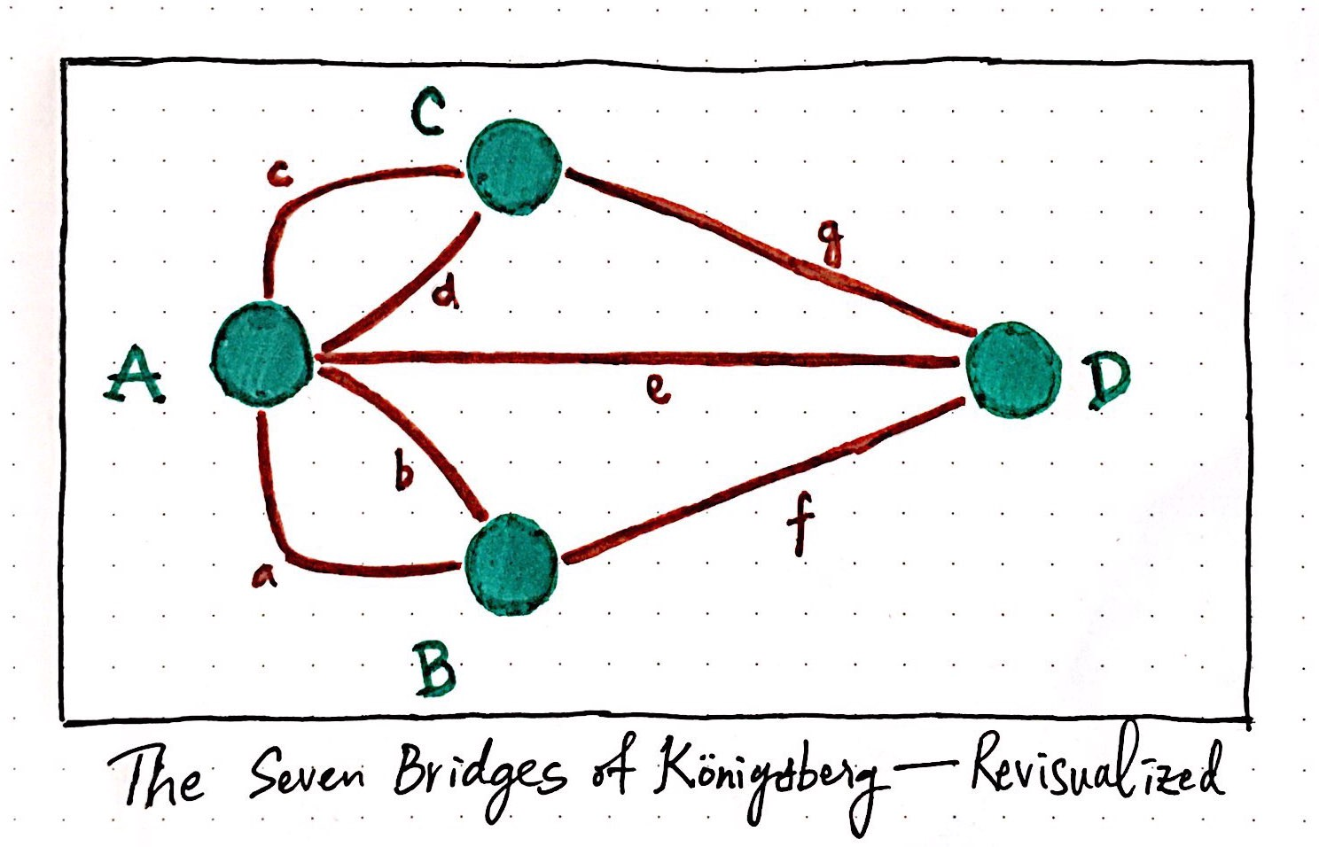

Slide 9
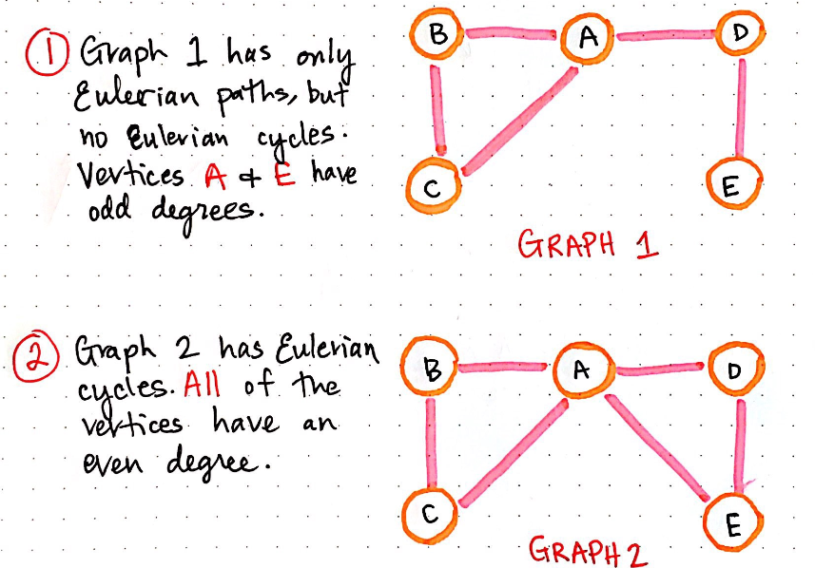
EULERIAN EXAMPLES

Slide 10
FLEURY’S ALGORITHM
Ensure the graph has either 0 or 2 odd vertices.
If 0, start anywhere. If 2, must start at one of them.
Follow edges one at a time, if choosing between a bridge and a non-bridge, always choose the non-bridge.
Stop when you run out of edges.

Slide 11
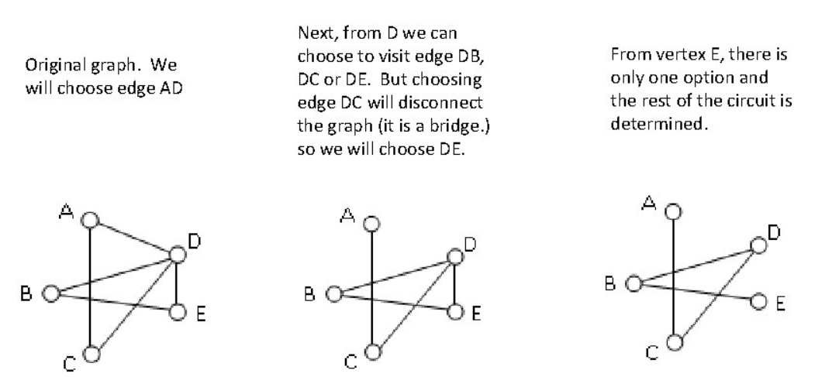
USING FLEURY’S ALGORITHM TO FIND A CIRCUIT

Slide 12
BIG CONCEPT
Due to the conditions of Euler Paths and Circuits, the famous Konigsberg Bridge puzzle is impossible.

