Slide 1
Smart Trash Can Educational Robot
Presentors: Parker Higgins, Nick Weber and Stefan Hendricks
Advisors: Dr. Jong-Hoon Kim and Saifuddin Mahmud

Slide 2
Motivation
Educational robotics have been reported in the past in several research articles, but most of them are for STEM-related education.
However, the educational robot that will be presented can be used for green education, especially in Early Childhood Education.
The Smart Trash Can will use visual recognition to identify recyclable objects.
A visual Block based programming tool will be developed to control its movements.

Slide 3
Introduction
Purpose of the Smart Trash Can (STC): To teach recycling to young school children
Additional Purpose: The Visual Programming tool is a simplified version of a programming interface for educators to use.
The STC is a child friendly “dinosaur” theme to increase positive interaction with students.
STC performs positive gestures when presented with recyclable object.
STC is made of inexpensive materials, so that it may be used as a learning tool in educational institutions
Preliminary Dinosaur STC sketch
Notes:
Last bullet - mainly targeted towards the educators who may not have the funds to afford an expensive robot

Slide 4
Initial Goals
Create physical/visual design
Implement movement mechanics
Implement open/close mechanics
Object Detection (sonar, QR code, etc.)
Visual Programming Interface (Block Code)

Slide 5
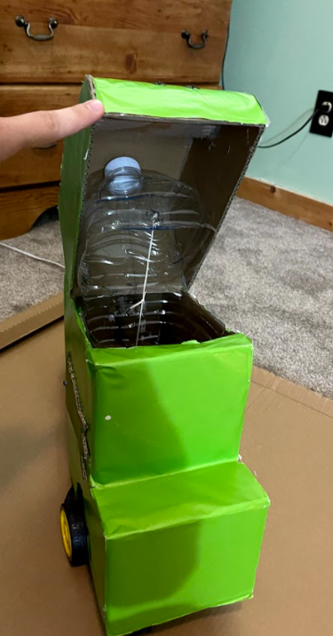
Ideal Interaction
Student approaches STC and presents object
STC detects object
STC accepts recyclable object
STC rejects Trash
STC performs corresponding gesture
STC moves on to next student
STC with head open revealing recycle bin

Slide 6
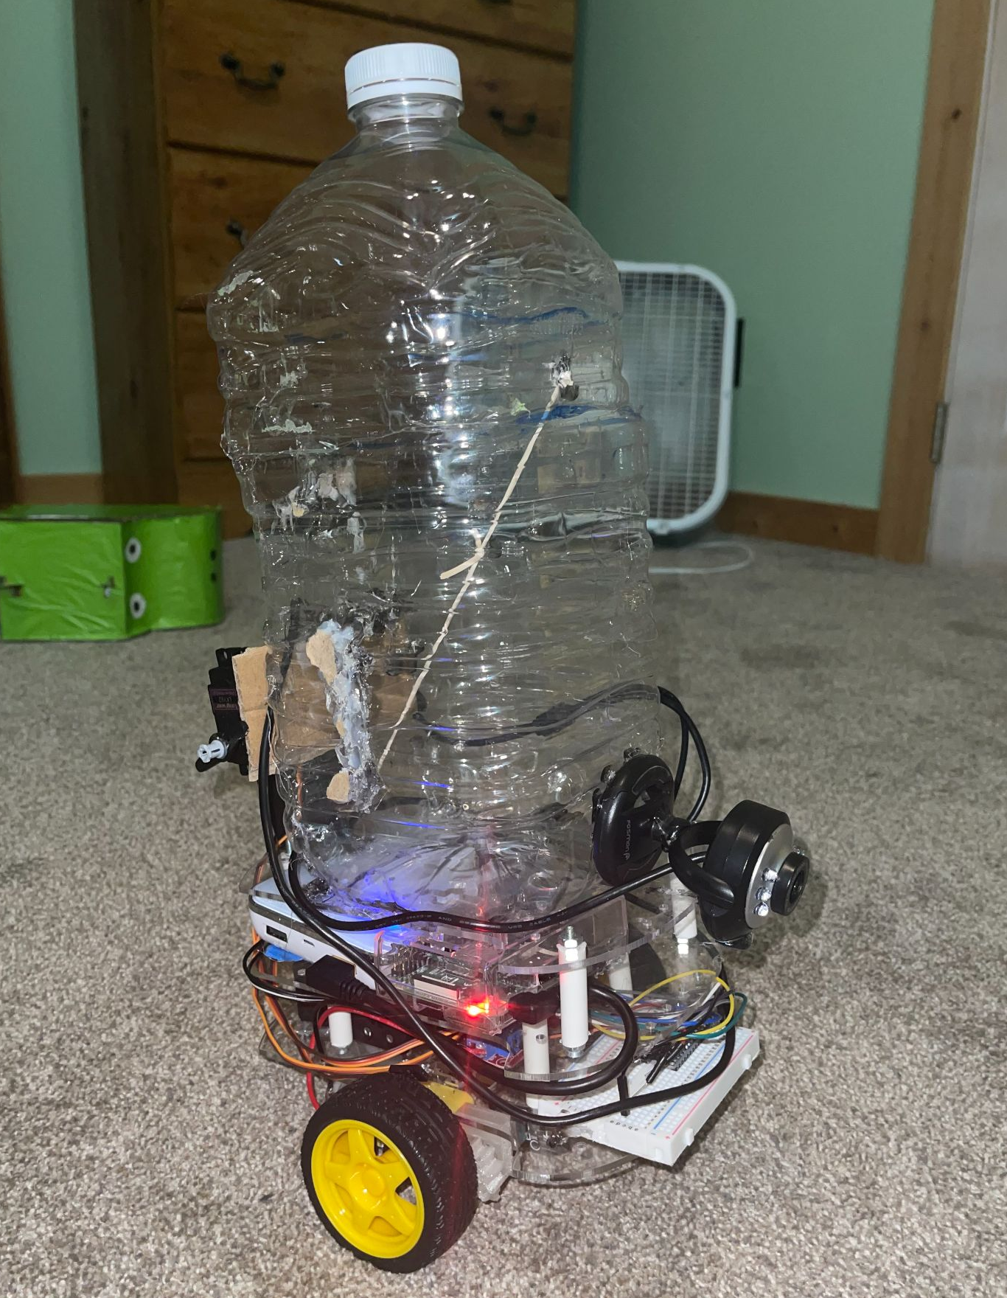
Implementation (physical design)
Smaller prototype to test mobility/mechanics.
1 gal plastic water bottle as the trash can temporarily.
Arduino controls servo motors for the arms, open and close mechanic, and to move the trash can using two DC motors to control the wheels.
Powered by 8 AA batteries.
Raspberry pi will be used in order to work with the object detection system that is taking input from the camera on the front.

Slide 7
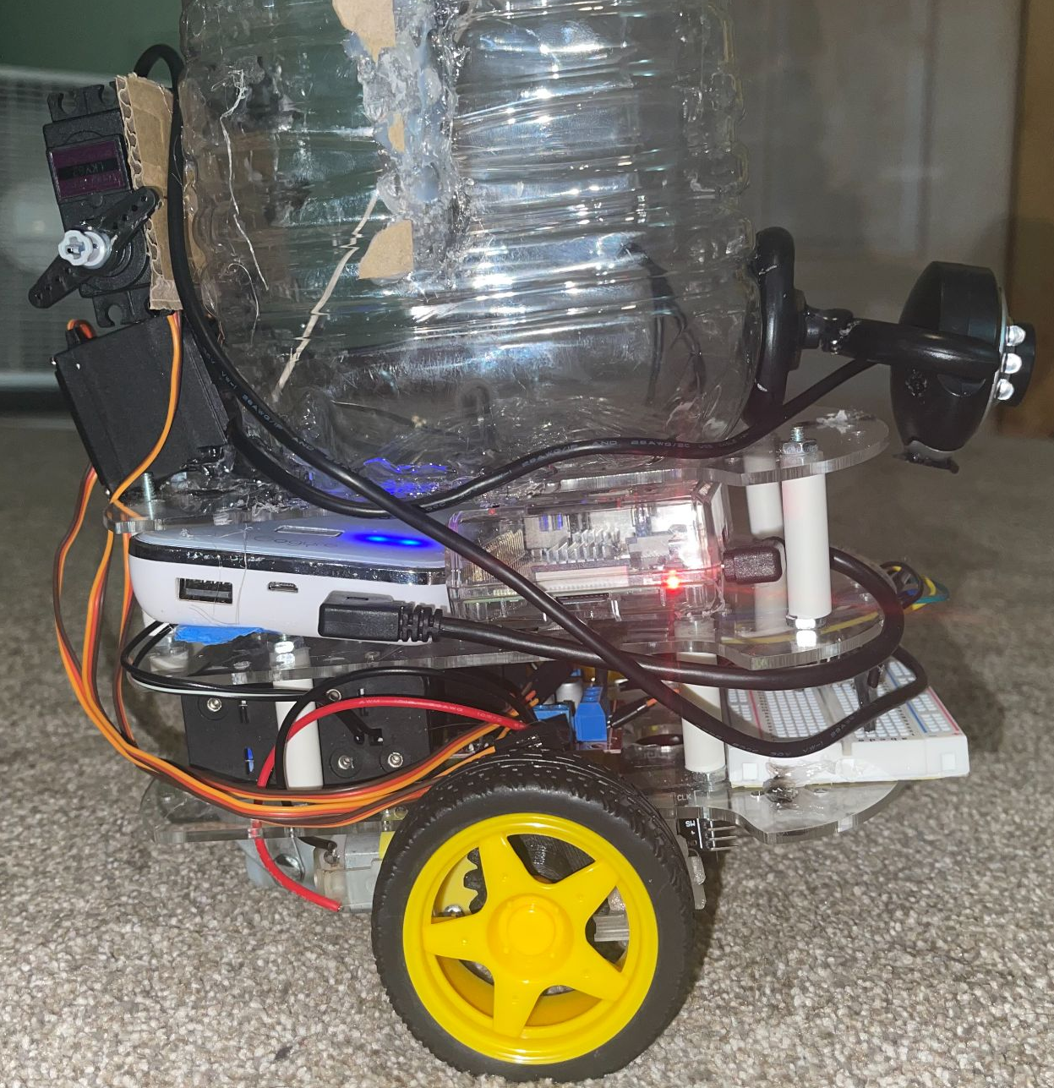
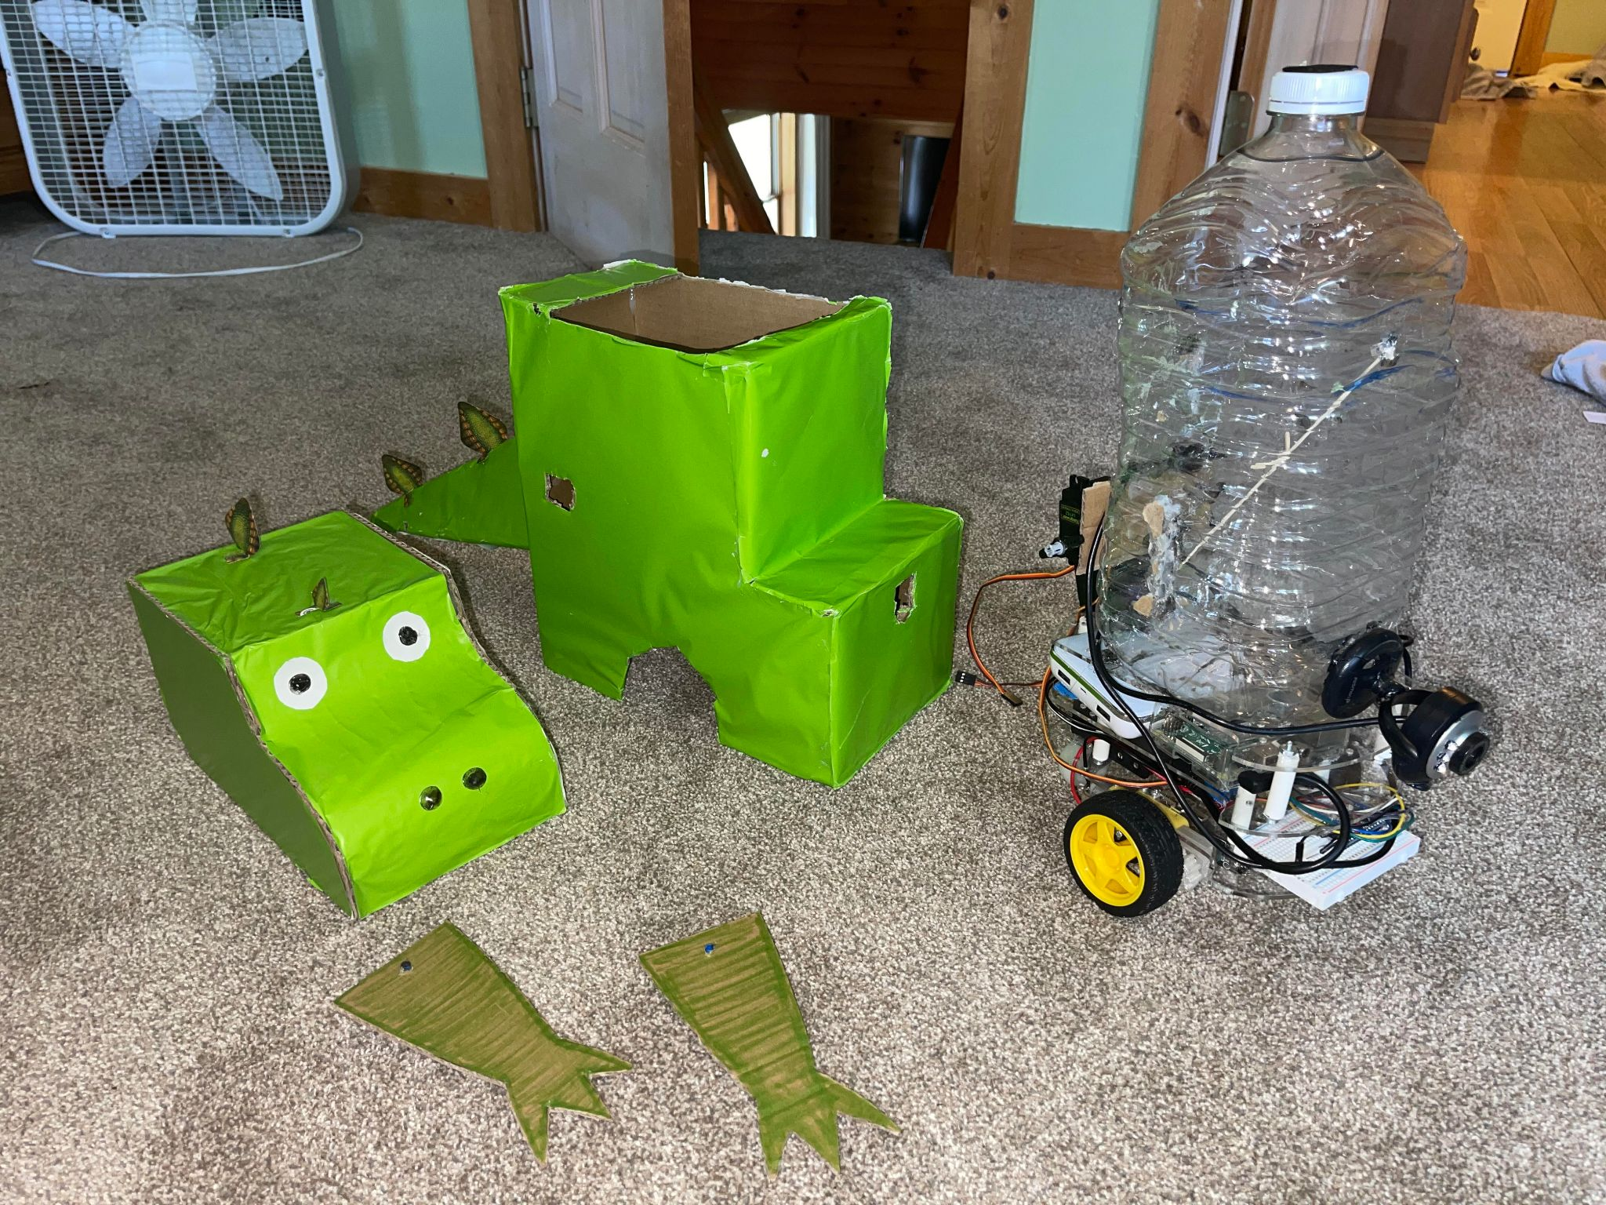
Implementation (physical design) cont.
We then took these parts and secured them onto a 3 tier structure.
After the parts were completed, We started to create the cosmetics.
We created a cardboard exterior that is easily removable to be able to access the components.
We cut the cardboard to shape and then colored it green and added scales.
The head and arms are removable as well.

Slide 8
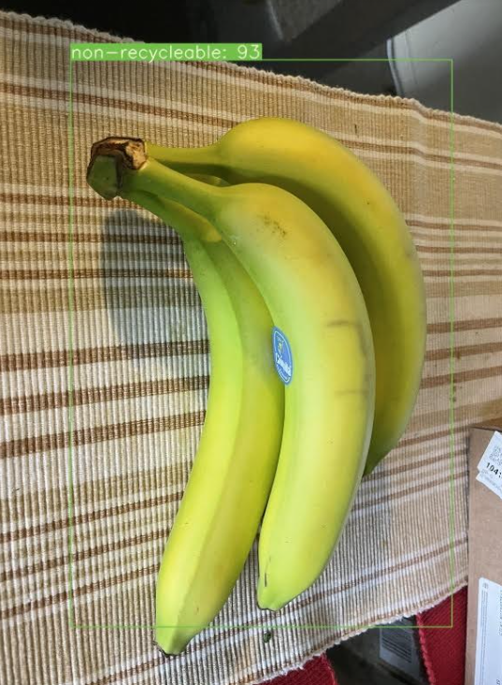
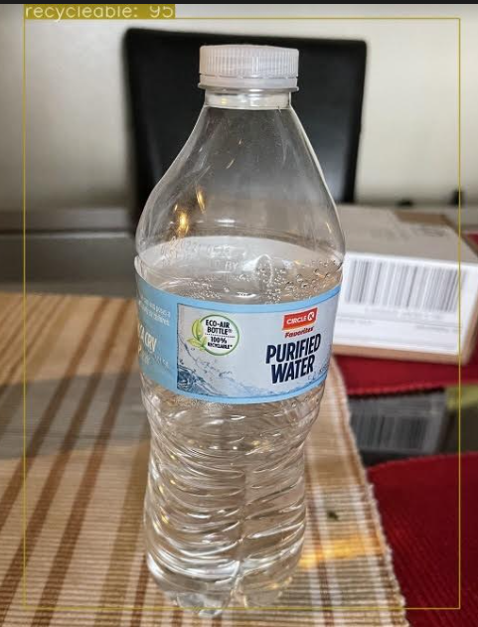
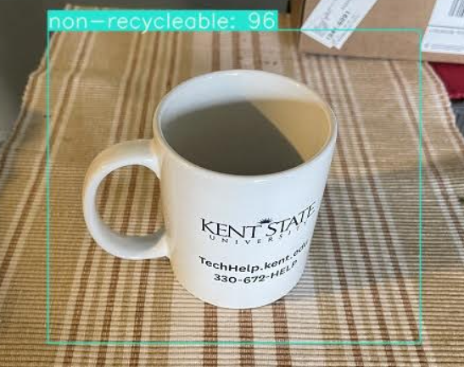
Object Detection
Technology made available to us via the Kent State Advanced Telerobotics Research Laboratory.
Object Detection method determines if particular item is recyclable via the shape, .

Slide 9
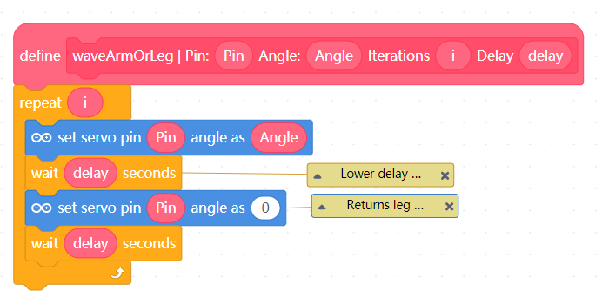
Implementation (Visual Programming Interface)
mBlock Programming Interface
Blocks can be ordered in interface and loaded directly into Arduino.
Blocks developed:
Wave arm
Setup Wheel
Rotate Wheel
etc.
Educators can move blocks around to control the STC’s movements.
Sample Block
mBlock Programming Interface

Slide 10
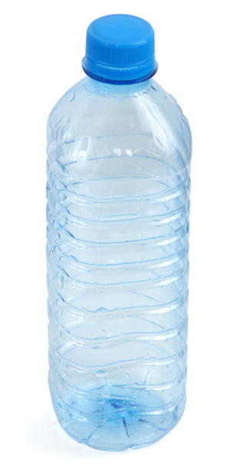
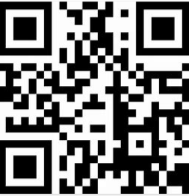
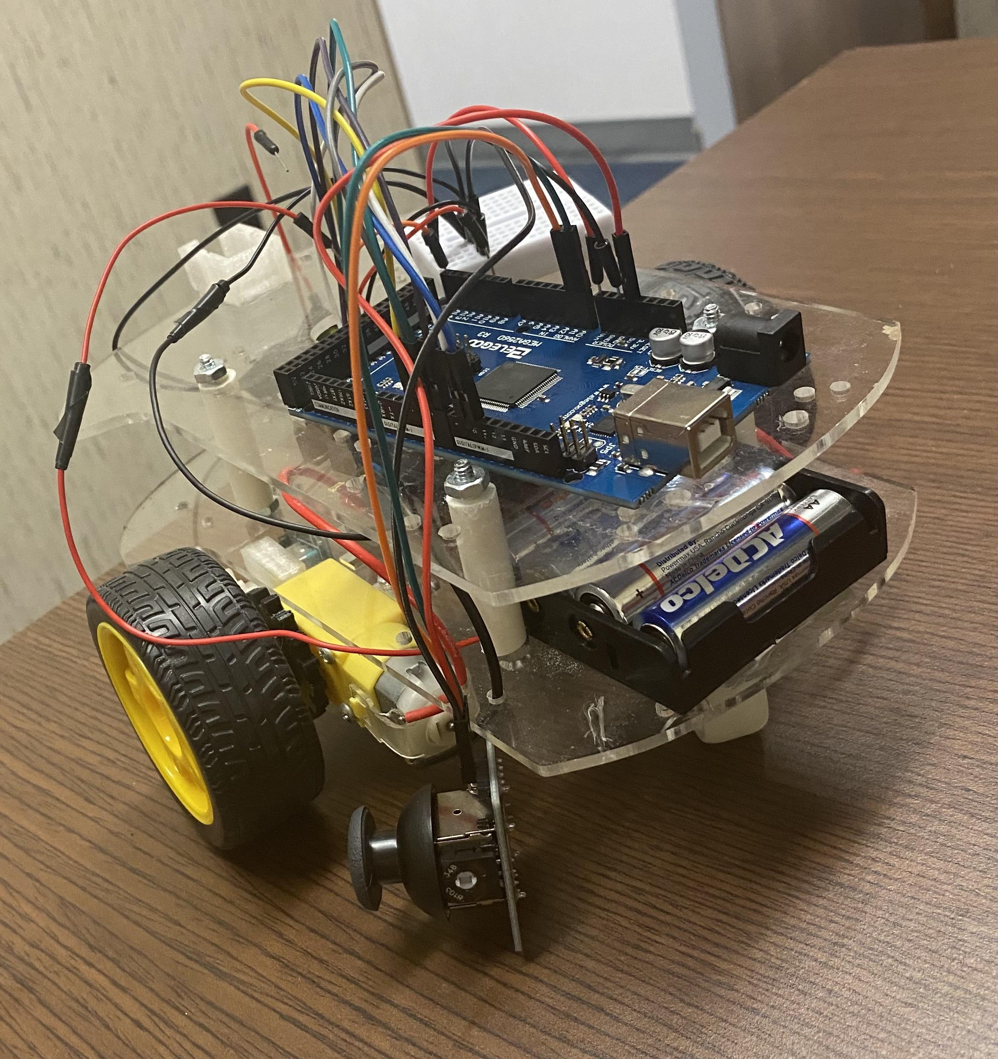
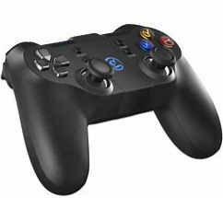
Limitations and Future plans
Creating customized software for STC Block Code
Fine Tuning blocks (how specific/broad for educators to learn)
What would be the best way to teach programming with blocks?
Wireless semi-autonomous control of STC
Improve Object Detection methods
Sonar, QR codes, etc.
Joystick Control

Slide 11
Conclusion
The first prototype of the Educational Smart Trash Can Robot is complete.
The basic structure and mechanics of the Smart Trash Can have been implemented.
The conceptualization of the Block Based Visual Programming Interface is in a basic functional stage.
The current structure of the STC is inexpensive which makes it applicable as a potential educational tool.

Slide 12
Thank You for Listening!
Feel free to ask questions if you have any!

