Slide 1
Choose Ohio First Annual Conference
April 25th,2021

Slide 2
VR in the Courtroom
Presenters: Makayla Henninge, Moses Michael, Lane Simpson, Patricia Williams, Samantha Zehner
Advisors: Angela Guercio, Bathi Kasturiarachi, Younghun Chae

Slide 3
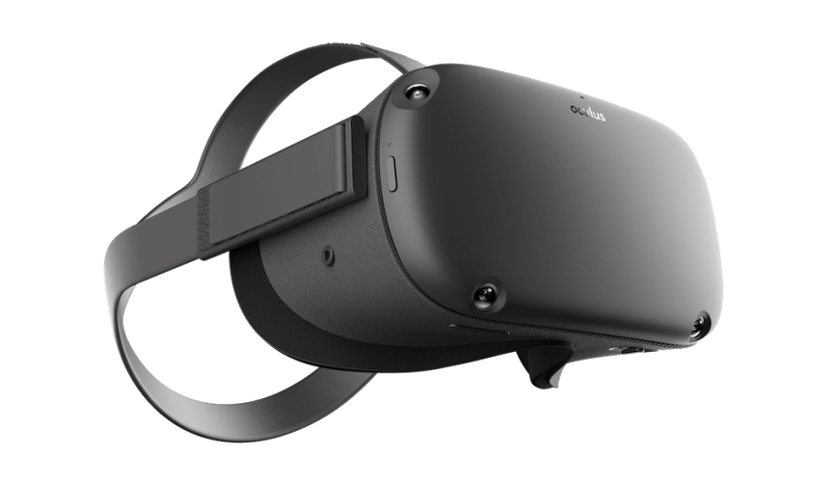
Virtual Reality
Virtual Reality is a simulated experience, allowing a user to interact inside of a 3D environment.
Virtual Reality technology first saw mainstream release in 2016
VR most often sees use in entertainment

Slide 4
Use of VR in 2021
While a large part of the market is in developing virtual reality video game experiences, VR technology has been seeing use in real-life applications, such as basic simulations in
surgery
combat training
flight simulations
dangerous event reconstructions, etc.
In this presentation we discuss the feasibility of the application of VR in the courtroom, and what possibility it offers to the legal world.

Slide 5
Technology in the Courtroom
Past 5 years there has been a 484% increase in using technology
Trial exhibits and demonstrates evidence by using paper photographs
Programs specifically designed for trial
Trial Director and Sanction
Computer-generated graphics allow a more interactive trial, taking it a step forward
Using three-dimensional holographic images

Slide 6
Technology in the Criminal Field
Detection, Monitoring and Positioning systems
Drones
Global Positioning Systems (GPS)
Gunshot Technology
DNA and Fingerprints
Clear view of crime scenes
Rapid Identification
Police can quickly see criminal history of individuals
Next Generation Identification (NGI)

Slide 7
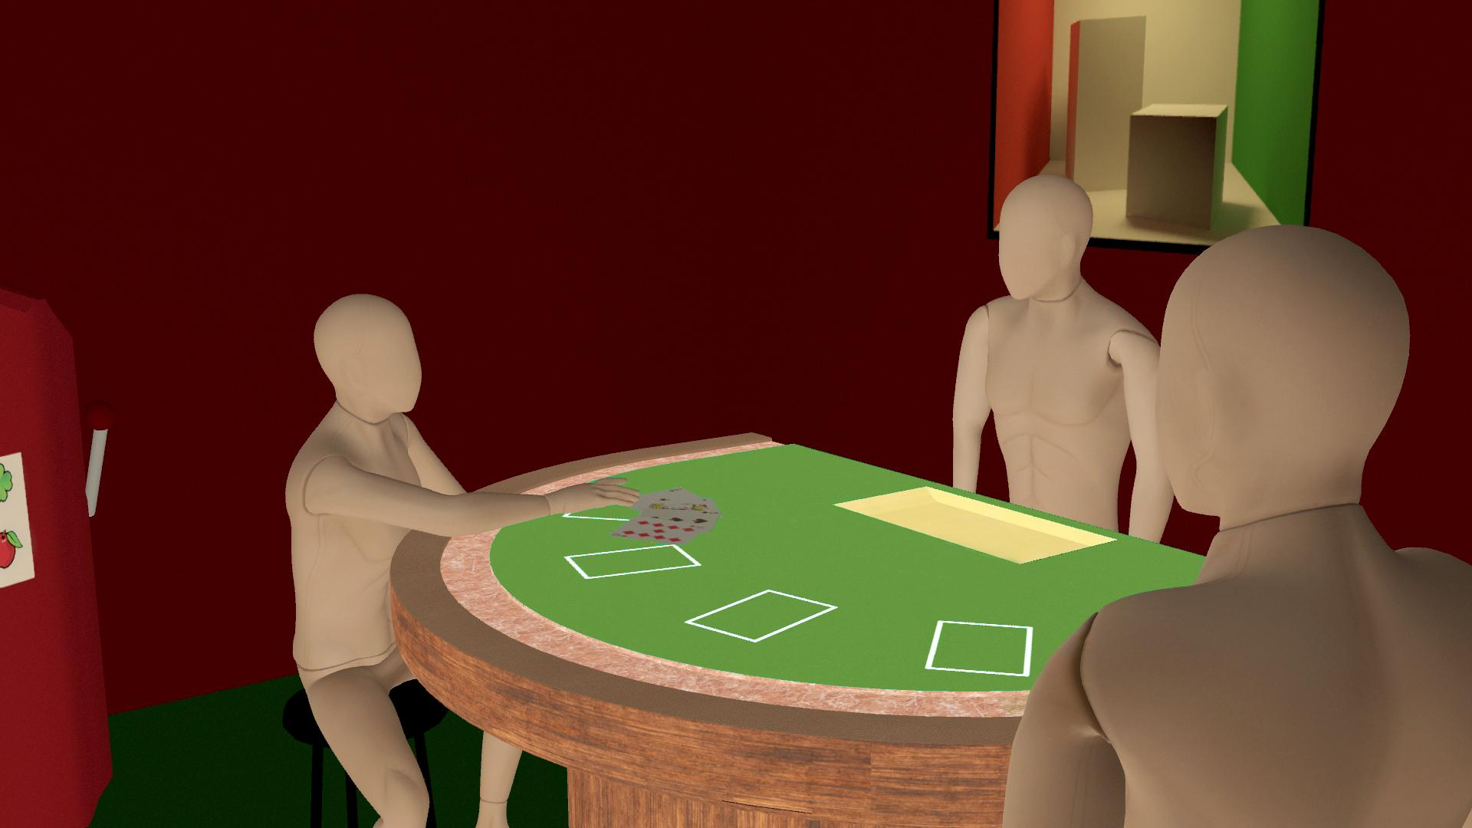
Case Scenario Example
dealer
witness
suspect

Slide 8
Use of VR in Courtroom: Pros
Current pros to using VR in the courtroom is that it could potentially provide more insight into a case, as well as help people on the jury decide a verdict.
VR in the courtroom could also show the jury the emotions and split second decisions made that they would not normally be able to see.

Slide 9
Use of VR in Courtroom: Cons
VR in the courtroom creates a extra step in the case.
Affordability and Accessibility could potentially be issues for some jury’s.

Slide 10
Affordability - Is VR Expensive?
Immersivity is how much of the physical world is replaced with the virtual world (Coburn)
Fidelity is how realistic the input and virtual environment seems
When immersivity and fidelity are on the rise in products, it calls for more expensive equipment

Slide 11
How Much Does it Cost?
The cheapest current model of VR with motion controls is the Oculus Quest 2 for $299.99
The cheapest general model of VR with no sensors or motion controls is the Google Cardboard which can run under $10
A VR headset that is wearable and has lens displays but no controls or sensors can run in a range of $25-$50

Slide 12
Accessibility for VR
Accessibility means that people who have disabilities have the same or similar opportunities or access to an event or activity as someone who does not have a disability.
Is VR accessible?
Not particularly. Most VR’s have a heavy emphasis on either headset wearing, standing/moving, and motion controls. These can all be aspects that could exclude people with disabilities.

Slide 13
Conclusion
As of now, it is affordable but not very accessible to some individuals. With that being said, without modifications or improvements there would be some issues with access. As well as potential problems with ethics and psychology.
Using VR in the courtroom is a relatively new concept and has not had a lot of exposure. With that being said, it is possible that with some research, modifications, and time this can become a tool to utilize in the courtroom or legal use.

Slide 14
Citations
Coburn, Joshua Q., et al. “A Review of the Capabilities of Current Low-Cost Virtual Reality Technology and Its Potential to Enhance the Design Process.” ASME Digital Collection, September 2017, https://asmedigitalcollection.asme.org/computingengineering/article/17/3/031013/370980/A-Review-of-the-Capabilities-of-Current-Low-Cost
Cappellino, J.D., Anjelica. “Technology in the Courtroom : An Evolving Landscape.” Expert Institute, June 2020, https://www.expertinstitute.com/resources/insights/evolving-landscape-technology-courtroom/#:~:text=While%20computer%2Dgenerated%20graphics%20help,taking%20it%20a%20step%20further.&text=Even%20witnesses%20can%20present%20themselves,the%20use%20of%20hologra
N/A. “The Growing Role of Technology in the Criminal Justice Field.” Purdue University Global, April 2018, https://www.purdueglobal.edu/blog/criminal-justice/growing-role-technology-criminal-justice/
Tikkanen, Amy “US Airways Flight 1549” Britannica, December 2016
https://www.britannica.com/topic/US-Airways-Flight-1549-incident

Slide 15
Citations
Kaufman, Bruce. “Virtual Reality Faces Daunting Courtroom Realities.” Bloomberg Law, November 2017, https://news.bloomberglaw.com/business-and-practice/virtual-reality-faces-daunting-courtroom-realities/
Ryan, AJ. “Thoughts on Accessibility Issues with VR.” The AbleGamers Charity, https://ablegamers.org/thoughts-on-accessibility-and-vr/
Vatorms. “Love Black And White.” cleanpng.com, www.cleanpng.com/png-love-julie-logo-lady-justice-lawyer-1162445/ .
Templeton, Graham. “Using VR in the Courtroom.” Extreme Tech, May 2016, https://www.extremetech.com/extreme/229168-upcoming-very-bad-idea-992-using-vr-in-the-courtroom
Vaughn, Ron. “Is Virtual Reality the Future of Courtrooms?” Oklahoma Bar Journal, May 2019, https://www.okbar.org/barjournal/may2019/obj9005vaughn/#:~:text=One%20of%20the%20obvious%20problems,the%20jury%20a%20biased%20perspective.&text=Essentially%2C%20that%20means%20if%20you,your%20perspective%20better%2C%20you%20win

