Slide 1
Internship Experiences in Computer Science

Slide 2
Contents
What is an Internship?
Knowledge and Skills
Technologies
Tools and Software's
Certifications
Communication
Questions?

Slide 3
What is an Internship?
Internships give students the opportunity to earn academic credit and gain experience in a professional environment. Internships also help learners determine whether a particular career path is a good fit for them.
Furthermore, internships assist students in developing professional connections that may lead to job opportunities. Students still receive professional training from an internship that they would not receive in a typical classroom.

Slide 4
“Interns are like not-cut diamonds; They have flaws, some of them are totally worthless, but once you cut them well, they can become something great one day.”
- Barney Buszuro

Slide 5
Types of Internships
1. Paid Internships
Professional sectors like health, architecture, science, engineering, law, business (particularly accounting and finance), technology, and advertising frequently offer paid internships. Internships for work experience typically take place in the second or third year of study.
This kind of internship aims to broaden an intern's expertise both within the organization and within their academic pursuits. The organization anticipates the intern bringing ideas and expertise from school.
2. Unpaid Internships
Unpaid internships are temporary work arrangements that allow prospective employees to observe a work environment and gain work experience without compensation.

Slide 6
Types of Internships
3. Work Research, Virtual Research (graduation) or Dissertation
This is mostly done by students who are in their final year of school. With this kind of internship, a student does research for a particular company. The company can have something that they feel they need to improve, or the student can choose a topic in the company themselves. The results of the research study will be put in a report and often will have to be presented.
4. Virtual Internship
A different kind of internship that is gaining popularity is the virtual internship, in which the intern works virtually and is not physically present at the place of employment. Without having to physically be present in an office, it offers the opportunity to obtain work experience. The internship is carried out virtually, through phone, email, and online interactions. Virtual interns frequently have the freedom to choose their own paces.

Slide 7
How to Find an Internship’s
Use Your College's Career Center (Handshake)
Leverage Your Network (Friends, Family, Professors, Connections)
Use Job Search Sites (Indeed, LinkedIn)
Reach out directly to HR via Email

Slide 8
How to Get an Internship
Apply Early and Widely
Start Early: Start looking for an internship early—even a year before the start date.
Find People Who've Done Internships: Speak with your lecturers and fellow students who have completed internships; they can guide you through the procedure.
Ask About Opportunities: Before applying, it is OK (and encouraged!) to directly inquire with organizations about any internship openings.
Review and Revise Each Application: It doesn't mean your application should be less polished just because you submit it early. Spend time editing and proofreading.
Ask for Help: Professors can assist you in creating an effective internship application that will interest particular companies.

Slide 9
How to Get an Internship
2. Strengthen Your Resume
Make It Professional: Resumes should look neat and well-organized, with a simple font face and standard font size.
Tailor the Resume to the Internship: The individuals responsible for hiring interns know if they've received a generic stock resume — make sure you include specific details that will appeal to the company you want to intern at.
Promote Yourself: Modesty has no place on a CV. Don't be afraid to highlight your most amazing achievements and endeavors.
Be Unique: Thousands of people apply for the most sought-after internships. Highlight personal qualities and endeavors that show off distinctive traits.

Slide 10
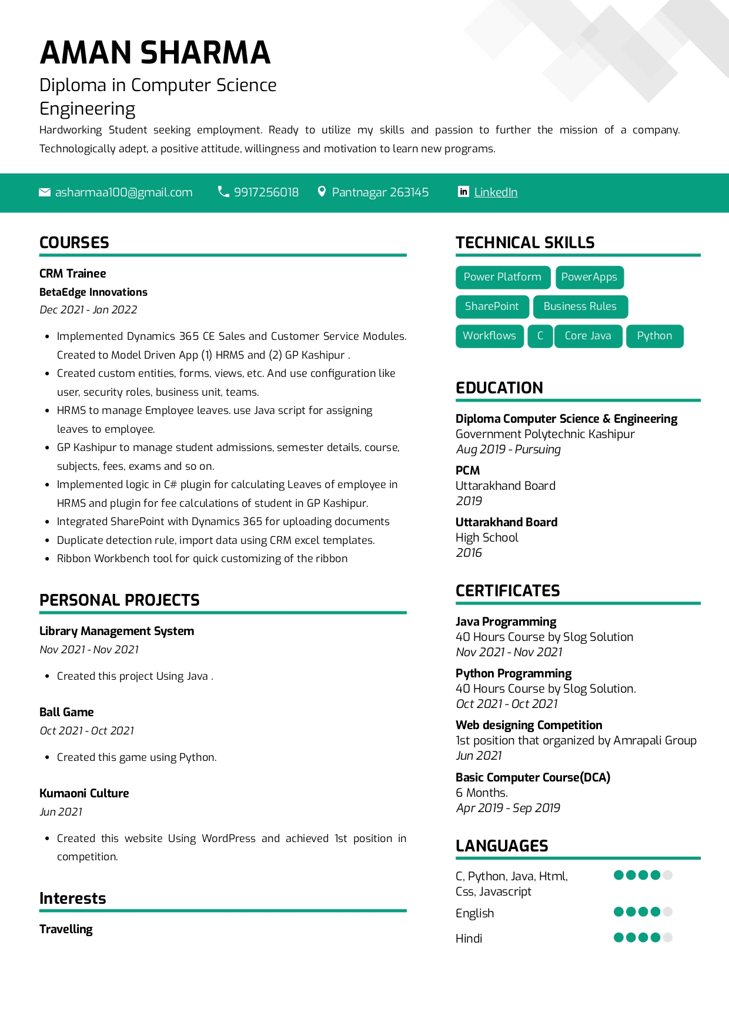

Slide 11
How to Get an Internship
3. Write a Unique Cover Letter
Make It Special: For each application, write a special cover letter. A generic cover letter leaves a bad impression.
Know Your Audience: Recognize the general aesthetic and atmosphere of a potential employer and reflect that in each cover letter you write.
Catch Their Eye: The best cover letter highlights unique attributes, skills, and experiences that separate you from other candidates.
Be Confident: Emphasize qualities and abilities while saying clearly why and how a certain opportunity benefits both sides.
Revise: Revisions are a necessary step for any cover letter. Grammatical and spelling errors can reflect poorly on you.

Slide 12
How to Get an Internship
4. Prepare for an Interview
Arrive on Time: Professional candidates who are eager for interviews rarely arrive late.
Do Your Research: Demonstrating knowledge about an organization, its history, and its services shows the level of care and dedication expected of interns.
Be Professional: Wear business-appropriate attire and communicate clearly and politely.
Ask Questions: Interviewers usually leave time at the end of an interview for questions. Prepare a few in advance so you don't come across uninterested in the role.
Rehearse: Practice is the best way to get over interview-related anxiety. Having enough preparation can increase your chances of success.

Slide 13
Types of Questions from HR
Introduce yourself/ Describe Yourself in three-four Sentence.
What is your Greatest weakness and Greatest Strength?
Tell Me About a Time When...You Overcame an Obstacle
Tell Me About a Time When...You Experienced Conflict
Do You Work Well with Others?
How Would You Define Success?
What is Your Leadership Style?
What Kind of Work Environment Do You Like?
Why should we hire you?

Slide 14
Types of Questions from Technical Engineer
Sessions/ Cookies
SQL
Data Structures
Operating Systems
Algorithms
OOPs Concepts (abstraction, encapsulation, inheritance and polymorphism)
Your Projects and the frameworks and methods you’ve used!
You have to code!!

Slide 15
Benefits of Internships
You'll Gain Industry Experience
You Can Test Out a Career Path
You'll Develop and Refine Critical Skills
You Can Expand Your Professional Network
You May Secure a Job

Slide 16
Knowledge & Skills
Programming Languages (C, C++, Java, Python, JavaScript)
SQL
Linux
API’s (Rest, SOAP)
GitHub
Cloud Technologies (AWS, Azure, GCP)
Microsoft 365 (Teams, Outlook, Excel, PowerPoint)

Slide 17
Technologies
Trending Technologies in 2023
Artificial Intelligence and Machine Learning
Data Science
Full Stack Development
Virtual Reality and Augmented Reality
Blockchain
Cyber Security

Slide 18
Tools and Software's
Everyone needs to know a few specific tools and programs in order to adapt and code more effectively.
We will look at a few of the tools and software that are used by various technologies, and which can be good to understand and utilize for a project to highlight your work on resumes.

Slide 19
Tools and Software's
Artificial Intelligence and Machine Learning
Scikit Learn
TensorFlow
PyTorch
Weka
KNIME
Apache Mahout
Keras

Slide 20
Tools and Software's
Data Science
Apache Spark
MATLAB
D3.js
BigML
Excel
Tableau
Jupyter
Matplotlib
NLTK

Slide 21
Tools and Software's
Full Stack Development
Frontend
Visual Studio Code
HTML5 Boilerplate
Chrome DevTools
Sass
TypeScript
Bootstrap
Git
jQuery
AngularJS
Backend
PHP
JavaScript
Laravel
Django
MongoDB
MySQL
Apache
NGINX
Docker
Jira

Slide 22
Tools and Software's
Virtual Reality and Augmented Reality
Vuforia
Wikitude
ARKit
ARCore
ARToolKit

Slide 23
Tools and Software's
Blockchain
Solidity
Hyperledger Fabric
Ethereum
Solc
MetaMask
Remix
Geth
Web3.js
Embark

Slide 24
Tools and Software's
Cyber Security
Kali Linux
Metasploit
Nikto
Burp Suite
Nmap
Nagios
Splunk
Wireshark

Slide 25
Software Companies
Emerging Technologies and Software’s to get an Internship:
Salesforce
HubSpot
SAP
IBM-RPA
Oracle
AWS

Slide 26
Certifications
Why to Earn a Certificate?
Self-Esteem Boost
Increase Knowledge and Understanding
Career Advancement
Employer Confidence
Proven Professional Achievement
Certifications will help you in one way or other!!

Slide 27
Certifications

Slide 28
Certifications

Slide 29
Certifications

Slide 30
Certifications

Slide 31
Communication
Talk face to face whenever possible
Be very specific
Ask questions
Check in frequently
Make it personal
Ask for Feedback

Slide 32
Thank You

Slide 33
Questions?

Slide 34
References
https://www.bestcolleges.com/resources/ultimate-guide-internships/

