Slide 1
Ohio Longitudinal Transition Study (OLTS) 2016-2017
Spring 2018

Slide 2

Anticipated Outcomes
Identify the State Performance Plan Indicators related to secondary transition.
Understand the process for completing the OLTS survey forms.
Use OLTS data and evidence-based predictors to identify in-school factors to promote post-school success.
Notes:
Make a shortcut on your desktop

Slide 3
SST Update
Notes:

Slide 4

State Performance Plan (SPP) and Annual Performance Report (APR)

Slide 5
State Performance Plan (SPP) Indicators
1
Youth with IEPs graduating from high school with a regular diploma
2
  Youth with IEPs dropping out of high school
  Youth aged 16 and above with IEPs that contain each of the required components for secondary transition
13

Slide 6
State Performance Plan (SPP) Indicators
  Youth who are no longer in secondary school, had IEPs in effect at the time they left school, and were:
  Enrolled in higher education within one year of leaving high school.
  Enrolled in higher education or competitively employed within one year of leaving high school.
  Enrolled in higher education or in some other postsecondary education or training program; or competitively employed or in some other employment within one year of leaving high school.
14

Slide 7
Ohio Longitudinal Transition Study (OLTS)

Slide 8
The IDEA of 2004
Post-school Outcomes
Each local education agency (LEA) is required to collect outcome data for students with disabilities as they exit high school.
These data are collected at least once every six years. (LEAs >50,000 collect annually).
Schools can use the data to identify factors that promote post-school success and address these in school improvement efforts.

Slide 9
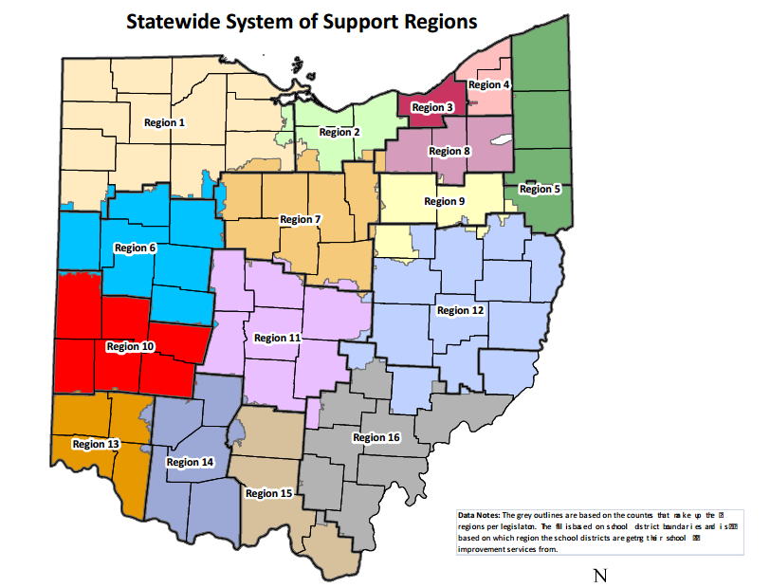


OLTS Partners
Notes:
OEC divided Ohio’s school districts into 5 cohorts to conduct exits and follow-ups on their graduates with IEPs during years from 2006-2014.
The regional State Support Teams provide technical assistance and training for the implementation of the Ohio Longitudinal Transition Study (OLTS).
Kent State University provides the survey training; statistical analysis and management of the data; and state, regional and local reporting.
Ohio Longitudinal Transition Study website:

Slide 10
OLTS Process
Exit Survey
Fill out OLTS self-review form (for your organizational purposes only)
Survey all graduates and students aging out
Read questions out loud and paraphrase as necessary
Enter data at www.olts.org by June 30, 2018
Follow-Up Survey
Call students to collect follow-up information – try to contact at least 4 times
Enter data at www.olts.org by August 30, 2019

Slide 11
Ohio Longitudinal Transition Study (OLTS) Data

Slide 12
OLTS Data
SPP/APR Data – Engagement Rates (2016 Graduates)
Percent of youth who are no longer in secondary school, had IEPs in effect at the time they left school, and were: | Number | Percent
A. Enrolled in higher education within one year of leaving high school. | 280 | 28.8%
B. Enrolled in higher education or competitively employed within one year of leaving high school. | 656 | 67.5%
C. Enrolled in higher education or in some other postsecondary education or training program; or competitively employed or in some other employment within one year of leaving high school. | 811 | 83.4%
Total | 972

Slide 13
OLTS Data
Post-school Outcome Trends by Year

Slide 14
Using Ohio Longitudinal Transition Study (OLTS) Data for Continued Improvement

Slide 15
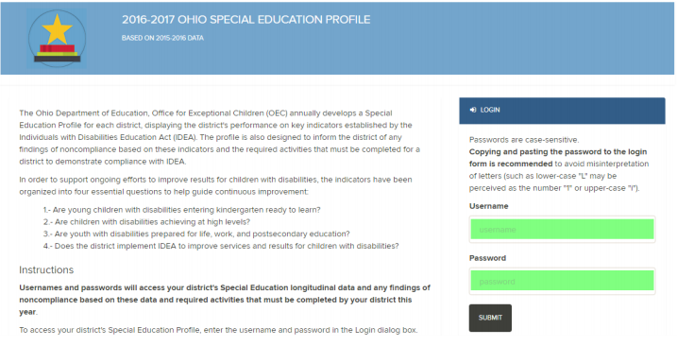
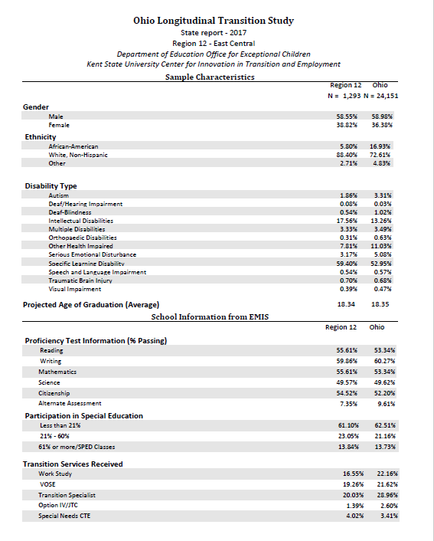
Continuous Improvement
Using Indicator Data and OLTS Data

Slide 16
A “Tool” to Facilitate
Continuous Improvement
What are we doing now?
What do we need to do?
What will we do?
How will we measure our progress?

Slide 17
Improve Services with Transition Indicators
Post-School Outcomes
Indicator 14
Good
Not So Good
Graduation
(Indicator 1)
Expectations and standards?
Various pathways available?
Linkage to post-school environments?
Dropping Out
(Indicator 2)
Why?
Appropriate programs?
Address student and family needs?
Why?
What’s the Quality of Our IEPs?
Indicator 13
Notes:
Post-School Outcomes ~Indicator 14~
Postsecondary education and/or training
Graduation ~Indicator 1~
Expectations and standards?
Various pathways available?
Linkage to post-school environments?
Dropping Out ~Indicator 2~
Why?
Appropriate programs?
Address student and family needs?
What’s the Quality of Our IEPs? ~Indicator 13~
Measurable post-school and annual goals
Transition-related assessments
Course of study, services, and activities
Coordination of services

Slide 18
Improve Region/District Level Services Using Transition Indicators
Post-School Outcomes
~Indicator 14~
Postsecondary education and/or training
Employment
Independent living
Good?
Not so good?
Why? Why Not?
Graduation
~Indicator 1~
Expectations and standards?
Various pathways available?
Linkage to post-school environments?
Dropping Out
~Indicator 2~
Why?
Appropriate programs?
Address student and family needs?
What’s the Quality of Our IEPs?
~Indicator 13~
Measurable post-school and annual goals
Transition-related assessments
Course of study, services, and activities
Coordination of services

Slide 19


Slide 20

Using Transition Indicators to Improve Region/District Level Services
Post-School Outcomes
~Indicator 14~
Postsecondary education and/or training
Good?
Not so good?
Why? Why Not?
Graduation
~Indicator 1~
Expectations and standards?
Various pathways available?
Linkage to post-school environments?
Dropping Out
~Indicator 2~
Why?
Appropriate programs?
Address student and family needs?
What’s the Quality of Our IEPs?
~Indicator 13~
Measurable post-school and annual goals
Transition-related assessments
Course of study, services, and activities
Coordination of services

Slide 21
Improve Services with Transition Indicators
Post-School Outcomes
Indicator 14
Good
Not So Good
Planned vs. Actual Data
Planned vs. Actual Data
Graduation
(Indicator 1)
Why?
Dropping Out
(Indicator 2)
What’s the Quality of Our IEPs?
Indicator 13
Notes:
Post-School Outcomes ~Indicator 14~
Postsecondary education and/or training
Graduation ~Indicator 1~
Expectations and standards?
Various pathways available?
Linkage to post-school environments?
Dropping Out ~Indicator 2~
Why?
Appropriate programs?
Address student and family needs?
What’s the Quality of Our IEPs? ~Indicator 13~
Measurable post-school and annual goals
Transition-related assessments
Course of study, services, and activities
Coordination of services

Slide 22
Postsecondary Engagement Education/Training
Actual
2-year
college 18.0%
4-year
college 13.2%
Other
training 3.2%
Ohio Longitudinal Transition Study Annual Report, Fall 2017

Slide 23
Improve Services with Transition Indicators
Post-School Outcomes
Indicator 14
Actual Data
2-year college/Tech school – 18%
4-year college – 13%
Other Training – 3%
Difference in Planned vs. Actual:
2-year college/Tech school – 16%
4-year college – 15%
Other Training – 12%
Good
Not So Good
Graduation
(Indicator 1)
Why?
Dropping Out
(Indicator 2)
What’s the Quality of Our IEPs?
Indicator 13
Notes:
Actual Data:
2 year college/Tech school – 18%
4 year college – 13%
Other Training – 3%
Difference in Planned vs. Actual:
2 year college/Tech school – 16%
4 year college – 15%
Other Training – 12%

Slide 24
Using Transition Indicators to Improve Region/District Level Services
Post-School Outcomes
~Indicator 14~
Postsecondary education and/or training
Good?
Not so good?
Actual Data:
2 year college/Tech school – 18%
4 year college – 13%
Other Training – 3%
Why? Why Not?
Difference in Planned vs. Actual:
2 year college/Tech school – 16%
4 year college – 15%
Other Training – 12%
Graduation
~Indicator 1~
Expectations and standards?
Various pathways available?
Linkage to post-school environments?
Dropping Out
~Indicator 2~
Why?
Appropriate programs?
Address student and family needs?
What’s the Quality of Our IEPs?
~Indicator 13~
Measurable post-school and annual goals
Transition-related assessments
Course of study, services, and activities
Coordination of services

Slide 25

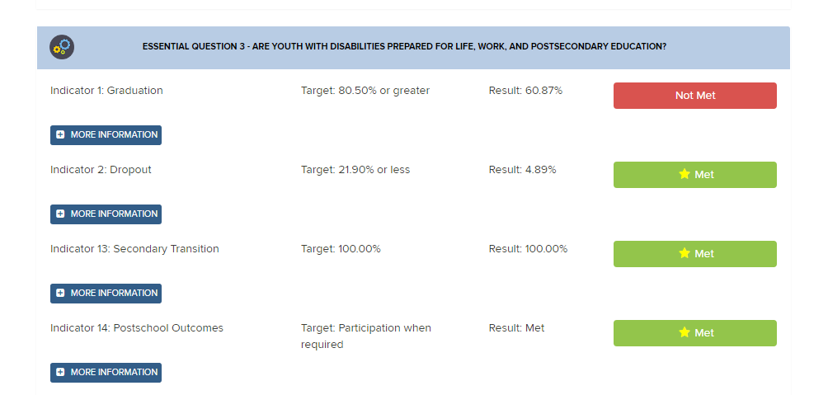
Special Education Profile

Slide 26
Improve Services with Transition Indicators
Post-School Outcomes
Indicator 14
Who graduates?
69.7% (SWD)
85.7% (all)
20.3% Dropout
Good
Not So Good
Graduation
(Indicator 1)
Why?
Dropping Out
(Indicator 2)
What’s the Quality of Our IEPs?
Indicator 13
Notes:
69.7% SWD graduate
85.7% all graduate
20.3% Dropout

Slide 27
Using Transition Indicators to Improve Region/District Level Services
Post-School Outcomes
~Indicator 14~
Postsecondary education and/or training
Good?
Not so good?
Actual Data:
2 year college/Tech school – 18%
4 year college – 13%
Other Training – 3%
Why? Why Not?
Difference in Planned vs. Actual:
2 year college/Tech school – 16%
4 year college – 15%
Other Training – 12%
Graduation
~Indicator 1~
Expectations and standards?
Various pathways available?
Linkage to post-school environments?
Dropping Out
~Indicator 2~
Why?
Appropriate programs?
Address student and family needs?
69.7% SWD graduate – Ohio
85.7 % All graduate - Ohio
What’s the Quality of Our IEPs?
~Indicator 13~
Measurable post-school and annual goals
Transition-related assessments
Course of study, services, and activities
Coordination of services
20.3% Dropout

Slide 28
Using Transition Indicators to Improve Region/District Level Services
Now collect more data from the OLTS Report to complete the picture of needs
  Proficiency Testing
  Special Education Participation
  Transition Services Received
  How Student Plans to Pay for Needs after Graduation
  Transition Services Ratings
  Finding Job
  Other data

Slide 29
Proficiency Test Information
Ohio Longitudinal Transition Study Annual Report, Fall 2017

Slide 30
Participation in Special Education
Ohio Longitudinal Transition Study Annual Report, Fall 2017

Slide 31
Transition Services Received
Ohio Longitudinal Transition Study Annual Report, Fall 2017

Slide 32
Plans to Pay for Needs
Ohio Longitudinal Transition Study Annual Report, Fall 2017

Slide 33
Service Ratings
Ohio Longitudinal Transition Study Annual Report, Fall 2017

Slide 34
Improve Services with Transition Indicators
Proficiency Passing
Reading – 65%
Writing – 65%
Math – 59%
Science – 54%
Citizenship – 57%
Alt. Assess. – 11%
Help Finding Job
Parent – 13%
Friend – 18%
Agency – 12%
Own – 39%
Post-School Outcomes
Indicator 14
Good
Not So Good
Graduation
(Indicator 1)
Why?
Dropping Out
(Indicator 2)
What’s the Quality of Our IEPs?
Indicator 13

Slide 35
Improve Services with Transition Indicators
Post-School Outcomes
Indicator 14
SPED Participation
<21% - 66%
21-60% - 20%
=/>61% - 14%
Pay for Needs
Differences in Scholarships, Student loans, Family help, Work
Good
Not So Good
Graduation
(Indicator 1)
Why?
Dropping Out
(Indicator 2)
What’s the Quality of Our IEPs?
Indicator 13

Slide 36
Improve Services with Transition Indicators
Transition Services Received
Work Study – 23%
VOSE – 22%
Tran. Spec. – 24%
JTC – 3%
Spec. CTE –4%
Career Assessment – 39%
CTE – 40%
AT – 3%
Reasons not Working
Can’t find job
Needs help
Lack of skills
Transportation
Benefit loss
Parenting
Post-School Outcomes
Indicator 14
Good
Not So Good
Graduation
(Indicator 1)
Why?
Dropping Out
(Indicator 2)
What’s the Quality of Our IEPs?
Indicator 13

Slide 37
Improve Services with Transition Indicators
Ratings of Transition Services
High – CTE, Work on own, DD services
Low – Proficiency Tests, Help applying to college
Pay for Needs
Differences in Scholarships, Student loans, Family help, Work
Post-School Outcomes
Indicator 14
Good
Not So Good
Graduation
(Indicator 1)
Why?
Dropping Out
(Indicator 2)
What’s the Quality of Our IEPs?
Indicator 13

Slide 38
Using Transition Indicators to Improve Region/District Level Services
Transition Services Received
WorkStudy – 23%
VOSE – 22%
Tran. Spec. – 24%
JTC – 3%
Spec. CTE – 4%
Career Assessment – 39%
CTE – 40%
AT – 3%
Post-School Outcomes
~Indicator 14~
Postsecondary education and/or training
PSE Services
Register for Disability Services – 7%
Remedial Courses – 9%
Extra Time on Tests – 17%
Tutoring – 14%
Good?
Not so good?
Actual Data:
2 year college/Tech school – 18%
4 year college – 13%
Other Training – 3%
Why? Why Not?
Difference in Planned vs. Actual:
2 year college/Tech school – 16%
4 year college – 15%
Other Training – 12%
Proficiency Passing
Reading – 65%
Writing – 65%
Math – 59%
Science – 54%
Citizenship – 57%
Alt. Assess. – 11%
Reasons not Attending
Not enough money
Need help applying
Not accepted
Incorrect course of study
Graduation
~Indicator 1~
Expectations and standards?
Various pathways available?
Linkage to post-school environments?
Dropping Out
~Indicator 2~
Why?
Appropriate programs?
Address student and family needs?
69.7% SWD graduate – Ohio
20.3% Dropout
What’s the Quality of Our IEPs?
~Indicator 13~
Measurable post-school and annual goals
Transition-related assessments
Course of study, services, and activities
Coordination of services
SPED Participation
<21% - 66%
21-60% - 20%
=/>61% - 14%
Ratings of Transition Services
High – CTE, Work on own, DD services
Low – Proficiency Tests, Help applying to college
Pay for Needs
Differences in Scholarships, Student loans, Family help
Other Info:

Slide 39
It’s YOUR Turn!
Using the OLTS data and SPP/APR data, create a picture of your region’s postsecondary employment outcome.

Slide 40
Improve Region/District Level Services with Transition Indicators
Post-School Outcomes
~Indicator 14~
Postsecondary employment
Transition Services Received
Reasons not Working
Good?
Not so good?
Actual Data:
Why? Why Not?
Difference in Planned vs. Actual:
Proficiency Passing
Finding Job
Graduation
~Indicator 1~
Expectations and standards?
Various pathways available?
Linkage to post-school environments?
Dropping Out
~Indicator 2~
Why?
Appropriate programs?
Address student and family needs?
Indicator Data:
What’s the Quality of Our IEPs?
~Indicator 13~
Measurable post-school and annual goals
Transition-related assessments
Course of study, services, and activities
Coordination of services
Indicator Data:
SPED Participation
Ratings of Transition Services
Pay for Needs
Other Info

Slide 41
Postsecondary Employment
Actual
Full-Time 30%
Part-Time 21%
Less than 20 hrs 9%
Ohio Longitudinal Transition Study Annual Report, Fall 2017

Slide 42
Improve Services with Transition Indicators
Post-School Outcomes
Indicator 14
Actual Data
FT Employment – 30%
PT Employment – 21%
Difference in Planned vs. Actual:
FT Employment – 10%
PT Employment – 18%
Good
Not So Good
Graduation
(Indicator 1)
Why?
Dropping Out
(Indicator 2)
What’s the Quality of Our IEPs?
Indicator 13

Slide 43
Improve Region/District Level Services Using Transition Indicators to
Transition Services Received
Work Study – 23%
VOSE – 22%
Tran. Spec. – 24%
JTC – 3%
Spec. CTE – 4%
Career Assessment – 39%
CTE – 40%
AT – 3%
Post-School Outcomes
~Indicator 14~
Postsecondary Employment
Reasons not Working
Can’t find job
Needs help
Lack of skills
Transportation
Benefit loss
Parenting
Good?
Not so good?
Actual Data:
FT Employment – 30%
PT Employment – 21%
Why? Why Not?
Difference in Planned vs. Actual:
FT Employment – 10%
PT Employment – 18%
Proficiency Passing
Reading – 65%
Writing – 65%
Math – 59%
Science – 54%
Citizenship – 57%
Alt. Assess. – 11%
Help Finding Job
Parent – 13%
Friend – 18%
Agency – 12%
Own – 39%
Graduation
~Indicator 1~
Expectations and standards?
Various pathways available?
Linkage to post-school environments?
Dropping Out
~Indicator 2~
Why?
Appropriate programs?
Address student and family needs?
69.7% SWD graduate – Ohio
85.7 % All graduate - Ohio
20.3% Dropout
What’s the Quality of Our IEPs?
~Indicator 13~
Measurable post-school and annual goals
Transition-related assessments
Course of study, services, and activities
Coordination of services
SPED Participation
<21% - 66%
21-60% - 20%
=/>61% - 14%
Ratings of Transition Services
High – CTE, Work on own, DD services
Low – Proficiency Tests, Help applying to college
Pay for Needs
Differences in Scholarships, Student loans, Family help, Work
Other Info:

Slide 44
What do we do?

Slide 45
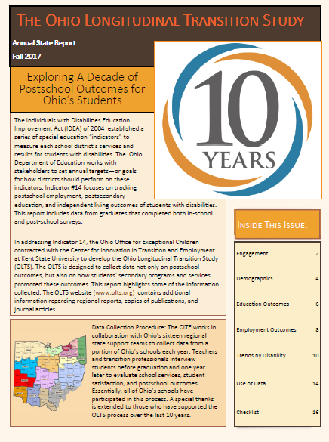

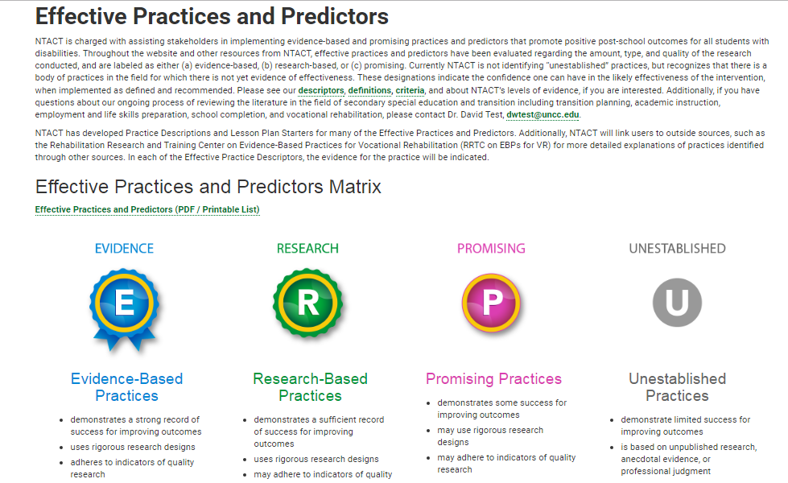
Evidence-Based Predictors & Practices for Post-School Success
www.olts.org
www.ohioemploymentfirst.org
http://www.transitionta.org/effectivepractices

Slide 46
Predictors- Ohio www.olts.org
Postsecondary Employment
Postsecondary Education
Career technical education
Work study
Job Training Coordination (JTC)
Apply for work before graduation
Passing the Proficiency Test
Participation in the general education curriculum

Slide 47
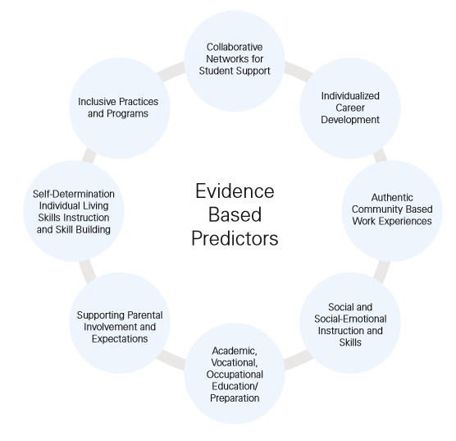
Predictors – National
www.transitionta.org www.ohioemploymentfirst.org

Slide 48
Using the national predictors, rate your region
+ or -

Slide 49
What Do the Data Mean for Ohio?
What is important in transition planning?
  Course of Study
  Career and Technical Education
  Vocational Training Programs (WS/JTC)
  Career Development
  Self Determination and Advocacy Training
  The Transition Planning Process

Slide 50
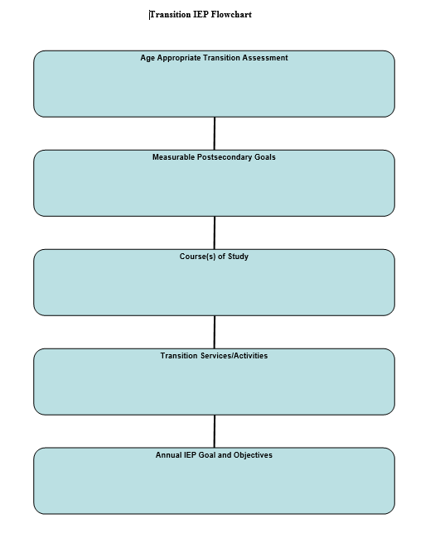
Transition IEP Flowchart
Age Appropriate Transition Assessment
Measurable Postsecondary Goals
Course(s) of Study
Transition Services/Activities
Annual IEP Goal and Objectives

Slide 51
Evidence-Based Practices
Chaining
Community Based Instruction
Computer Assisted Instruction
Mnemonics
Self-Monitoring and Self Management
Video Modeling
Prompting
Self Advocacy and Self Determination
Visual Supports
Mobile Technology
Simulation
http://www.transitionta.org/effectivepractices

Slide 52
Questions and Contacts?
Center for Innovation in Transition and Employment (CITE) @ Kent State
Robert Baer, PhD – Director
  rbaer@kent.edu
Rachel McMahan Queen, PhD – Outreach Director
  rmcmahan@kent.edu
Stacia Kaschak, MEd – Project Director, OLTS
  smather@kent.edu

Slide 53

education.ohio.gov

Slide 54





Join the Conversation
OHEducation
@OHEducation
@OHEducationSupt
OHEducation
OhioEdDept
education.ohio.gov/text

