Slide 1
Ohio Longitudinal Transition Study (OLTS) 2016-2017
Spring 2018

Slide 2
Your Presenters
Amy Szymanski – Ohio Department of Education, Office for Exceptional Children
Stacia Kaschak and Rachel McMahan Queen – Center for Innovation in Transition and Employment, Kent State University
Please note: This webinar is being recorded for future use as needed.

Slide 3
Anticipated Outcomes
Identify the State Performance Plan Indicators related to secondary transition.
Understand the process for completing the OLTS survey forms.
Use OLTS data and evidence-based predictors to identify in-school factors to promote post-school success.
Notes:
Make a shortcut on your desktop

Slide 4
State Performance Plan (SPP) and Annual Performance Report (APR)

Slide 5
State Performance Plan (SPP) Indicators
1
% of youth with IEPs graduating from high school with a regular diploma
2
% of youth with IEPs dropping out of high school
% of youth aged 16 and above with IEPs that contain each of the required components for secondary transition
13

Slide 6
State Performance Plan (SPP) Indicators
% of youth who are no longer in secondary school, had IEPs in effect at the time they left school, and were:
Enrolled in higher education within one year of leaving high school.
Enrolled in higher education or competitively employed within one year of leaving high school.
Enrolled in higher education or in some other postsecondary education or training program; or competitively employed or in some other employment within one year of leaving high school.
14

Slide 7
Ohio Longitudinal Transition Study (OLTS)

Slide 8
The IDEA of 2004 Post-school Outcomes
Each local education agency (LEA) is required to collect outcome data for students with disabilities as they exit high school.
These data are collected at least once every six years. (LEAs >50,000 collect annually).
Schools can use the data to identify factors that promote post-school success and address these in school improvement efforts.

Slide 9
OLTS Partners
Notes:
OEC divided Ohio’s school districts into 5 cohorts to conduct exits and follow-ups on their graduates with IEPs during years from 2006-2014.
The regional State Support Teams provide technical assistance and training for the implementation of the Ohio Longitudinal Transition Study (OLTS).
Kent State University provides the survey training; statistical analysis and management of the data; and state, regional and local reporting.
Ohio Longitudinal Transition Study website:

Slide 10
OLTS Process
Exit Survey
Fill out OLTS self-review form (for internal use)
Survey all graduates and students aging out
Read questions out loud and paraphrase as necessary
Enter data at www.olts.org by June 30, 2017
Follow-Up Survey
Call students to collect follow-up information – try to contact at least 4 times
Enter data at www.olts.org by August 30, 2018
DONE

Slide 11
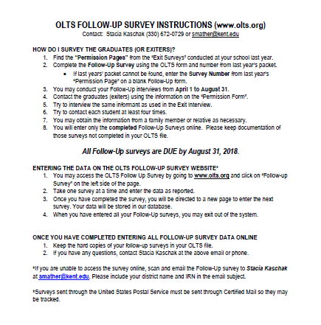

Slide 12
Ohio Longitudinal Transition Study (OLTS) Data

Slide 13
OLTS Data SPP/APR Data – Engagement Rates (2016 Graduates)
Percent of youth who are no longer in secondary school, had IEPs in effect at the time they left school, and were: | Number | Percent
A. Enrolled in higher education within one year of leaving high school. | 280 | 28.8%
B. Enrolled in higher education or competitively employed within one year of leaving high school. | 656 | 67.5%
C. Enrolled in higher education or in some other postsecondary education or training program; or competitively employed or in some other employment within one year of leaving high school. | 811 | 83.4%
Total | 972

Slide 14
OLTS Data Post-school Outcome Trends by Year

Slide 15
Postsecondary Engagement Education/Training
Actual
2-year college 18.0%
4-year
college 13.2%
Other
training 3.2%
Ohio Longitudinal Transition Study Annual Report, Spring 2018

Slide 16
Postsecondary Employment
Actual
Full-Time 30%
Part-Time 21%
Less than 20 hrs 9%
Ohio Longitudinal Transition Study Annual Report, Spring 2017

Slide 17
Predictors- Ohio www.olts.org
Postsecondary Employment
Postsecondary Education
Career technical education
Work study
Job Training Coordination (JTC)
Apply for work before graduation
Passing the Proficiency Test
Participation in the general education curriculum

Slide 18
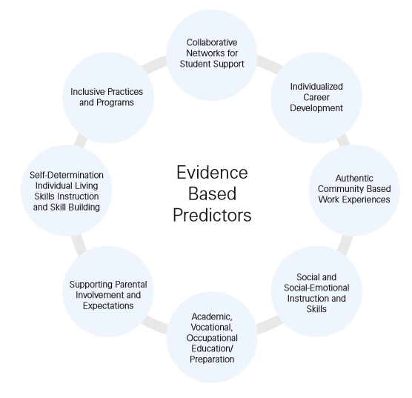
Predictors – National
www.transitionta.org www.ohioemploymentfirst.org

Slide 19
Using the national predictors, rate your region + or -

Slide 20
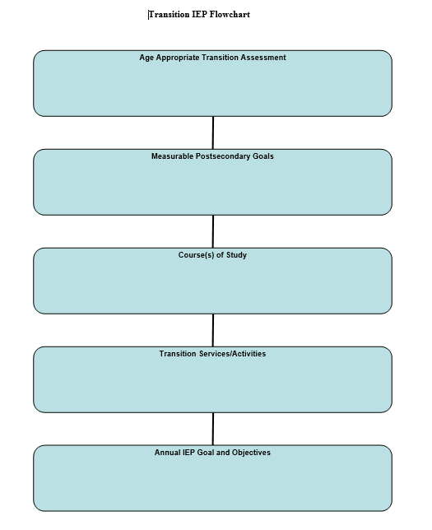
What Do the Data Mean for Ohio?
What is important in transition planning?
Course of Study
Career and Technical Education
Vocational Training Programs (WS/JTC)
Career Development
Self Determination and Advocacy Training
The Transition Planning Process

Slide 21
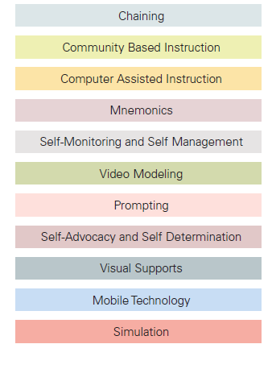
Evidence-Based Practices
http://www.transitionta.org/effectivepractices

Slide 22
Questions and Contacts? Center for Innovation in Transition and Employment (CITE) @ Kent State
Robert Baer, PhD – Director
rbaer@kent.edu
Rachel McMahan Queen, PhD – Outreach Director
rmcmahan@kent.edu
Stacia Kaschak, MEd – Project Director, OLTS
smather@kent.edu

Slide 23
education.ohio.gov

Slide 24
Join the Conversation
OHEducation
@OHEducation
@OHEducationSupt
OHEducation
OhioEdDept
education.ohio.gov/text

