Slide 1
Web Best Practices
Leveraging the Power of Web Analytics, Web Monitoring and Content Strategy

Slide 2
Anne Palmieri
Web, Training Coordinator
University Communications and Marketing
Web Team: Lin Danes, Rob DiVincenzo,
Ian McCoullough, Tim Priester and Sara Smith

Slide 3
Determine the priority pages and actions you want visitors to view and execute, respectively.
Identify Goals
Yearly
Improve Conversion
Monitor Analytics
See traffic volume coming into the site and its sources. Measure effectiveness of external marketing and social media activity. View destination pages to see relative interest in upcoming programs and events. Review activity as it relates to identified conversion measures.
Review findings from conversion reports, and usability tests to identify improvement opportunities. Track when updates are made for before-and-after comparisons.
Web Best Practices Cycle
Yearly
Monthly
Identify the principal scenarios visitors should be able to achieve on the site. Reach out to new or infrequent users, and test their ease with running the scenarios. Use the results to identify areas for improvement.
Test Usability
Control Quality
SiteImprove reports pinpoint web pages with broken links and misspellings. Pages with the most issues go to the top of the Priority Pages list for handling. Pages are also scanned for web accessibility compliance.
Yearly
Monthly
Audit Content
Each Semester
Over time, content gets out of date. A periodic page-by-page review of site content helps ensure errors and omissions that cannot be detected by Siteimprove are addressed.

Slide 4
Identify Goals
Yearly
Determine the priority pages and actions you want visitors to view and execute, respectively.

Slide 5
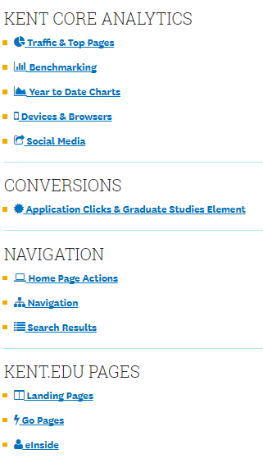
Conversions We Track
Monthly dashboard reports are provided to:
Every campus
Admissions
Online Giving
You can login any time to review data.
Monthly reports can be provided to your via email upon request.

Slide 6
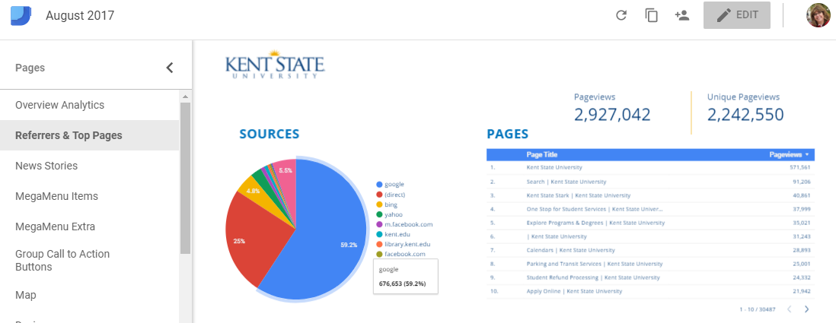
Data Studio
Google Data Studio (beta) turns your Google Analytics data into informative dashboards and reports that are easy to read, easy to share, and fully customizable. Dashboarding allows you to tell great data stories to support better business decisions. Visit https://datastudio.google.com/ to sign-up.

Slide 7
What are you tracking?
What should you be tracking?

Slide 8
What should you be tracking?
What priority pages do you want visitors to view? ______________________________________________________________________________________________________________________________________________________________________________________________________________________________________
What actions do you want visitors take?
______________________________________________________________________________________________________________________________________________________________________________________________________________________________________

Slide 9
Monitor Analytics
Monthly
See traffic volume coming into the site and its sources. Measure effectiveness of external marketing and social media activity.
View destination pages to see relative interest in upcoming programs and events.
Review activity as it relates to identified conversion measures.

Slide 10
What to Look For
Web analytics tools report differently
Trends, not numbers, are important

Slide 11
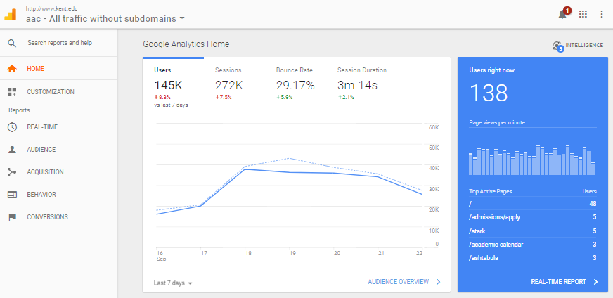
Google Analytics
Home - a dashboard overview of common metrics
TIP! Google Analytics Solutions, http://bit.ly/2eUKxQX,is a great resource.

Slide 12
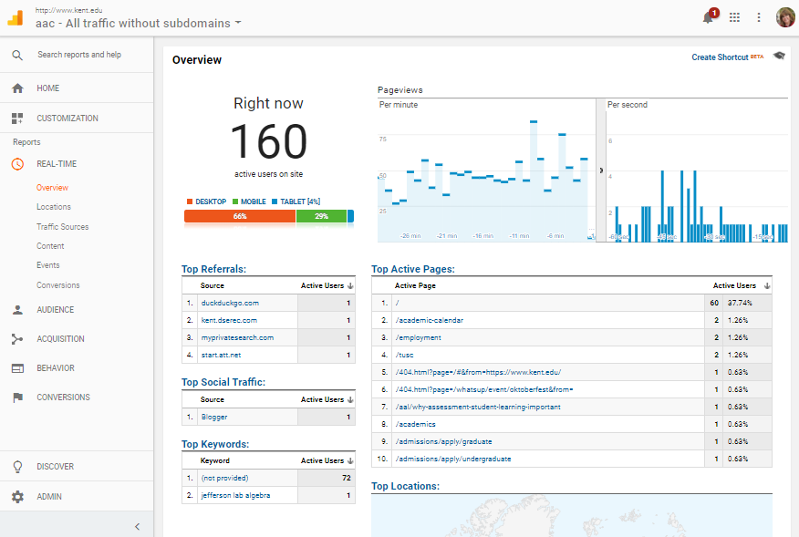
Real-Time
See who is viewing your site in real-time.

Slide 13
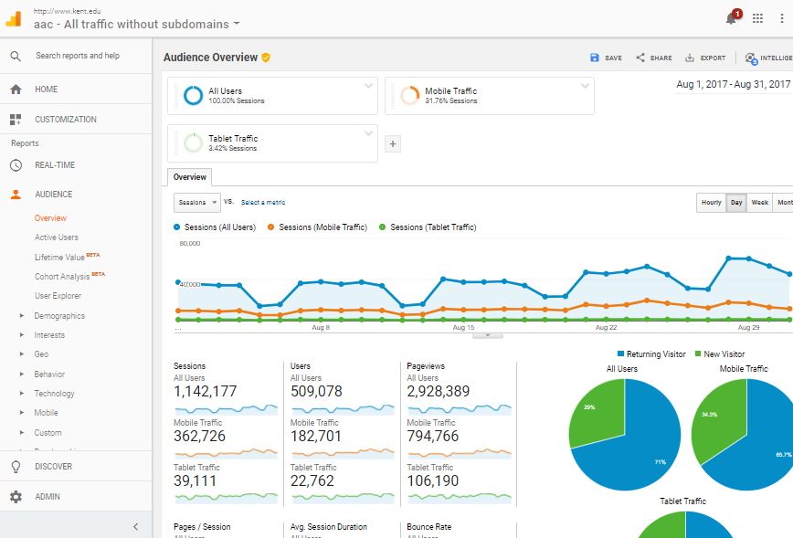
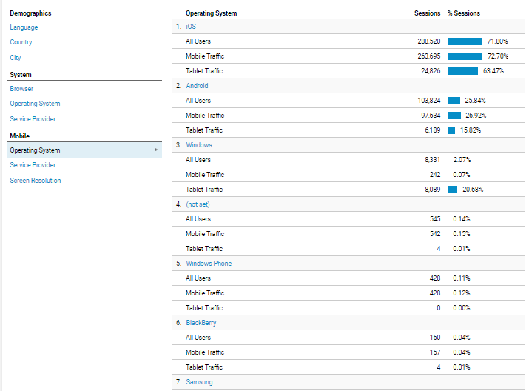
Audience
You can select additional filters below the results.

Slide 14
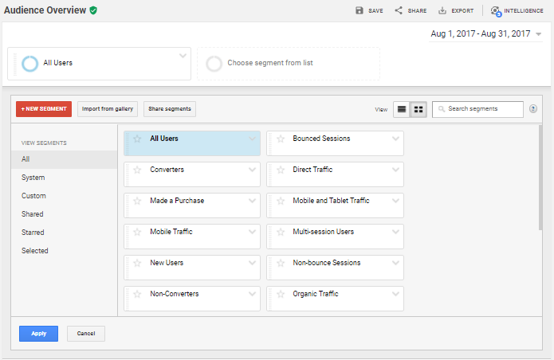
Audience Segments
Select what segments you want included in the report.

Slide 15
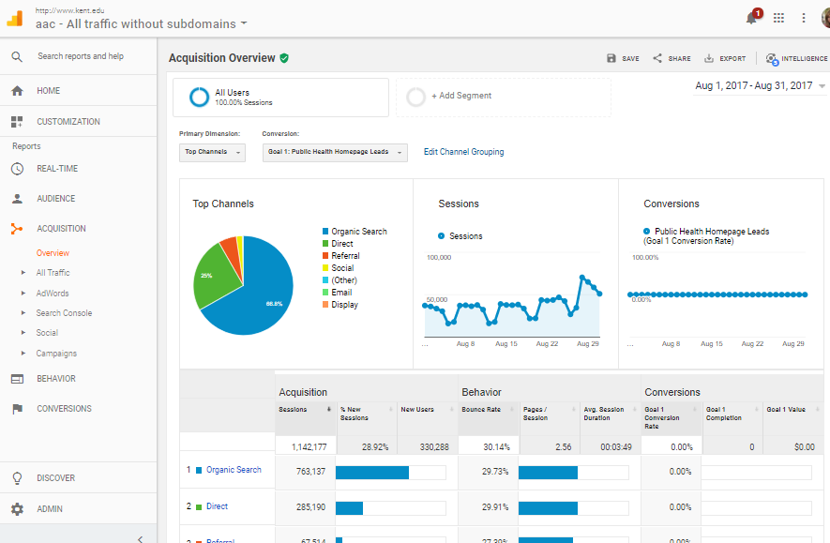
Acquisition
Identify best referral sources
Measure return on effort

Slide 16
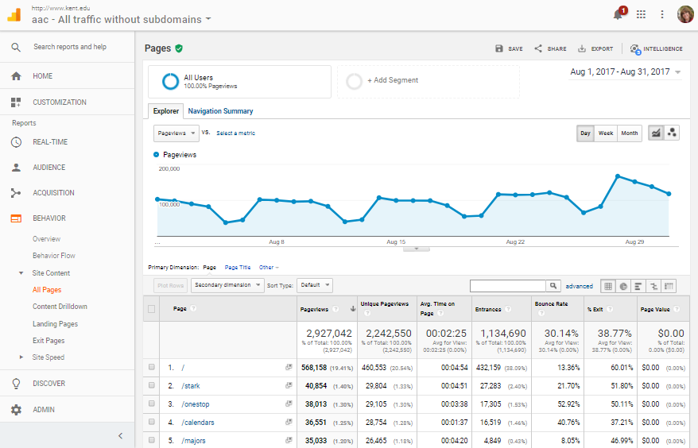
Behavior: Content
Track top pages (any missing?)
Watch for high bounces

Slide 17
Sessions vs. Users
Analytics measures both sessions and users in your account. Sessions represent the number of individual sessions initiated by all the users to your site. If a user is inactive on your site for 30 minutes or more, any future activity is attributed to a new session. Users that leave your site and return within 30 minutes are counted as part of the original session.
The initial session by a user during any given date range is considered to be an additional session and an additional user. Any future sessions from the same user during the selected time period are counted as additional sessions, but not as additional users.
Notes:
The initial session by a user during any given date range is considered to be an additional visit and an additional visitor. Any future sessions from the same user during the selected time period are counted as additional visits, but not as additional visitors.

Slide 18
Pageviews
A pageview is defined as a view of a page on your site that is being tracked by the Analytics tracking code. If a user clicks reload after reaching the page, this is counted as an additional pageview. If a user navigates to a different page and then returns to the original page, a second pageview is recorded as well.

Slide 19
Unique Pageviews
A unique pageview, as seen in the Content Overview report, aggregates pageviews that are generated by the same user during the same session. A unique pageview represents the number of sessions during which that page was viewed one or more times.
If a user views the same page 3 times during the same visit, then it will count as 3 page views and 1 unique pageview.
If the same user exits your site, comes back after 30 minutes (session expires) and views the same page again, it will count as 4 page views and 2 unique page views.

Slide 20
Control Quality
Monthly
SiteImprove reports pinpoint web pages with broken links and misspellings. Pages with the most issues go to the top of the Priority Pages list for handling. Pages are also checked for accessibility compliance.

Slide 21
Common Errors
Time treatment 9 a.m. – 5:30 p.m. 8:15 a.m. – noon
Date/month format January 2019 (not abbrev. w/o date) Jan. 15 (abbrev. w/ date)
Kent State terms FlashLine, FLASHcard, Kiva, MAC Center, Student Recreation & Wellness Center (SRWC), University Auditorium in Cartwright Hall

Slide 22
Reference Tools
Web Editor Quick Reference Guide http://bit.ly/2wNC6fs
Webteam Website https://www.kent.edu/node/101351
Guide to Marketing https://www.kent.edu/node/271551
Kent State Guide to Brand
Guide to Social Media
Guide to University Style
Guide to Web Standards

Slide 23
Most Common Errors
Phone number treatment
xxx-xxx-xxxx (use hyphens, not parentheses)
Time treatment
9 a.m. – 5:30 p.m.
8:15 a.m. – noon
noon is not capitalized
Date/month treatment
January 2010 (not abbreviated without a date)
Jan. 15, Feb. 21, March, April, May, June, July, Aug. 22, Sept. 23, Oct. 31, Nov. 11, Dec. 12 (abbreviated with a date)
One word: online, website, email (no hyphen)
Kent State email address (not University email address, KSU email address, Kent email address, FlashLine address)

Slide 24
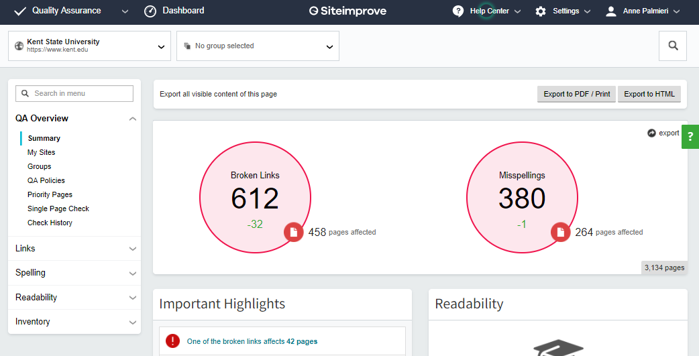
Siteimprove QA
Quality Assurance
Broken links
Misspellings
TIP! Learn more about Siteimprove at their Help Center at https://support.siteimprove.com/hc/en-gb.

Slide 25
Broken Links
Review the Pages with Broken Links list
Select the page to view the errors location.
Select the link at the top of the page to open the page in your browser. If logged in to Drupal, select the Edit button to fix the broken link.
While on the page, check for misspellings too.

Slide 26
Misspellings
Spelling mistakes are located and corrected the same way broken links are. An action can be designated four ways:
Add to Dictionary - add a word to the dictionary so it will not be seen as a misspelling, this must apply site-wide
Confirm as Misspelling - confirms a potential misspelling as a misspelling
Ignore on This Page - ignores the misspelling on only this page
Ignore on all Pages - ignores the misspelling on the entire website, this must apply site-wide

Slide 27
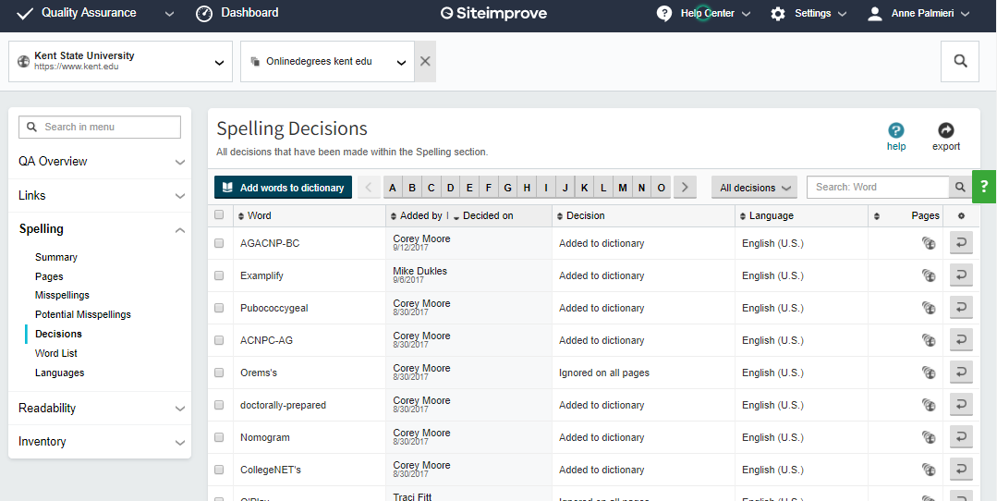
Update the Dictionary
Review past decisions
Make corrections with undo

Slide 28
Pages to Check
Copy/paste URLs to check individual pages
Priority pages
Academic pages
New pages

Slide 29
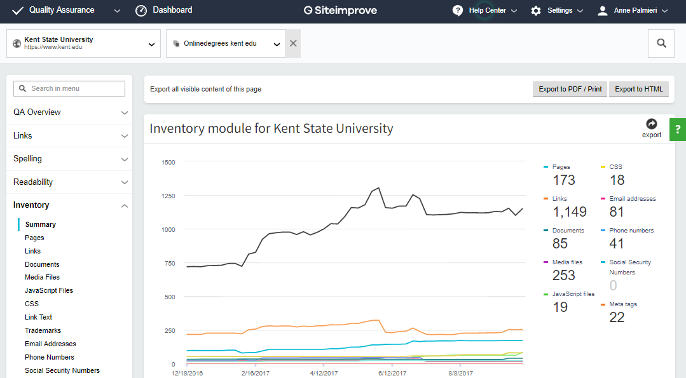
Inventory Lists
Phone Numbers - confirm xxx-xxx-xxxx format
Media Files - image files should be 1MB (1,000 KB) or less
Linked Text - descriptive for assistive technology?

Slide 30
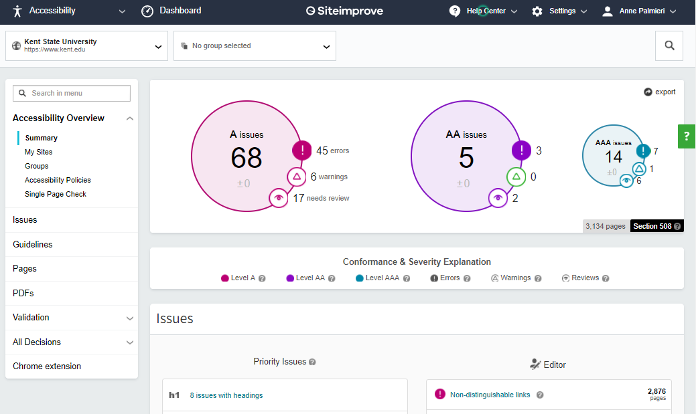
Siteimprove Accessibility
Accessibility Overview

Slide 31
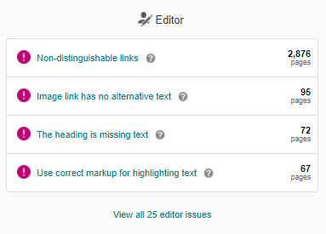
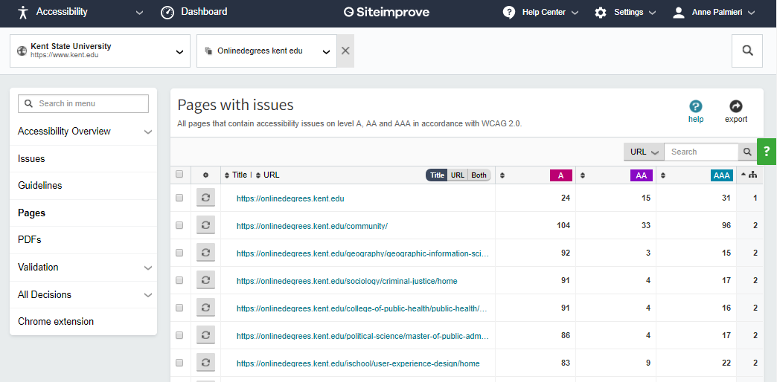
Accessibility Issues
Prioritize fixes by audience:
Students
Employees
Public Marketing
Editor issues
A and AA issues

Slide 32
Audit Content
Every Semester
Over time, content can become dated. Periodically review the content of your site page-by-page. Be sure to review all menus too. This will ensure errors and omissions are addressed.

Slide 33
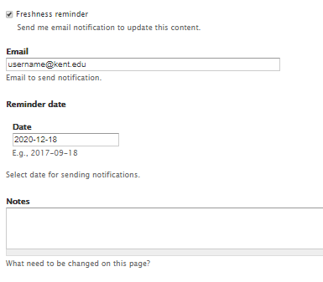
Freshness Reminder
Request a content review email reminder through Drupal.
Select the Freshness reminder option toward the bottom or your page to schedule a reminder.
NOTE: A new reminder must be entered if the page needs reviewed again.

Slide 34
Benchmarking Defined
A measurement of the quality of an organization's policies, products, programs, strategies, etc., and their comparison with standard measurements, or similar measurements of its peers.
The objectives of benchmarking are (1) to determine what and where improvements are called for, (2) to analyze how other organizations achieve their high performance levels, and (3) to use this information to improve performance.

Slide 35
How Benchmarking Works
Select a program or process to benchmark.
Identify the key performance metrics.
Choose universities and/or similar internal departments to benchmark.
Collect data on performance and practices,
Analyze the data and identify opportunities for improvement.
Adapt and implement the best practices, setting reasonable goals and ensuring university-wide acceptance.

Slide 36
Collect Data
Audit the competition as well as similar departments to see what content they feature.
Collect data
What information is displayed on their homepage?
How is information is presented: video, images, slideshows, graphic design or plain text?
Note how many previews are featured before needing to click to see more.
What call-to-actions are present.
Determine the importance they place on the content by noting where the content is displayed in the the navigation.
What phrases and keywords are consistently used?

Slide 37
Know Your Options
Follow the Guide to Marketing https://www.kent.edu/node/271551
Discover templates or create your own. https://www.kent.edu/node/455376#templates
View the various color palette options. https://www.kent.edu/sites/default/files/file/Color-Palette-Mockups_1.pdf
Improve home page designs by adding elements. https://www.kent.edu/node/448696 Visit these sites for inspiration:
College of Nursing - https://www.kent.edu/node/91466
College College of Education, Health and Human Services - https://www.kent.edu/node/65891

Slide 38
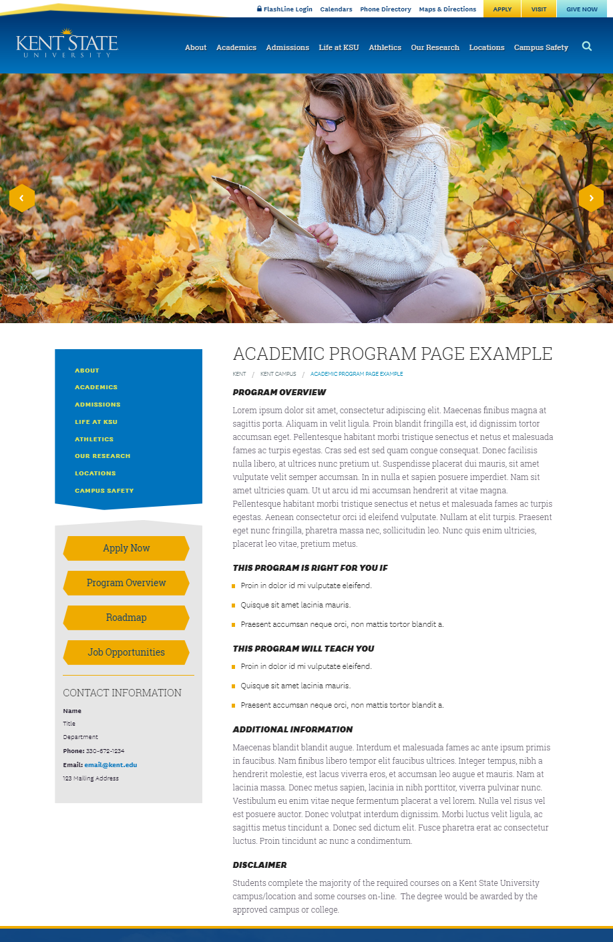
Academic Program Page
View an academic program page example at https://www.kent.edu/node/618426.

Slide 39
Program Page Body
PROGRAM OVERVIEW
One paragraph limited to 3 or 4 sentences or one sentence for each of the bulleted items below:
Crux of program
Concentrations & Minors
Class format - size (large or small), lab, all online
THIS PROGRAM IS RIGHT FOR YOU IF
Bulleted list of personality traits or characteristics of students who would do well in the field e.g. “If you like people”, “If you like numbers”, etc.
THIS PROGRAM WILL TEACH YOU
Bulleted list of what the program will teach a student.
ADDITIONAL INFORMATION
In a paragraph format describe prerequisites, limitations and relevance toward additional degrees.
DISCLAIMER
Include as needed for online degrees.

Slide 40
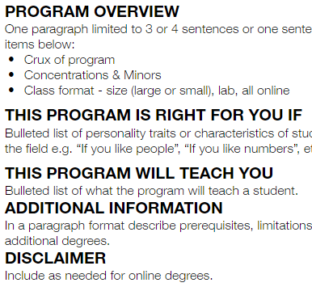
Shared Program Page Pane
To allow program information to be consistent across all campuses, those with common programs will use a shared pane.
An internal basic page is created and it is added to each site’s similar program page.
This section displays the body text of the actual program page.
TIP! Instructions on how to add an internal basic page to another page are available at https://www.kent.edu/node/186871.

Slide 41
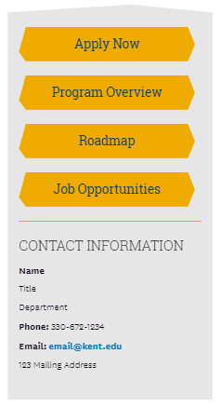
Academic Program Block
Placed under the left menu.
Provides links to:
Apply Now
Roadmap
Job Opportunities
Includes contact information:
Name
Title
Department
Phone
Email Address
Address
View the Academic Program Block template at https://www.kent.edu/node/610361.

Slide 42
Testing Usability
Yearly
Usability is a quality attribute that assesses how user friendly interface is to use. The word "usability" also refers to methods for improving ease-of-use during the design process.
TIP! Learn more about usability at http://www.nngroup.com/articles/usability-101-introduction-to-usability/.

Slide 43
Testing Objectives
Identify the principal scenarios visitors should be able to achieve on the site.
Request feedback from new, infrequent and key users.
Use the results to identify areas for improvement.
Look for and note the trends/opportunities that naturally emerge

Slide 44
Testing Types
Formal with observation
Machine to machine
Eye tracking
Mini-test of a few fixes
Large-scale web application test

Slide 45
Determine if it is Useful
Usability = how easy and pleasant these features are to use
Utility = whether it provides the features you need
Useful = usability + utility

Slide 46
5 Quality Components
Learnability: How easy is it for users to accomplish basic tasks the first time they encounter the design?
Efficiency: Once users have learned the design, how quickly can they perform tasks?
Memorability: When users return to the design after a period of not using it, how easily can they reestablish proficiency?
Errors: How many errors do users make, how severe are these errors, and how easily can they recover from the errors?
Satisfaction: How pleasant is it to use the design?

Slide 47
Testing Basics
Reserve space or approach students in department
5-8 participants
Offer incentives for participation
Gift cards - Starbucks and Amazon are good choices
Food - provide pizza for lunch or cookies and coffee for a mid-morning or afternoon session

Slide 48
Focus Groups
Focus groups can be a powerful tool in system development, but they should not be the only source of information about user behavior.
In interactive systems development, the proper role of focus groups is not to assess interaction styles or design usability, but to discover what users want from the system.

Slide 49
User Testing
Locate representative users: employees (faculty and staff), parents, alumni and students.
Ask the users to perform representative tasks with the design.
Observe what the users do, where they succeed, and where they have difficulties with the user interface.
Use language the user understands.
Remain silent and let the users do the talking. Avoid leading them or offering hints.
Use a Qualtrics form to capture information for easy reporting.
Clear the test computer’s cache between sessions.

Slide 50
Improve Conversion
Yearly
Review findings from conversion reports, and usability tests to identify improvement opportunities. Track when updates are made for before-and-after comparisons.

Slide 51
Website Health
Google Analytics come into play at this juncture of website health, as well.
Helps evaluate the effectiveness of the site, as does testing.
Can validate whether website enhancements or revisions move the dial at all. For example, we can look at the performance of our overview pages before and after their titles were styled to look like links.
Another feature in Google Analytics is the ability to actually add what could be considered a kind of “physical” more measurable goal in the tool itself.

Slide 52
Measurable Goals
Beyond comparative data, Google Analytics offers measurable goals.
Goals are a versatile way to measure how well your site fulfills targeted objectives.
Goals reflect achievement on the website
A completed goal is logged as a conversion
Goals can also have monetary value
Goals can be grouped
Downloads
Registrations
Information requests

Slide 53
Types of GA Goals

Slide 54
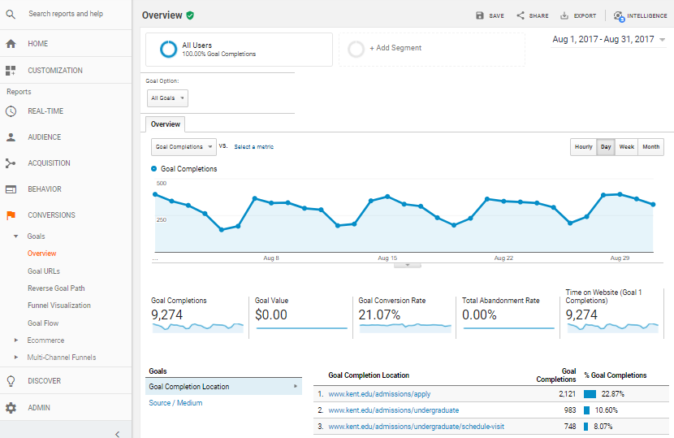
Monitoring your GA Goals
Over time, tracking will reflect the effectiveness of the goal.

Slide 55
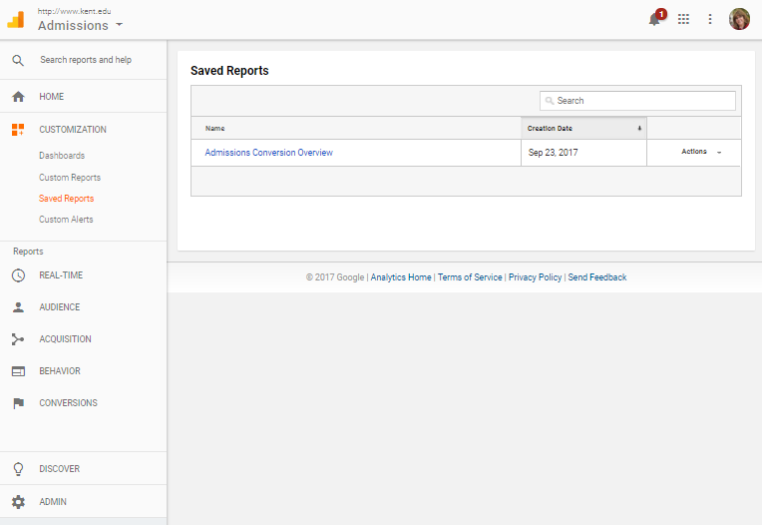
Save Reports
Reports can be saved for future use. Select the save icon a the top of the screen. From there you can reopen the report, update the date range of the report to view updated data.

Slide 56
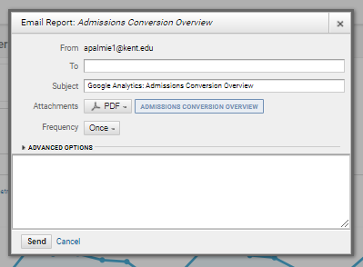
Schedule Reports
Reports can be scheduled
Popular pages
Conversion rates

Slide 57
Questions and Support
University Communications and Marketing
Web Services, https://www.kent.edu/webteam
Lin Danes, Director, Web Services & Interactive Media
ldanes@kent.edu
Anne Palmieri, Web, Training Coordinator
apalmie1@kent.edu, 330-672-8506
Support Tickets
http://support.kent.edu

