Slide 1
Managing Capital Assets
Mike Farina
Controller’s Office
farinami@kent.edu
2-8614

Slide 2
KSU Policy 5-12.3 Administrative policy regarding acquisition, inventory control, and sales or other disposal of capital assets http://www.kent.edu/policyreg/
(B) Capital Assets – any tangible personal property such as equipment, furniture, or other assets, with a value greater than $5,000, including all costs to prepare the asset for use (Installation, Freight, Training) and an estimated useful life greater than 1 year. (Real Property & Library Books are Excluded in this discussion).

Slide 3
Classes of Equipment
Aircraft
Art Work (Non-Deprec.)
Audio Visual Equipment
Athletic Equipment
Communications Equip.
Computer Hardware
Lab Equipment
Food Service Equipment
Grounds Equipment
Machinery
Maintenance Equip.
Medical Equipment
Misc. Equipment
Musical Equipment
Office Equipment
Office Furniture
Vehicles-Passenger and Non-Passenger

Slide 4
Equipment Life Cycle
Purchasing
Acquisition
Disposal
Inventory Control

Slide 5
Purchasing
Equipment purchases are made using the on-line Flashcart procurement system (SciQuest) and must follow the policies issued by the Procurement/Purchasing department.
Equipment purchases should be coded to one of the following accounts:
78011-Equipment/Furniture greater than $5,000 (capital)
78013-Computer hardware greater than $5,000 (capital)
72024-Equipment/Furniture less than $5,000 (expendable)
72023-Computer hardware less than $5,000 (expendable)
78019-Fabricated equipment (should not be used without Controller office approval)
78021-Service Center equipment (only to be used by specific departments)

Slide 6
Purchasing (cont’d)
The Controller’s office will verify account codes for accuracy during this approval process based on dollar amount, item, and quantities to ensure that the equipment is properly classified.
Please be sure to attach an itemized quote to your requisitions as this helps us with our approval process.
Capitalization is determined by item, not by order.

Slide 7
Purchasing (cont’d)
Capital Equipment Costs Include:
Original contract or invoice cost
Shipping and handling
Taxes imposed on the purchase
Installation and training costs
Excluded Equipment Costs:
Warranties
Consumable/Expendable items

Slide 8
Acquisition
Accounts Payable pays the vendor.
All transactions hitting 78011 or 78013 create temporary tags in Banner-Fixed Assets.
Controller’s Office will assign a permanent tag or make corrections to the capitalization with journal entries.
Permanent tags are sent to the departments for completion.

Slide 9
Tagging Capitalized Equipment
Inventory tag naming conventions:
Blue tags with 6 digit ID - majority of equipment assigned will be issued a blue tag (non-federally funded assets).
Gold tags with 7 digit ID – equipment funded all or partially by a Federal grant.
No physical tag – vehicles and airplanes are assigned a unique number based on their VIN/serial #, typically the last 7 digits.
After a tag is assigned it is sent via campus mail to the organization’s equipment coordinator along with an Inventory Control Form.

Slide 10
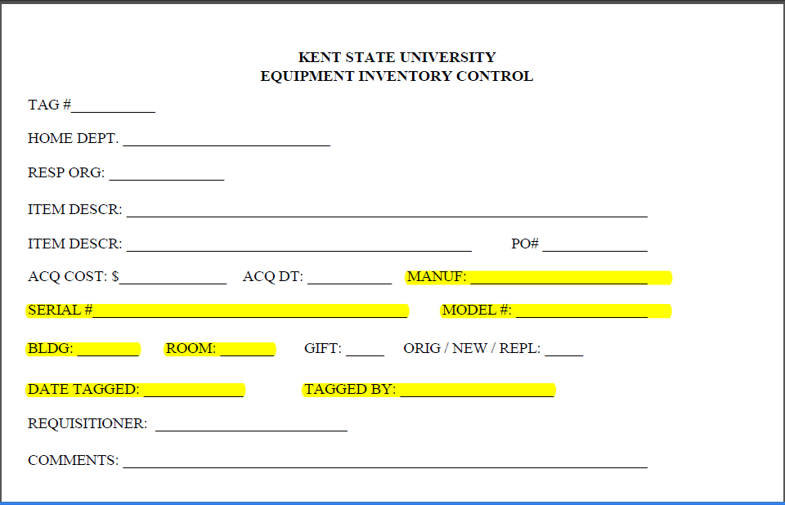

Slide 11
Tagging Capitalized Equipment
The information we have is only as good as the information supplied to us by the organization! Please fill out all items on the form before returning.
The inventory tag should ideally be affixed on a flat surface near an externally visible manufacturer’s model/serial number.
If it is not possible to affix the tag to the asset, then please note “Unable to tag” and give reasoning in the comments section of the form. Keep the tag along with the item’s purchase records in your files for the life of the asset. A permanent marker may also be used if needed.

Slide 12
Inventory Control
The Controller’s Office is responsible for the recordkeeping for capital assets.
The departmental Chairs/Heads and Equipment Coordinators are responsible for asset maintenance.

Slide 13
Responsibilities of the Chair/Department Head
Financial responsibility for capitalized equipment rests with the relevant Chair or Department Head (purchasing, payment, record keeping, etc.).
Each Chair/Department Head should assign an equipment coordinator – someone with access to equipment and equipment records including requisitions, purchase orders, invoices, etc.
The bi-annual “Departmental Inventory Confirmation” certification and any asset management forms that address the disposition of capital equipment must be signed by the Chair or Department Head prior to submission to the Controller’s office.

Slide 15
Equipment Coordinator
Keep asset in a location and manner to avoid damage, theft, or other loss and maintain accurate records of purchases, dispositions, and location of all capitalized assets.
Tagging equipment upon receipt of both the asset’s inventory tag and “Equipment Inventory Form” and returning this completed form to the Controller’s office.
Reviewing the status of all capitalized equipment listed on the “Departmental Inventory Confirmation” which is made available to organizations bi-annually by the Controller’s office.

Slide 16
Equipment Coordinator
Notifying the Controller’s office of any change in equipment status (physical location change, organization change, equipment coordinator change, dispositions, etc.) by submitting the proper forms.
Notifying University Police immediately if equipment is stolen.
Notifying the University Foundation when equipment is received as a gift to the University. University Foundation must acknowledge the gift and notify the Controller’s office. If the Controller’s office determines that the item is capital equipment (when we have a true appraisal of the asset’s FMV), it is recorded in the asset management system (Banner).

Slide 17
Physical Audits
Physical audits occur bi-annually. Every organization must have 100% of its capital assets reviewed once every 2 years. The department head is responsible for overseeing this.
Confirmation of the assets on the listing are the responsibility of the department.
The Controller’s office should be notified of any equipment with an original cost over $5,000 (per unit) that is not on the list so that we can research it.

Slide 18
Physical Audits
FY18 Reports will be sent out by the end of February.
Verify that every asset listed is present and in good working order.
Clearly mark any changes that need to be made.
Do not delete any items.
Need to be signed by Equipment Coordinator and Department Head and returned to the Controller’s Office.

Slide 19
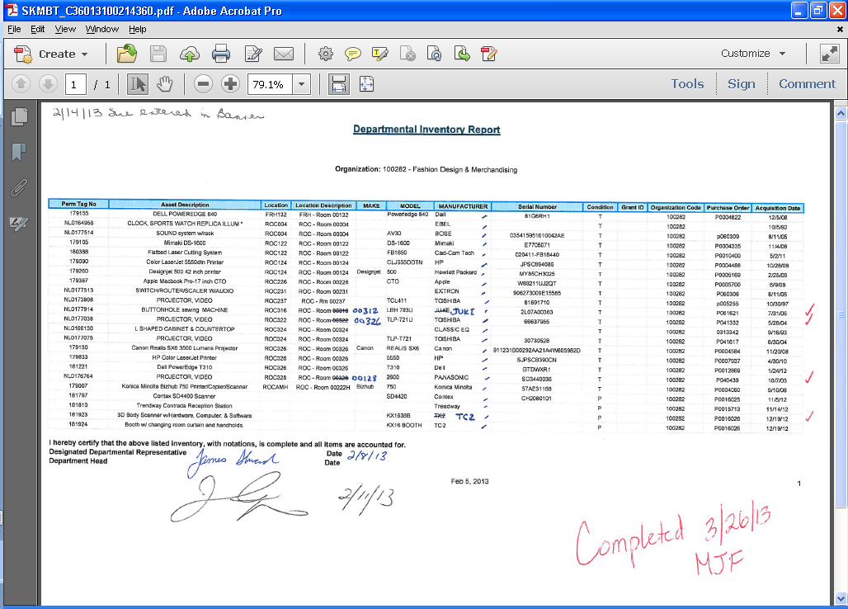

Slide 20
Uniform Guidance 2 CFR 200.313: Uniform Administrative Requirements, Cost Principles, and Audit Requirements for Federal Awards - Equipment
As a recipient of federal funding, the University is required to complete a physical inventory of its equipment and other assets every 2 years.
By not returning your inventory confirmation report to the Controller’s office, the University is out of compliance with this regulation.
Link to 2 CFR 200.313 - Equipment

Slide 21
Changes in Equipment Status
Types of changes in equipment status that must be reported to the Controller’s office:
Equipment relocated within a department/organization
Equipment transferred to another KSU department/organization
Must be signed by both initiating and receiving departments.
A change in the organization of record will not make any changes to where the expense was recorded for an asset.

Slide 22
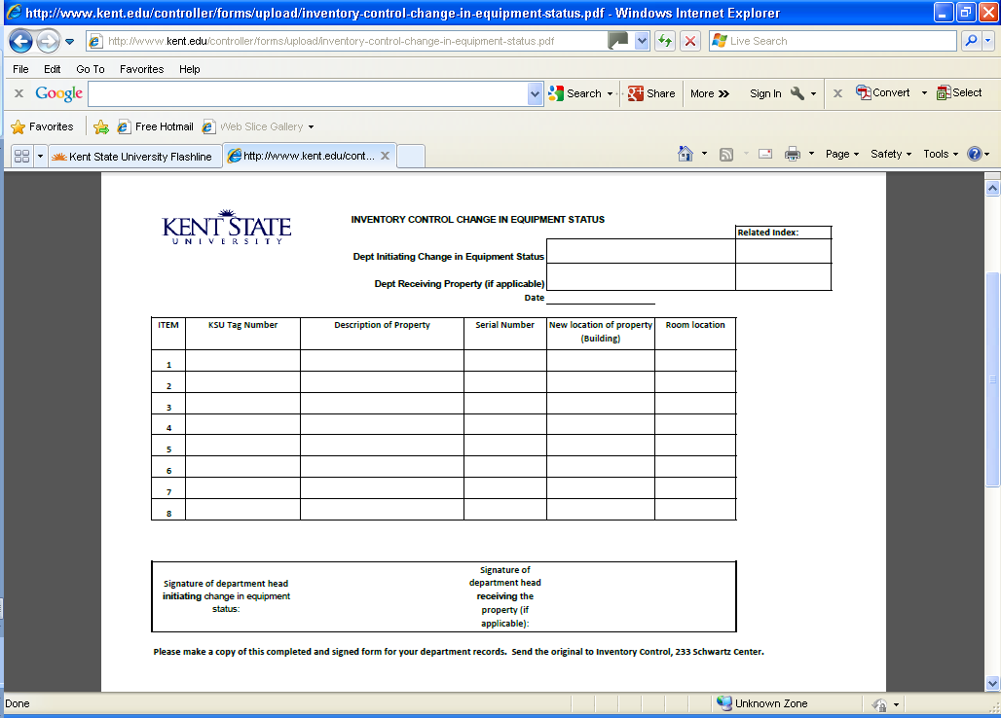

Slide 23
Disposal
Situations that call for the retirement and removal from inventory records (surplus property) may include:
Equipment that is past its useful life and is no longer used
Stolen equipment
Equipment that is traded in
Equipment that is lost
Equipment that is destroyed
Equipment that is sold
Equipment that is returned to a research sponsor

Slide 24
Disposal
Policies and procedures concerning surplus property are the responsibility of the Purchasing/Procurement Department.
The Procurement department website has instructions for disposing of surplus property.
Only the Procurement department is authorized to sell or auction equipment.
Fleet Services should be contacted when trading in or disposing of vehicles.
A Disposal Form must be completed and returned to the Controller’s Office.

Slide 26
Forms
https://www.kent.edu/controller/forms-library
Disposition form (and instructions)
Change in Status form
Equipment Coordinator form
Agreement for Assignment of University Equipment

Slide 27
Resources
Kent State, Controller’s Office, 330-672-2392, http://www.kent.edu/controller/financialaccounting
Kent State, Procurement/Purchasing, 330-672-2276, http://www.kent.edu/procurement/
Kent State, Fleet Services, 330-672-2345, http://www.kent.edu/ufm
Kent State, Police Services, 330-672-3070

Slide 28
Questions?

