Slide 1
Indexes: Fund/Org/Programs & Accounts
December 17, 2018

Slide 2
What is FOAP?
FOAP is the chart of account elements of Fund, Organization, Account, and Program.
Each FOAP element has a hierarchy built into Banner to facilitate reporting.
An Index is a shortcut created in Banner for keying your department’s Fund, Organization, and Program combination (Indexes have no hierarchy).
All financial transactions processed in Banner require the use of FOAP to some degree.
FOAP Elements are the drivers for approvals of workflows.
The goal of this presentation is to gain a better understanding of FOAP and to be able to find various chart element information in Banner.

Slide 3
What is FOAP? Funds
Fund: a fiscal and accounting entity with a self-balancing set of accounts in which transactions are recorded and segregated to carry on specific activities. Also used to Identify funding source.
Unrestricted
Allocated – Generally consists of unused funding from prior fiscal year budgets and is usually used to fund expenditures not included in the base budget.
Education & General (E&G) – Funding from current year University Budget
Designated – subset of the general fund to account for a specific purpose/activity (should be self-supporting).
Restricted – Grants and contracts from external funding sources (federal, state, local, & private)

Slide 4
What is FOAP? Funds (continued)
Auxiliary – Self Supporting business activities; revenue sources from fees charged for services; does not receive University Budget Dollars
Unexpended Plant – Used for construction, renovation, and Acquisition of long-lived assets for University Purposes.
Renewal & Replacement – to provide funding for various non-operating, non-recurring maintenance needs. May fund construction project, but the actual project cannot run through an R&R.
Agency – 3rd party, self-supporting, business type organizations (or group of indeividuals) set up to benefit from University services (AP, Procurement, etc.). University is a custodian/fiscal agent for the organization, but does not have ownership over their funds.

Slide 5
What is FOAP? Funds – Numbering Conventions
In Banner Finance, funds are 6 digits, with the first digit defining the type of fund:
Unrestricted: 1
Restricted: 2
Auxiliary: 3
Plant: 7
Agency: 8
The second digit defines which campus:
Kent: 1
Ashtabula: 2
East Liverpool: 3
Geauga: 4
Salem: 5
Stark: 6
Trumbull: 7
Tuscarawas: 8

Slide 6
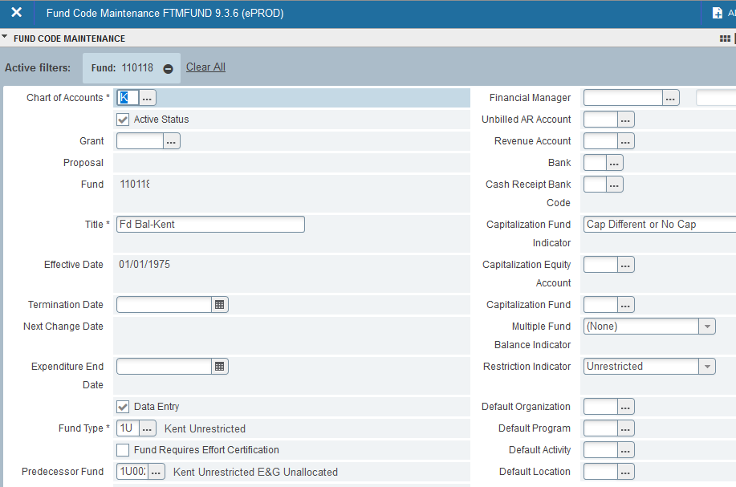
What is FOAP? Funds (continued)
FTMFUND is a helpful screen in Banner to find out more information about a specific fund and how it rolls up into the financials.

Slide 7
What is FOAP? Organizations
The organization field represents a department/budgetary unit within the University.
There are 7 levels of organizations: University, Campus, Executive, Division, Unit, Department, and the data-enterable level as the 7th level.
The organization code is a driver for approvals in many workflows and Flashcart.
6 digit field in Banner Finance, 1st digit indicates campus:
1 - Kent | 5 - Salem
2 – Ashtabula | 6 - Stark
3 – East Liverpool | 7 - Trumbull
4 - Geauga | 8 - Tuscarawas

Slide 8
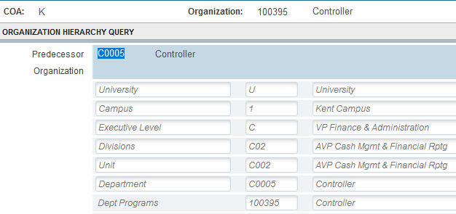
What is FOAP? Organizations (continued)
FTIORGH is a great Banner screen to see how a single organization rolls up within the University.
FGRORGH is a great Banner report to see how multiple organizations roll up within an Executive or Divisional Level.

Slide 9
What is FOAP ? Programs
A Program code classifies the expenditures by functional categories and is how we report on our Financial Statements.
Program Types:
1000 – Instruction & Departmental Research
2000 – Separately Budgeted Research
3000 – Public Services
4000 – Academic Support
5000 – Student Services
6000 – Institutional Support
7000 – Operation & Maintenance of Plant
8000 – Scholarship & Fellowship
9000 – Auxiliary Enterprises

Slide 10
What is FOAP? Accounts
An Account represents an individual asset, liability, equity, revenue, expenditure, or transfer classification.
Account Types (level 1):
10 – Assets (Balance Sheet Only)
20 – Liabilities (Balance Sheet Only)
50 – Revenues
60 – Labor Expenses
70 – Expenditures
80 - Transfers

Slide 11
What is FOAP? Accounts – Numbering Conventions
Revenue Account Types:
51 – Student Tuition & Fees
52 – Grants & Contracts
53 – Sales & Services
54 – State Appropriations
55 – Gifts
56 – Investment Income
57 – Other Revenue (non-operating)
Aligns with the categories on our financial statements.
Expense Account Types:
61 – Salaries & Wages
62 – Employee Benefits
71 – Travel & Entertainment
72 – Supplies
73 – Information & Communication
74 – Repairs & Maintenance
75 – Utilities
76 – Student Aid
77 – Miscellaneous
78 – Capital Expenditures
Used for Budgeting Purposes, but not reported this way on the Financial Statements.

Slide 12
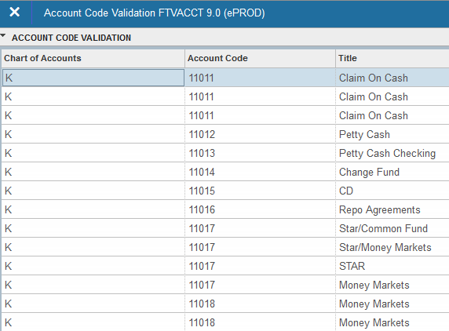
What is FOAP? Accounts (Continued)
FTVACCT is a helpful screen to use when deciding on an account to use:

Slide 13
Tying It All Together Indexes
Putting the Chart of Accounts Together (Example of a FOAP String):
Example of FOAP string: Dean, Arts & Sciences
100100 110118 - 100080 - 72017 - 4100
Index Fund Organization Account Program
Arts & Sciences Kent General Fund Dean – Arts & Sciences Office Supplies Academic Support

Slide 14
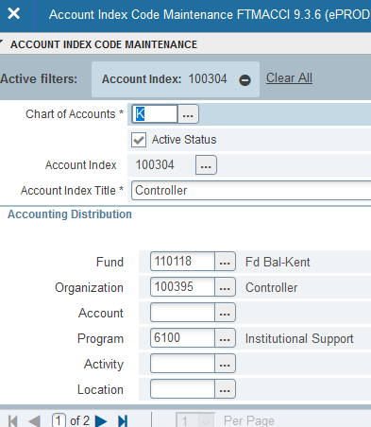
Tying It All Together Indexes
Banner Screen FTMACCI can assist in identifying any of these fields and how they relate to an Index(es).

Slide 15
Concluding Remarks
Working Paper Demonstration
Banner Screens Demonstration (Quick Guides for these screens can be found on the Controller's Office Website)
FTIORGH
FGRORGH
FTVACCT
FTMACCI
Questions?

Slide 16
Thank You!

