Slide 1
Kuali, Personnel Section

Slide 2
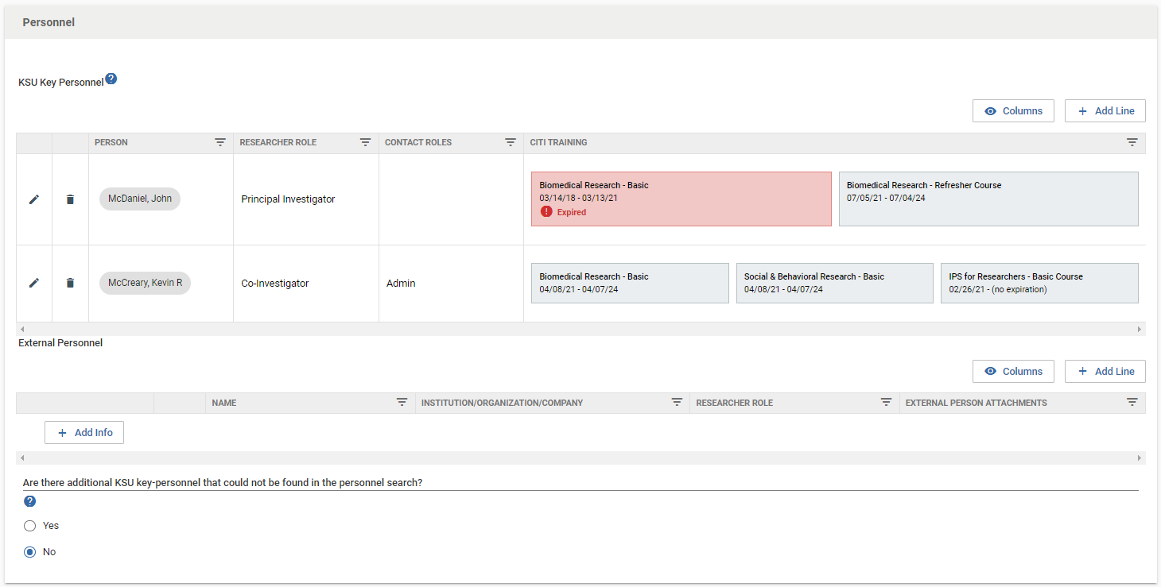
Personnel Section
Adding personnel
Research/Contact
Role
Permissions
CITI
External
KSU personnel not
auto filling

Slide 3
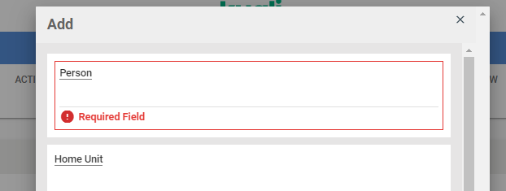
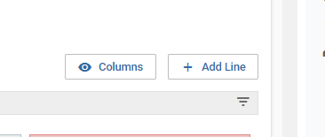
Personnel Section
Adding personnel
Additional personnel need to be added by clicking “+Add Line” then following the prompts.

Slide 4
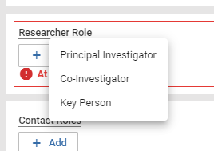
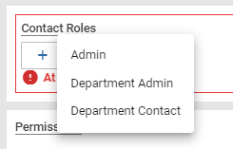
Personnel Section
Research/Contact Role
One option from either researcher role or contact role must be selected.
Selections do not play a significant role in IRB review other than researchers should not be listed as “Contact Role.”
Contact role is considered somebody that needs to be kept apprised of the research status but is not involved in the conduct of research procedures.

Slide 5
Personnel Section
Permissions
The designations are self-explanatory.
IMPORTANT – Full Access personnel are included on all protocol communications, Read-Only personnel are not.

Slide 6
Personnel Section
CITI
CITI should auto-fill. If it is not, one of the following are occurring:
CITI has not been completed.
CITI was not completed via KSU single sign on. Merging instructions are available on the training webpage.
CITI was completed through an external partner, such as a hospital.
There is a temporary error in the code that passes between CITI and Kuali. Logging out then back in or waiting until the next day typically resolves these issues.
If a CITI certificates does not appear, it must be uploaded.

Slide 7
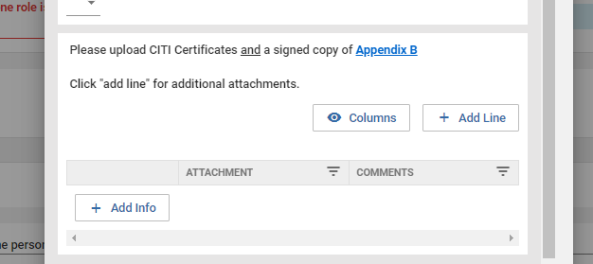
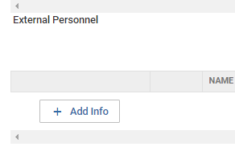
Personnel Section
External personnel
Appendix B must be completed and signed by the external investigator and uploaded.

Slide 8
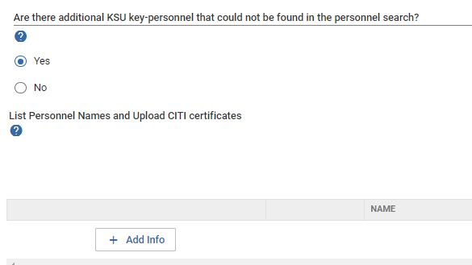
Personnel Section
KSU Personnel not auto filling
All current employees and students should auto-fill in the previous section. If they do not, manually add them by selecting yes and responding to the prompts.
Personnel listed in this section will not receive notification emails or be able to access the protocol. A printed copy should be provided.

Slide 9
Thank You.
www.kent.edu

