Slide 1
Kuali, Consent and Recruitment Sections

Slide 2
Consent and Recruitment Sections
Overview
Uploading
Stamped consent forms
Accessing forms

Slide 3
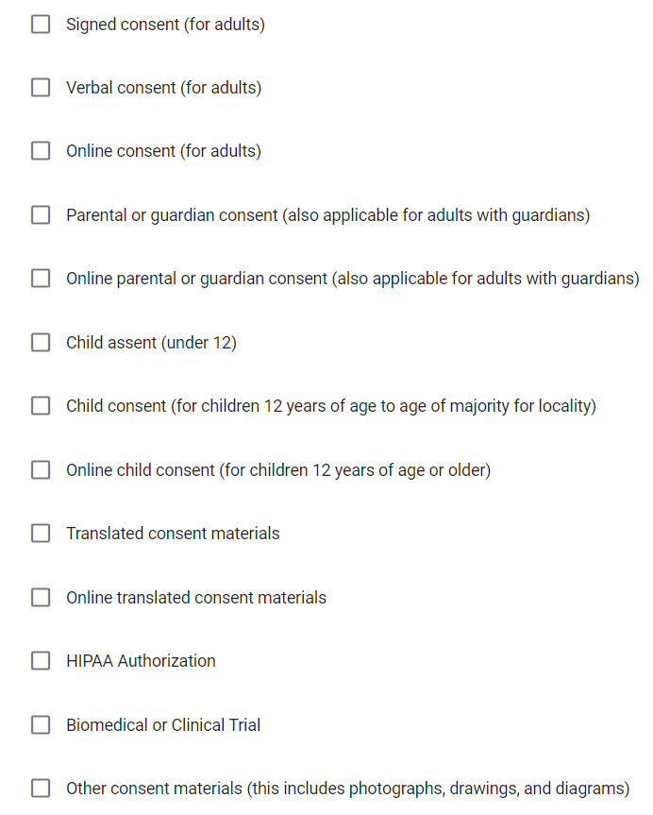
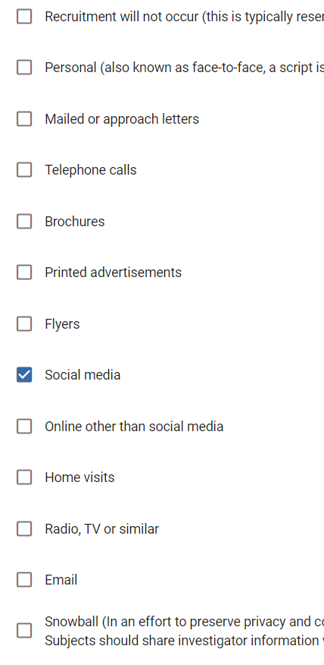
Consent and Recruitment Sections
Overview
Templates and help documents can be accessed via the in form links.
Select all the that apply.
Be prepared to upload the materials

Slide 4
Consent and Recruitment Sections
Uploading
Documents can be uploaded just as they are for any other online form.
Each selection will have a dedicated upload.
Make sure to upload forms that correctly correspond with the selections.

Slide 5
Consent and Recruitment Sections
Stamping consent forms
If you want to use a consent form that is stamped with approval information you MUST upload a PDF version of your consent materials.

Slide 6
Consent and Recruitment Sections
Accessing forms
All recruitment materials and consent forms should be retrieved from Kuali. This reduces the likelihood of using an incorrect recruitment or consent document.
Open by clicking the attachment

Slide 7
Thank You.
www.kent.edu

