Slide 2
Updated Position Control Form and Strategic Hiring Process Fall 2021
Presented by:
Human Resources
Office of the Provost
University Budget Office

Slide 3
Strategic Hiring History and Improvement Process
Personnel is the largest expense of the university.
70% of the university’s budget is comprised of salaries and fringe benefits.
Effective August 1, 2017, the Strategic Hiring Committee (SHC) was implemented.
The committee reviews all position requests for the university.
Position review by the SHC is the university’s permanent process for approving positions.
In 2021, the SHC tasked a subcommittee led by Human Resources, the Office of the Provost and the University Budget Office to develop a more effective and efficient process.
The SHC subcommittee reviewed all versions of the position control form and gathered feedback from many campus units and campuses.

Slide 4
Improvement Process Priorities
Added Financial Controls
Senior unit/department budget officers have been added to the workflow and approval.
Streamlined Process
Better defined process and procedures.
Training resources.
New website.
SHC email inbox.
Standardization of Position Control Form
The new PCF excel form replaces all previous forms used for Strategic Hiring.
One form for the entire university.

Slide 5
Position Control Form
Previously, there were many versions of the Position Control Form used by divisions and colleges for Strategic Hiring Committee (SHC) review.
The first step for improving this process was to standardize the Position Control Form (PCF).
Position information has been formatted in an easily read, standard format. This allows the SHC to make better informed decisions in an efficient and effective manner.
Position information, budget data and concise rationale.
Supported by organizational charts and relevant documentation from requesting unit.

Slide 6
2021 Position Control Form (PCF)

Slide 7
Header Section
Fill in the blanks for campus, division and college/unit pertaining to where the request originated.
Example:
Campus: Trumbull
Division: Regional Campuses
College/Unit: Admissions
Fill in the blanks showing who is completing this form.
Example:
Print Name: Jane Doe
Date: 11/10/21

Slide 8
Header Section

Slide 9
Gold Section – Current University Employees
The gold section is to be used for changes to current university employees.
Proposed Promotion, Salary Adjustment, Temporary Assignment, Supplement, New Position Request.
Lines within gold section are lettered to allow users to track positions across both areas of this section (Original and Proposed Position).
Example:
Admissions Coordinator is promoted to Admissions Director.

Slide 10
Gold Section – Current University Employees

Slide 11
Blue Section – New Employee Actions
The blue section is to be used when filling vacated positions and/or repurposing positions.
Lines within blue section are numbered to allow users to track positions across both areas of this section (Original and Proposed Position).
Example:
Admissions Assistant leaves the university and the unit is seeking to fill the position.

Slide 12
Blue Section – New Employee Actions

Slide 13
Position Rationale
The position rationale is intended for university units to provide a brief rationale/justification for the position(s) requested.
Rationale prompts: Define the need for position; position purpose; efficiency/savings; revenue potential; professional body/accreditation standards; legal compliance requirement.
Limit rationale to one paragraph per position.
Add further definition to position’s funding structure (Index, Account, and Position Number);
If applicable, include anticipated start-up package costs.
For internal promotions, please attach separate process documents.
Completed Salary Offer Worksheet (SOW) must be attached.
All waiver of posting requests should first be reviewed by the Affirmative Action/Equal Employment Opportunity department in Human Resources.
Internal promotion requests should include list of individuals considered for the opportunity and information regarding the process used to determine who was awarded the opportunity for promotion.

Slide 14
Position Rationale

Slide 15
Approvals
Required Approvals for Submission:
Senior Unit/Department Budget Officer
Chair/Department Lead
Dean/Unit Leader
Vice President
New to the approval SHC process is the additional requirement of unit budget officers to approve position requests.
Each unit’s senior budget officer will be held responsible for verifying the position record within Banner prior to it advancing within the strategic hiring process.
Electronic signature is acceptable.
The Strategic Hiring Committee will complete their section at the bottom of the form.

Slide 16
Approvals

Slide 17
Additional Documentation
With your submission, please include the following items (when applicable):
Completed Salary Offer Worksheets which have been approved by Human Resources.
Draft job description which has been reviewed by Human Resources, for any new titles requested.
Organizational charts showing the before and after changes to the requesting unit.
Relevant supporting documentation.
Examples: grant approvals, emails from unit leadership, start-up plans.

Slide 18
Submitting Position Control Forms (PCFs) for Review
Unit route PCFs internally for approvals.
Email to SHC Inbox
Units are to send all completed PCFs to the Strategic Hiring inbox at the following address: strategic_hiring@kent.edu
Emails sent to this inbox are monitored by staff in Human Resources, Office of the Provost and the University Budget Office.
Human Resources and University Budget Office will then review and forward to the SHC.
SHC Prep Team Review and Preparation for SHC Review
The SHC Preparation Team organizes all position control forms and sends all information to the Strategic Hiring Committee prior to the meetings.
Meetings generally occur twice a month.

Slide 19
Due Dates
Position control forms are due to Strategic Hiring inbox (strategic_hiring@kent.edu) by noon on the Wednesday prior to the SHC meeting.
A list of the SHC meetings for the semester are published on the Strategic Hiring website.
Dates are subject to change due to SHC availability and university closures.

Slide 20
Final Determination Process and Notification
The SHC renders a final decision on all position control forms at the SHC meetings.
Position control forms are returned to the requesting unit within a week of the final determination.
Upon receiving approval, units will be informed by email notifying them of next steps.
Types of workflows: PRA (post position), ETW (to change elements of the position).
Some position control forms require additional steps as outlined by Human Resources or require additional work to be performed by the requesting unit.

Slide 21
Online Resources
www.kent.edu/hr/strategic-hiring
Position Control Form.
Samples of completed Position Control Forms.
Examples provided for many types of PCFs.
FAQs.
Outline of SHC Process.
Due Dates.
Training Videos.

Slide 22
Future Enhancements
The development of an online workflow.
Strategic Hiring Prep Team, I/T and Lean team to be involved.
Linking position control form workflow with other relevant workflows to cut down on repeated approvals for the same position.

Slide 23
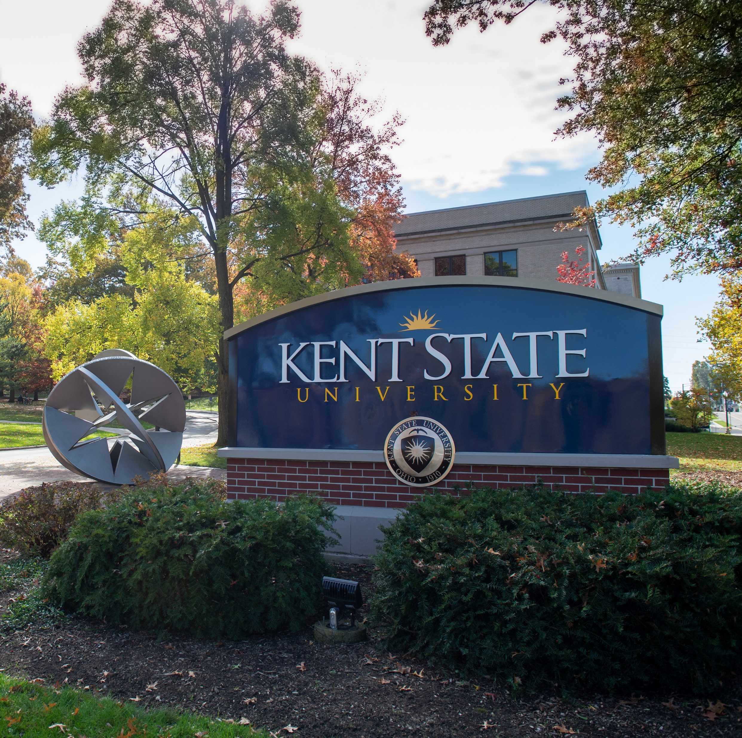
Contact Us
Website: www.kent.edu/hr/strategic-hiring
Email: strategic_hiring@kent.edu

Slide 24
Thank You.
www.kent.edu

