Slide 1
IDC & COR Entries December 17, 2020

Slide 2
Presentation Format - Teams
Please mute your computer, if you aren’t already.
Please ask any questions through the Conversation within the Teams meeting:
We will answer as many as we can in between the presentation and live demonstration. You can also reach out to me afterwards for anything not covered.

Slide 4
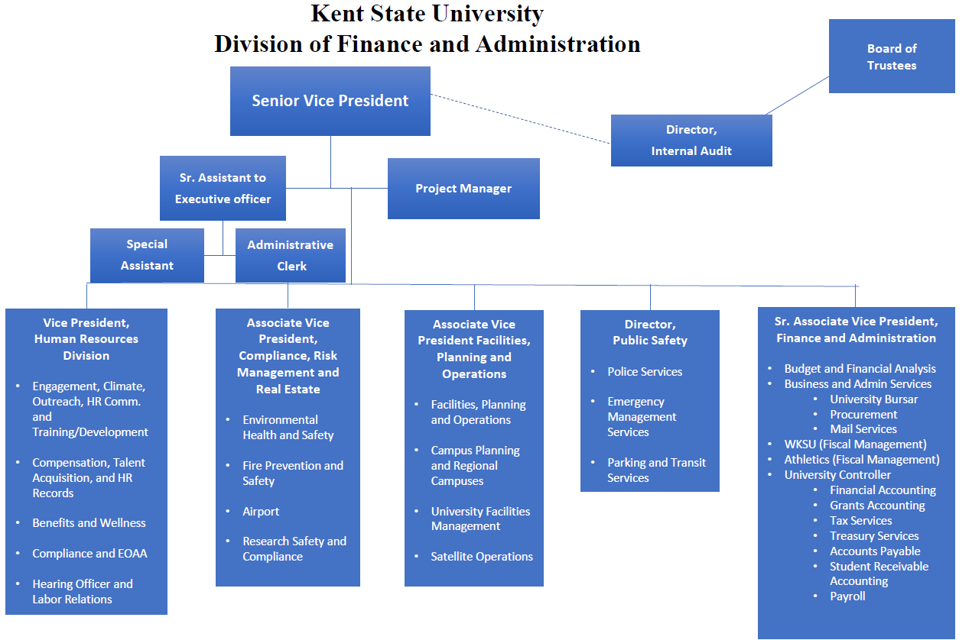

Slide 5
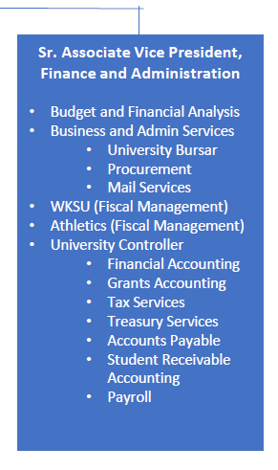

Slide 6
Internal Transactions
Between two or more KSU units – No cash exchanged.
KSU will never issue payment internally via Accounts Payable.
The Foundation is treated as an external customer.
IDC & COR transactions

Slide 7
Interdepartmental Charges (IDC)
Internal billing transactions for goods or services provided by the billing department.
Goods & Services provided must be provided in the natural course of business.
Ex. Parking Services selling parking passes.
Ex. Police Services providing security.
Ex. Residence Services providing guest housing.
Ex. Student media selling ad space.

Slide 8
Interdepartmental Charges (IDC) (Unrestricted Units)
E&G Indexes, Designated Indexes, Plant Indexes
Must not increase or decrease overall University expenditures.
Expense Account for both Debit & Credit sides.
Accounts 77020 (Goods) or 77201 (Services).
Should be initiated by billing department.
Prefer that 77032 not be used on debit side.

Slide 9
Interdepartmental Charges (IDC) (Unrestricted Units)
Example - Fire Safety Services (101230) performs a fire safety inspection of the Controller’s Office (100304) and replaces an expired fire extinguisher:
Inspection: D 100304-77201 $100
C 101230-77201 $100
Extinguisher: D 100304-72020 $25
C 101230-77020 $25

Slide 10
Interdepartmental Charges (IDC) (Auxiliary Units)
Since Auxiliaries are self-supporting or business-type enterprises (their expenditures should not exceed revenue), they should recognize IDC sales as revenue.
Account 53086 was created for IDC-Revenue (goods & services).
Example - The Controller’s Office (100304) rents a basketball court at the Rec Center (334000) for an afternoon:
D 100304-74103 $500
C 334000-53086 $500

Slide 11
Interdepartmental Charges (IDC) (Agency Units)
Self-supporting, business type enterprises, should recognize revenue from IDC trannsactions.
3rd Party to the University – Set up to benefit from University services (AP, Procurement, etc.)
University is a custodian/fiscal agent for the organization, but does not have ownership over the funds.
May still utilize transaction type IDC, but cannot truly have an internal transaction with a 3rd party. Caution should be used crediting agencies.
Do not use 53086, 77020, or 77201 on either side of the entry.

Slide 12
Corrections & Reimbursements (COR)
The COR rule class was created to differentiate between true sales and corrections or cost allocations.
Can be used to move revenue or expenditures.
Used when moving a specific existing revenue or expenditure(s):
Corrections
Reimbursements (full or partial)
Allocations

Slide 13
Corrections & Reimbursements (COR)
Example – The Controller’s Office (100304) used their P-Card to order $250 worth of Paper for the Bursar’s Office (100303) and $250 worth for themselves (total order = $500). To charge the Bursar’s Office for their share of the order, the following COR entry would be made by the Controller’s Office:
COR Debit 100303-72017 $250
COR Credit 100304-72017 $250

Slide 14
Corrections & Reimbursements (COR) Special Considerations
COR entries will not be approved until original transaction(s) have posted to Banner Finance.
Offset should post to the same Index-Account as original transaction.
Cannot be used on Grant or Cost Share indexes (use CTW).
Cannot be used to move labor or benefits (use SRW).
Cannot move encumbrance or budget dollars.

Slide 15
Corrections & Reimbursements (COR) Special Considerations
Contact the Controller’s Office and provide a very detailed document text for non-offsetting transactions to 78011 or 78013 (Inventory tags are created).
General transfers of funds or “sponsorships” are not permitted via COR. COR entries are intended to move/correct specific existing charges. In the event of a transfer/sponsorship, please utilize a budget revision. A common example of this situation would be multiple departments co-sponsoring an event before the event takes place.

Slide 16
Internal Transactions Grants
CORs are never allowed to be keyed to Grants.
IDCs are rarely allowed to be keyed to Grants.
In most cases, the original transaction must first be keyed to the home department and moved to the Grant index via the Cost Transfer Workflow.
Contact Grants Accounting for more information.

Slide 17
Keying IDCs or CORs
Both are keyed on FGAJVCM or FGAJVCQ in Banner, the difference is what you type into the journal type.
Quick guides on using these Banner screens are available on both the Controller’s website and BAS website.
Call the Controller’s Office if you need any further assistance!

Slide 18
Any Questions?

Slide 19
Q & A – Highlights (unrecorded)
It does not matter which line is keyed first, the debit or the credit, so long as the debit lines balance with the credit lines.
Document Text (FOATEXT) – this is helpful for adding additional information to assist the various stakeholders of your entry (budget managers, entry approvers, etc). The description line on the entry itself is limited to 35 characters and this is the description that will appear in the Banner reports, but FOATEXT offers unlimited lines to further describe the transaction, offer breakdowns of amounts, or other identifying information that may be helpful when reviewing the transaction. Use the down arrow on your keyboard to add additional detail lines.

