Slide 1
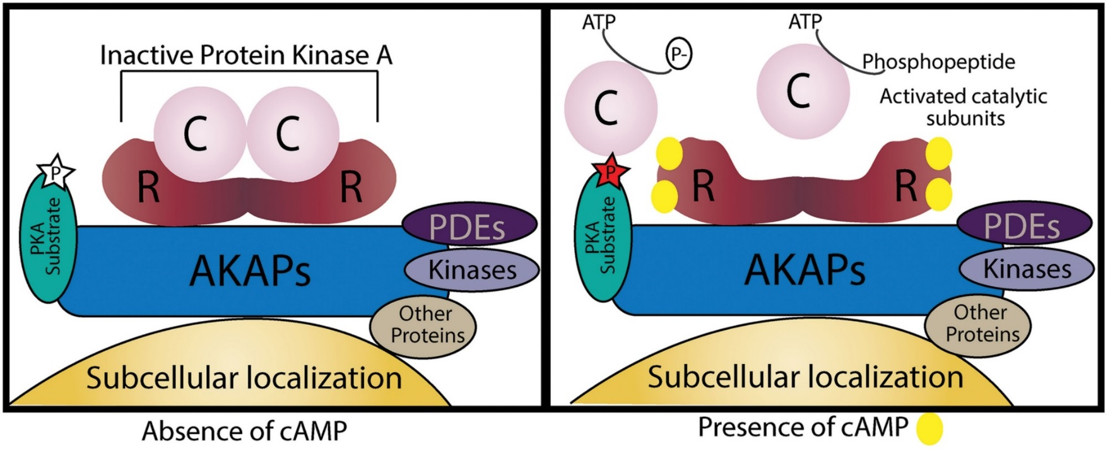
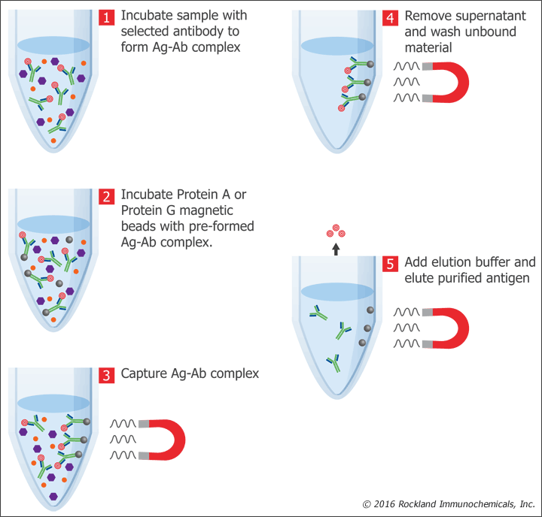
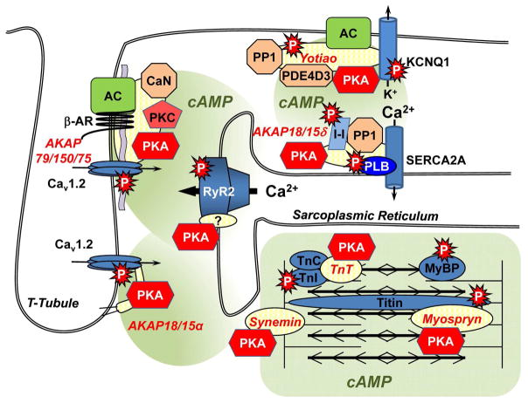
Co-immunoprecipitation of β-synemin and PKCε
Destiny Smith*, Madison Bonekovic*, and Mary Russell¥
*Kent State University at Trumbull, College of Nursing, Warren, OH
¥Kent State University at Trumbull, Department of Biological Sciences, Warren, OH
Overarching Goal of the Lab
Background continued
Rationale
Figures continued
In mammalian striated muscle, synemin is expressed as two predominate splice variants: α-synemin and β-synemin. Alpha-synemin contains a 312 aa insert near the tail that is lacking in β-synemin (Fig. 1). In contrast, avian synemin is expressed in only one isoform most similar to α-synemin. Thus, our goal is to determine the functional difference between α- and β-synemin. Two main approaches have been used:
To determine α- and β-synemin localize to different locations
To determine α- and β-synemin have different binding partners
A kinase anchoring proteins (AKAPs)…
Bind PKA (Figs. 2&3)
Target to specific subcellular locations (Figs. 2&3)
Localize AKAP/PKA complex on or near PKA substrate (Fig. 3)
Scaffold multi-protein complex containing additional signaling proteins (Figs. 2&3)
PKCε…
Upon activation by various stimuli, translocates to specific subcellular locations
Including sarcomeres in muscle cells
If β-synemin and PKCε are binding partners in vivo, it is expected that when the cells are lysed and β-synemin is pulled out of the lysate using antibody that specifically binds β-synemin, PKCε should also be a member of the protein-antibody complex and be co-IPed with β-synemin.
We are testing (1) if they are binding partners (we have preliminary data to support this theory).
And (2), if they are binding partners, do they bind when the β-adrenergic pathway is (plus isoproterenol) or is not (minus isoproterenol) stimulated.
Figure 3. Schematic illustration of PKA activation and anchoring by an AKAP.
Adopted from : Caleijo AI and Tasken K (2015) Front Pharmacol. 6:192. doi: 10.3389/fphar.2015.00192
Aim of this study
Figures
To determine β-synemin is able to bind PKCε
Methods
α-synemin
Transfect SW13 cells cDNA encoding:
Control, empty vector
ECFP-β-syn-P
ECFP-β-syn-WT
48 hours after transfection, treat cell with or without isoproterenol
This will act to stimulate the β-adrenergic receptor
Lyse open cells
Inhibit endogenous proteases
Carry out co-immunoprecipitation (co-IP) (Fig. 4)
Carry out a Western to separate proteins that are co-IPed based on size and visualize them
β-synemin
Background
Figure 1. Schematic of synemin. Both synemin isoforms contain a very short head domain (10 amino acids), a rod domain (310 amino acids, light blue box) allowing it to form polymers with type III IF proteins, and a very long C-terminal tail classifying it as a type IV IF protein. Both also contain a PKA binding domain (dark blue box) classifying it as an AKAP. The 312 amino acid insert in the C-terminal tail (aa 1151-1462, yellow box) is lacking in β-synemin and the only difference between the two isoforms.
Synemin…
Functions as intermediate filament (IF) protein, forms heteropolymers
Thus it binds to other IF proteins
Functions as an A-kinase anchoring protein (AKAP)
Binds PKA
Targets to multiple subcellular locations (Fig. 2)
Protein kinase A (PKA)…
Activated by cAMP (Fig. 3)
In a given cell type, multiple receptors signal through cAMP
Each results in targeted (different) PKA substrate phosphorylation events
Figure 4. Schematic illustration of Immuno-precipitation with magnetic beads.
Adopted from : Rockland Immunochemical Inc
Future Directions
If β-synemin is able to bind PKCε:
Determine if α-synemin is also able to bind PKCε
Localize binding region of PKCε on synemin
Determine if PKCε bound to synemin is active or inactive at this location
Contact Information
Corresponding author:
Mary Russell
4314 Mahoning Ave. N.W.
Warren, OH 44483
mrussel1@kent.edu
330-675-8913
Figure 2. Schematic illustration of AKAPs in cardiac muscle cells.
Adopted from : Kritzer KD et.al., (2012) J Mol Cell Cardiol. 52(2)351. doi: 10.1016/j.yjmcc.2011.05.002.
Notes:
Colors and background can be changed to match the theme of the project. Hight of slide MUST be 42 inches to fit the campus poster printer, the width can be changed to fit needs of the project. To do this, select “design” tab, and click on “slide size” and then choose “custom slide size.”

