Slide 1
Kuali, Admins
Managing a protocol review

Slide 2
Reviewer Resource
Step by Step:
Submission received
Assigning reviews
Levels of review
Preparing and returning reviews
Approving
Admin notes
Manage protocols
Kuali Zendesk

Slide 3
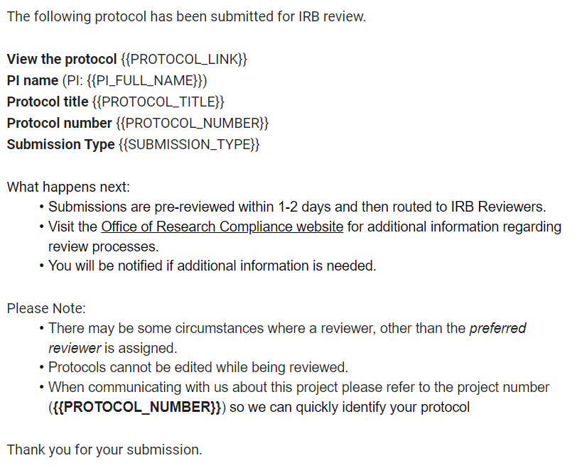
Managing the review process
Submission received
Look for the notification in your email OR
Regularly review “Needs attention”
You will be assigned as an admin by ORC student assistant
The processes are the same regardless of the application type (many IRB CR, amendments and closures can be administratively reviewed and a reviewer does not need to be assigned)

Slide 4
Managing the review process
Dashboard
The dashboard lets you know when a new submission is received, a review has bene submitted, and when a PI has resubmitted.
From here you will process protocols for which you are the Admin
NEW- this indicates when a new submission is received.
RETURNED BY REVIEWER – this indicates at least one reviewer has submitted their review
RESUBMITTED – this indicates the PI has resubmitted

Slide 5
Managing the review process
Dashboard- some limitations
NEW- protocols will stay in this status until a review is submitted and when a protocol is assigned full board review.
RETURNED BY REVIEWER – protocols will stay in this status until you return comments to PI.
Solutions:
Email rules can be created and used to track review status. When creating a rule, you can use unique subject lines in the notifications.
A paper “cheat sheet” can be created.

Slide 6
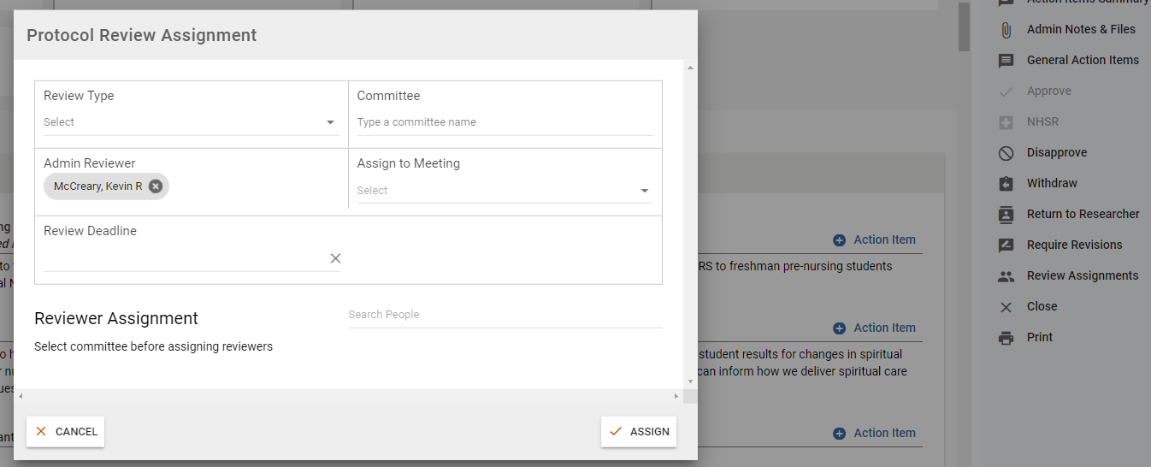
Managing the review process
Assigning reviews
Open the protocol – click review assignments
Complete the information and click “assign.”
Review type may be unknown until the review is assigned, set the deadline to two weeks.
Assign to a meeting is not known until approved or designated as full board.
IRB: the reviewer is noted in the protocol, but you must consider the reviewer expertise and their current review volume.
Select the committee, then assign primary reviewers in the section below

Slide 7
Managing the review process
IRB only
Exempt
Admin and one member
Expedited
Assign to IRB Chair after admin and one member has entered comments. Ensure the Chair can see comments by clicking assigned reviewers in the review panel (see slide 9).
Full Board
Manage per slide 11
Infrequently an additional reviewer may be needed
Revised protocols are reviewed administratively unless a member wants to see the revised version

Slide 8
Managing the review process
IBC only
Expedited
3 members are mandatory reviewers.
Community reps are always assigned as optional.
Full Board
Manage per slide 11
Revised protocols are re-reviewed by reviewers. A submitted review without comment is considered a vote for approval.

Slide 9
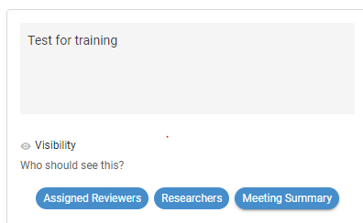
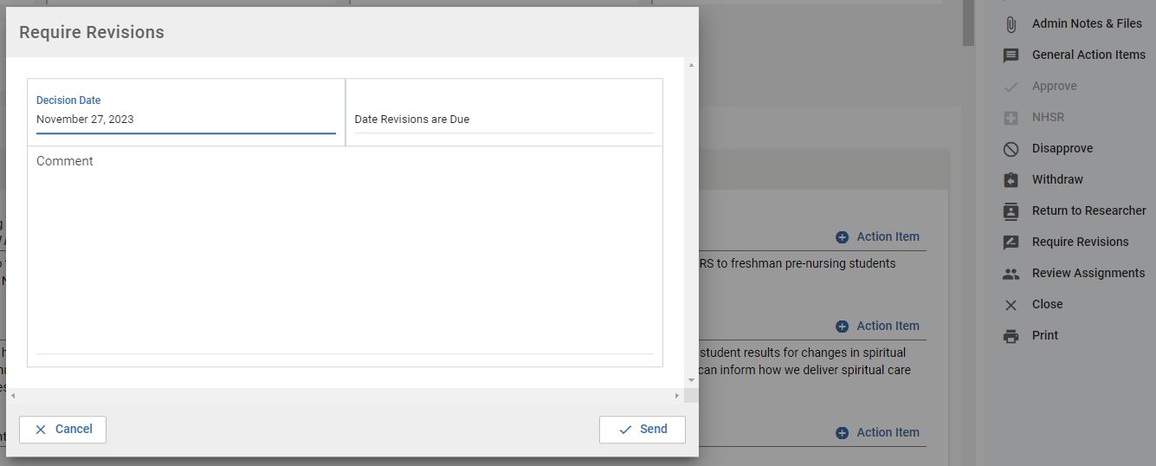
Managing the review process
Preparing and returning reviews
Return the review to the PI once all reviewers have submitted their review.
Make sure comments are visible by clicking researchers.
Click require revisions, add comment and due date if applicable, then send.

Slide 10
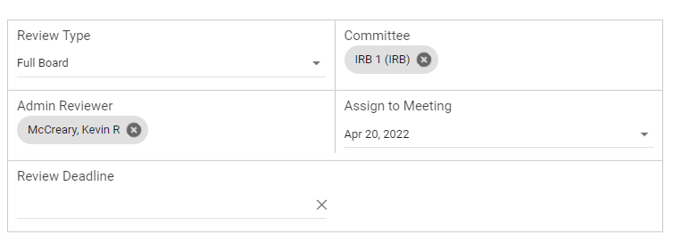
Managing the review process
Full board review
Make sure comments are visible by clicking “meeting summary.”
Assign the protocol to a meeting by assigning a Committee, Review type as Full Board, and the review date.

Slide 11
Managing the review process
Full board review
Members can enter their comments in the same way as any other review.
IRB
send the direct link to the protocol (along with Teams link) ~5 business days prior to the meeting.
During the meeting:
Prepare protocols for review and any other relevant materials in advance by opening them.
Click “start meeting”
At the end of the meeting, click “end meeting”
After the meeting – if not approved, add comments to the Admin Notes section and notify the PI when available to edit and where to access comments. This restarts the review process based on the vote

Slide 12
Managing the review process
The cycle repeats until all comments are addressed
IBC – see slide 6. Reassigning reviews is a repeat of making the initial assignment.

Slide 13
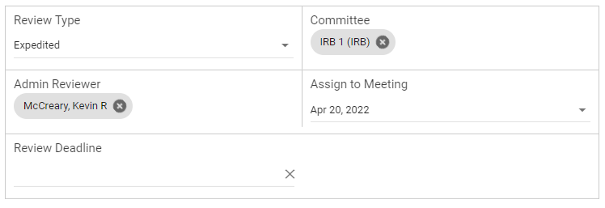
Managing the review process
Approving (or issuing a different determination)
As comments are addressed, click “resolved.”
Once all comments are resolved, ensure an agenda and “review type” is selected.

Slide 14
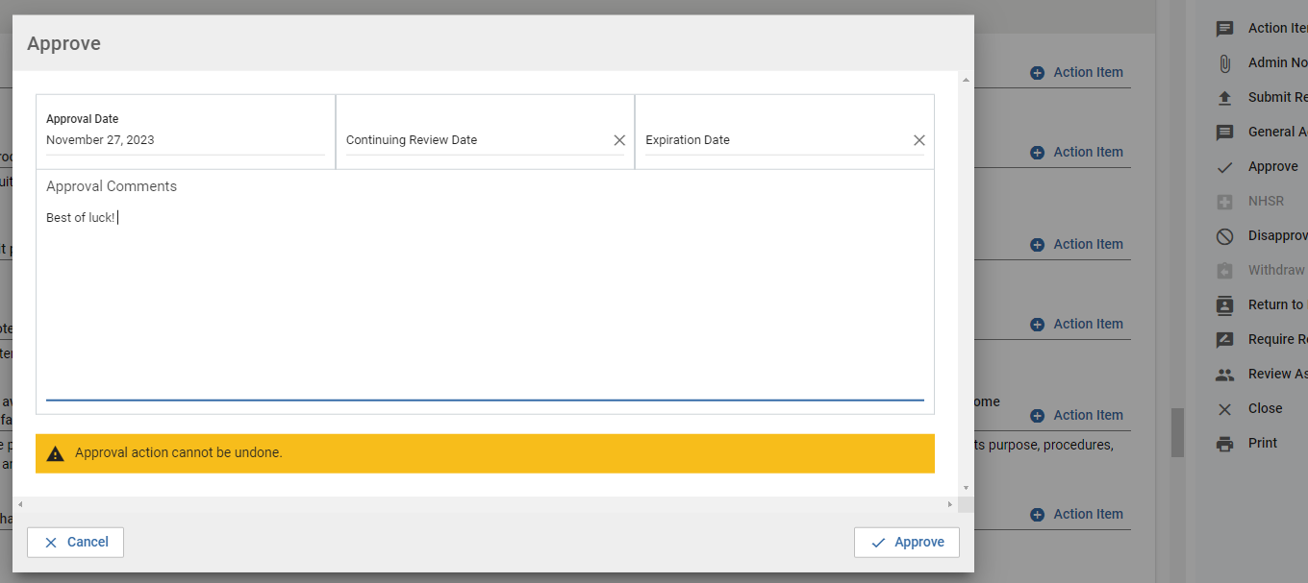
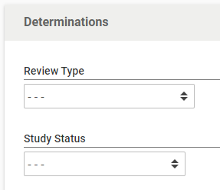
Managing the review process
Approving (or issuing a different determination)
Set “determinations.” Only applicable for IRB
Once all comments are resolved, click “approve” and enter any approval comments and set expiration dates, then click approve in the comment box.

Slide 15
Managing the review process
Approving (or issuing a different determination)
IRB expiration dates are as noted below unless a more frequent date is requested by a member/Board
Exempt – 5 years
Expedited – 3 years
Full board – 1 year
IBC expiration dates are always one year.
Continuing reviews must be approved prior to the expiration dates – researchers are advised to submit at least 6 weeks in advance.

Slide 16
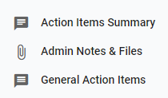
Managing the review process
Admin notes
Admin notes and files can be used to document conversations about the protocol or upload relevant files that may not be part of the protocol, this includes email correspondence and full board notes.
Notes and files can be made visible to the research team.

Slide 17
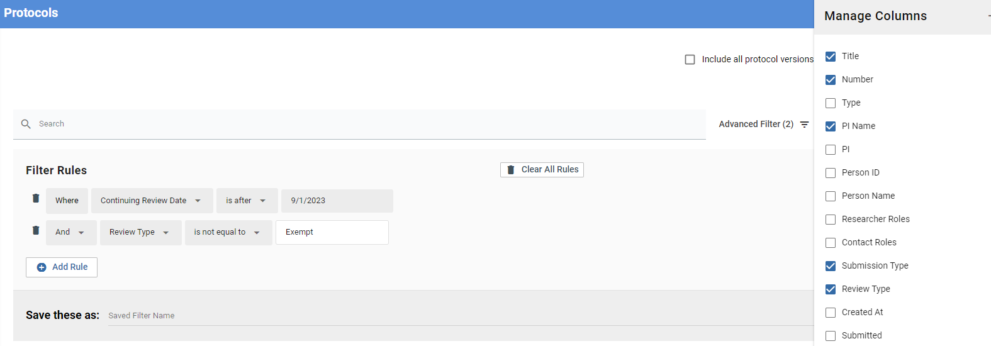
Managing the review process
Manage protocols
This acts your log and allows you to look for specific protocols as well as protocols in various statuses and any metric generating response.
Searches can be conducted using the “Search” bar, “Manage Columns,” and “Advanced Filters,” the latter can be used in combination.

Slide 18
Managing the review process
Kuali Zendesk
This is a solution database. Customer service can also be contacted by logging in – the protocols contact is Kevin McCreary.
https://kuali-research.zendesk.com/hc/en-us

Slide 19
Thank You.
www.kent.edu

