Slide 1
Kuali Overview for Researchers

Slide 2
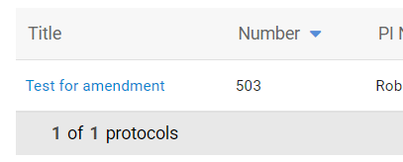
Accessing the protocol
Log into Kuali and open the protocol that needs to be amended

Slide 3
Important information to know
A PI can delegate anyone with Full Access (as designated in the original approval) to complete the amendment.
Only the PI can click the submit button!

Slide 4
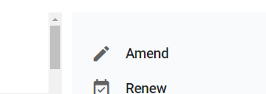
Completing the amendment
Once the protocol is open click the amendment button.

Slide 5
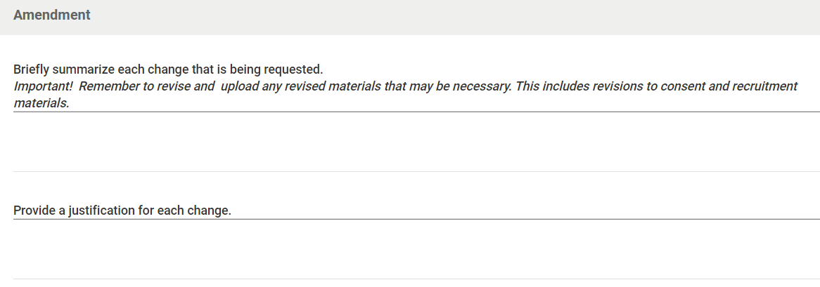
Completing the amendment
Respond to the both prompts.

Slide 6
Completing the amendment
Scroll to the protocol and revise the necessary fields.
If needed, be prepared to upload revised supporting documents such as consent or recruitment materials.

Slide 7
Creating a protocol
Submitting
Only the PI can click “Submit”
Delegate clicks “Notify PI To Submit”
PI logs in, reviews protocol and edits or submits
PI reviews protocol, signs, then clicks “Submit”
Notification email and review starts

Slide 8
Thank You.
www.kent.edu

