Slide 1
Kuali, IRB Members
External Members

Slide 2
IRB Member Resource
Step by Step:
Review notification
Log in
Reviewing a protocol
Finalizing a review
ORC/Chair Actions
Special circumstances
Support

Slide 3
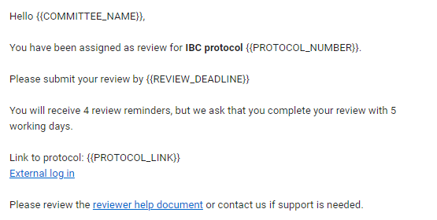
IRB Member Resource
Review notification
Look for the notification in your email.
You will receive 4 reminder emails.

Slide 4
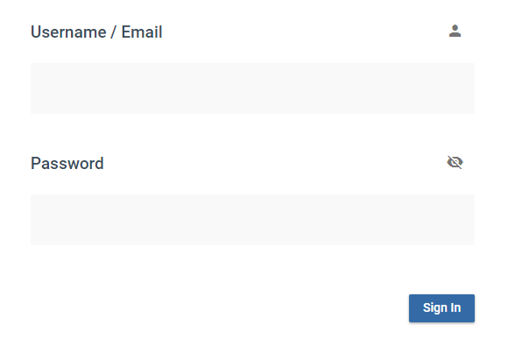
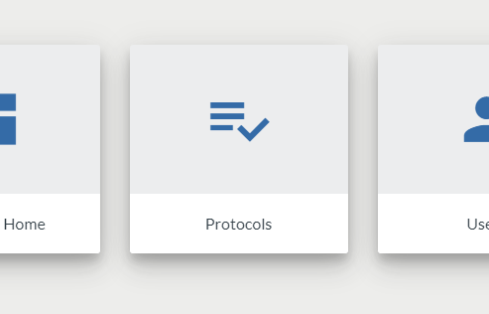
IRB Member Resource
Log in
Click external log in
Enter your assigned credentials
Click Protocols

Slide 5
IRB Member Resource
Access the protocols

Slide 6
IRB Member Resource
Complete the review as noted at the link below:
https://www.kent.edu/research/office-research-compliance/kuali-irb-member-ppt

Slide 7
Thank You.
www.kent.edu

