Slide 1
Kuali, IRB Members
For IRB and IBC Members

Slide 2
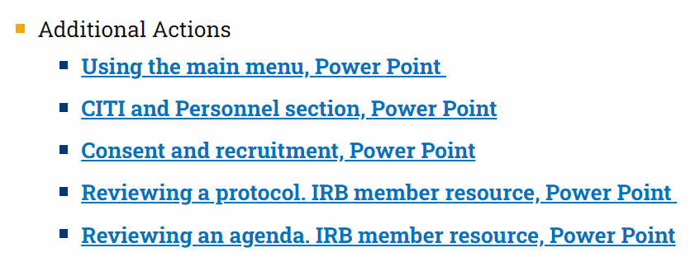
Reviewer Resource
Step by Step:
Review notification
Reviewing a protocol
Finalizing a review
ORC/Chair Actions
Reviewing revisions
Special circumstances
Access this PowerPoint
Visit: https://www.kent.edu/research/office-research-compliance/kuali-irb-application-and-help-docs

Slide 3
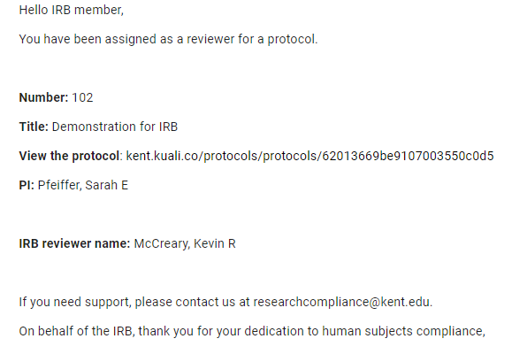
Reviewer Resource
Review notification
Look for the notification in your email.
Click “view the protocol” to start your review.
You will receive 4 reminder emails.
IBC: reviews are to be submitted within 14 days.
IRB: reviews are to be submitted within 5 working days.

Slide 4
Reviewer Resource
Review notification
You can also access protocols to review by selecting “Protocols Assigned to Me.”

Slide 5
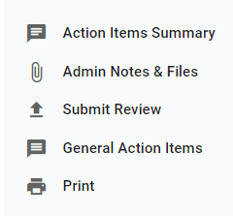
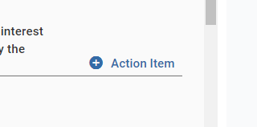
Reviewer Resource
Reviewing a Protocol
Comments are entered in two ways:
Select “Action Item”
Select “General Action Item”

Slide 6
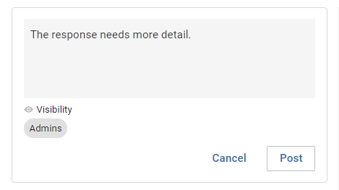
Reviewer Resource
Reviewing a Protocol
Action Items
Action Items are for addressing individual questions.
Click Action Item→ add the comment→ click Post
This comment may be too broad. What about the response needs more detail?

Slide 7
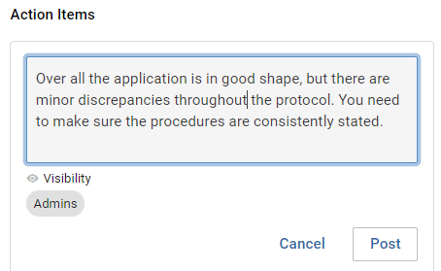
Reviewer Resource
Reviewing a Protocol
General Action Items
General Action Items are for overall comments to the PI and Admin/Chair.
Click General Action Item→ add the comment→ click Post
There are several inconsistencies in the description of the procedures (see parts...). Please ensure the procedures are consistently stated.
Being direct and concise helps everyone

Slide 8
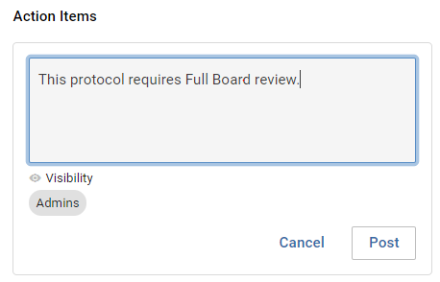
Reviewer Resource
Reviewing a Protocol
General Action Items can also be used to:
Request Full Board (Level III) review
Exempt (Level I approval) a protocol for which the PI completed a Level II/III application
Request to see the revised application.
IBC: any revised protocols for which you comment is returned to you for additional review (see slide 12).
Submitting your review without comment is considered your approval.

Slide 9
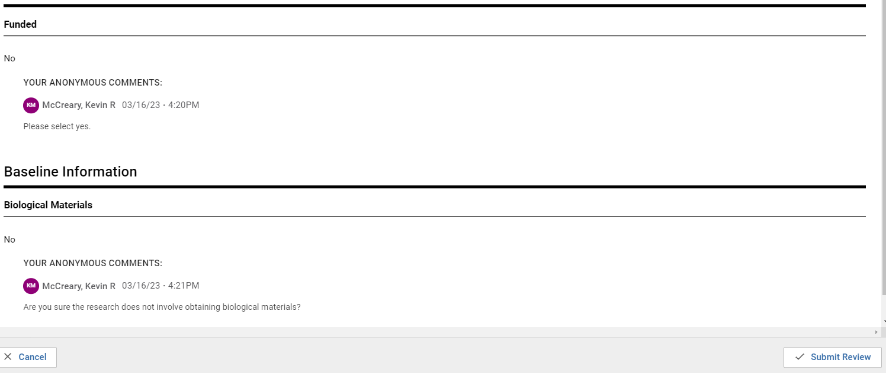
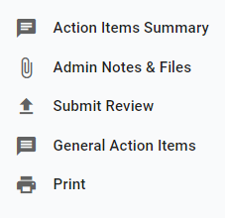
Reviewer Resource
Finalizing a Review
Click Submit Review (right-hand column)
Review your comments (in the pop-up window)
Click Submit Review again
The review is submitted!

Slide 10
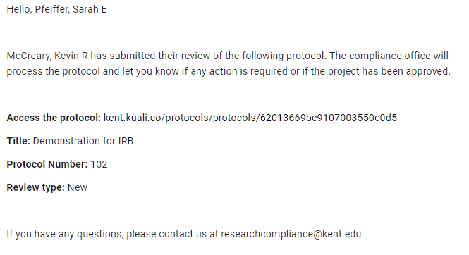
Reviewer Resource
Finalizing a Review
You will be copied on the notification to the researchers

Slide 11
Reviewer Resource
Admin/Chair Actions
Admin
Researchers cannot see comments until the Admin releases them.
IRB: ORC will complete the review unless you request to see the revised protocol.
Request to see the revised protocol by using the “General Action Items”
The IRB Chair will review all Level II IRB submissions prior to comments being released to the PI. IBC Chair reviews all IBC protocols.
IBC: comments are released after all 3 reviewers have submitted their review.
Review cycle continues until all 3 approve or a motion for full board.

Slide 12
Reviewer Resource
Reviewing a revised application
Same notification and reminders as noted in slide 3
Compare versions (compares 2 newest versions by default)

Slide 13
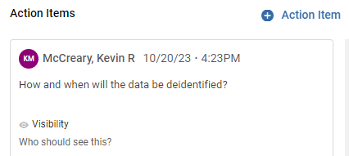
Reviewer Resource
Reviewing a revised application
Passive approach- no comment means the Action Item was addressed – you can include notes in General Action items
To seek further clarification, use the Action Item to state the comment was not addressed.
Review submission process is the same as noted on slide 9
This may be an opportunity to refine or clarify Action Items

Slide 14
Reviewer Resource
Special Circumstances
Sometimes a review may require the reviewer to become more engaged. The following are some tips:
Ask to be added as Personnel and enter the protocol yourself. Using this option, you’ll be able to enter text into the fields.
Meet with the PI via Teams, telephone, or face-to-face.
Email the PI.
Ask us for help.
It is often important to document offline conversations – they may be noted in the Admin Notes section

Slide 15
Thank You.
www.kent.edu

