Slide 2
Kuali Overview for Student Researchers

Slide 3
Overview
What is Kuali E-Protocols
Creating an application
Submitting an application
Other resources

Slide 4
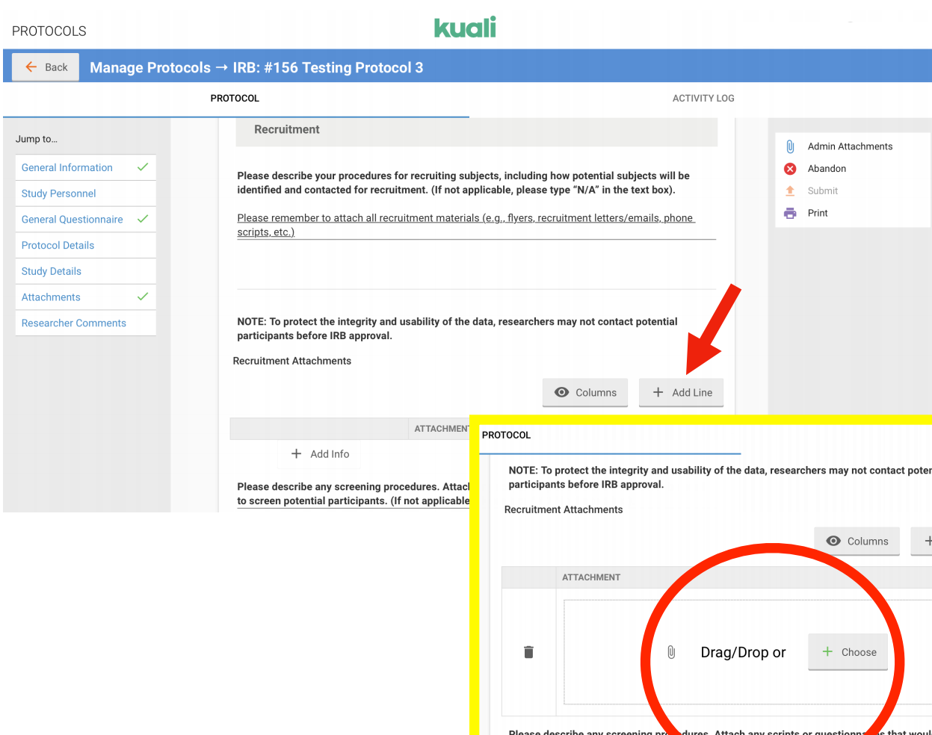
What is Kuali?
Kuali is
IRB e-protocol management software that consolidates processes and storage
Eliminates the need to email applications
Improved interface and capabilities

Slide 5
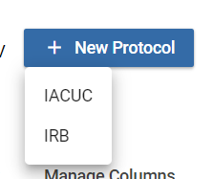
Creating a protocol
Log in
In the upper righthand corner select “+New Protocol”
Then “IRB”
Tip – remember your log number!

Slide 6
Creating a protocol
Meet with the faculty PI to determine who should start the application.
Organize consent forms, recruitment materials, and instruments – these need to be uploaded.
Enter the PI’s name
Student name cannot be listed as PI.

Slide 7
Creating a protocol
Adding personnel
The PI and the person completing the form will autoload.
To add another person, click “+Add Line”

Slide 8
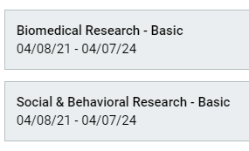
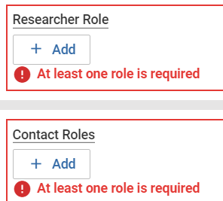
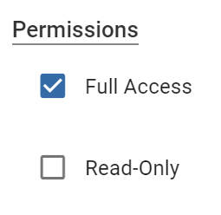
Creating a protocol
Personnel, continued
CITI should autoload
Permission
Researcher Role
Contact Role
Full Access (can edit) or Read Only (cannot edit)

Slide 9
Creating a protocol
If CITI certificates are not automatically uploading this means at least one of the following…
CITI has not been completed.
CITI was not completed via KSU single sign on (SSO).
CITI was completed through an external partner, such as a hospital.
There is a temporary error in the code being transmitted between Kuali and CITI. Logging out of Kuali may resolve the issue.

Slide 10
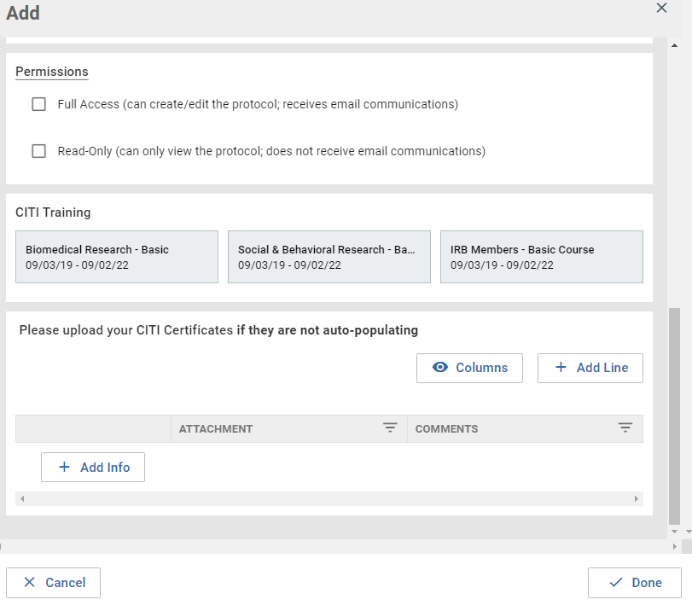
Creating a protocol
If a certificate does not appear, they will need to be manually uploaded.

Slide 11
Creating a protocol
Personnel continued
If KSU personnel are not autoloading, select YES and enter the required information.
Their CITI certificates must be uploaded.

Slide 12
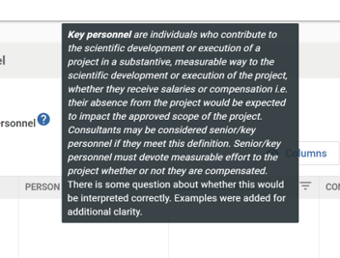
Creating a protocol
Hover your mouse over the ‘?’ for helpful tips

Slide 13
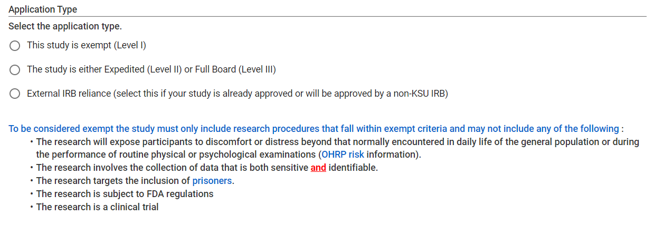
Creating a protocol
Select an application type
Selecting level I opens a screener

Slide 14
Creating a protocol
I selected Level I, but the screener says it isn’t!

Slide 15
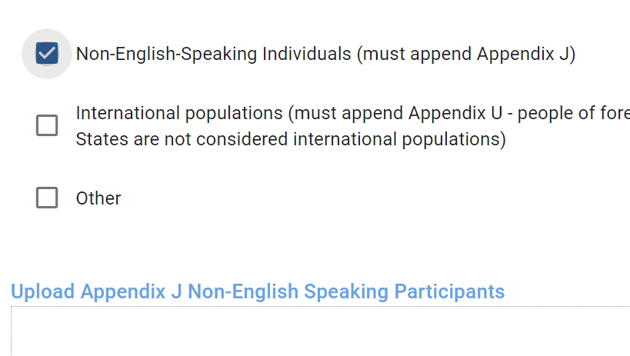
Creating a protocol
Appendices
We are in the process of retiring most appendices, but at this time some will need to be uploaded to Kuali.
Appendices can be downloaded from the form’s webpage or within Kuali.
Link

Slide 16
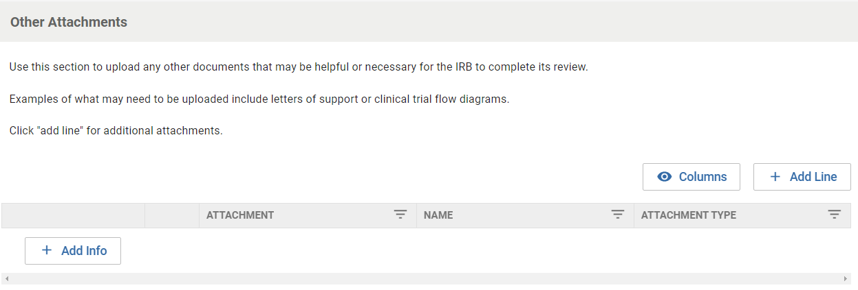
Creating a protocol
Multiple document uploads.
Click “Add Info” for the first doc, then “+Add Line” for additional documents

Slide 17
Submitting a protocol
Submitting
Only the PI can click “Submit”
Student clicks “Notify PI To Submit”
PI logs in, reviews protocol and edits or submits
PI reviews protocol, then edits (if needed), clicks “Submit”
Notification of submission email and review starts

Slide 18
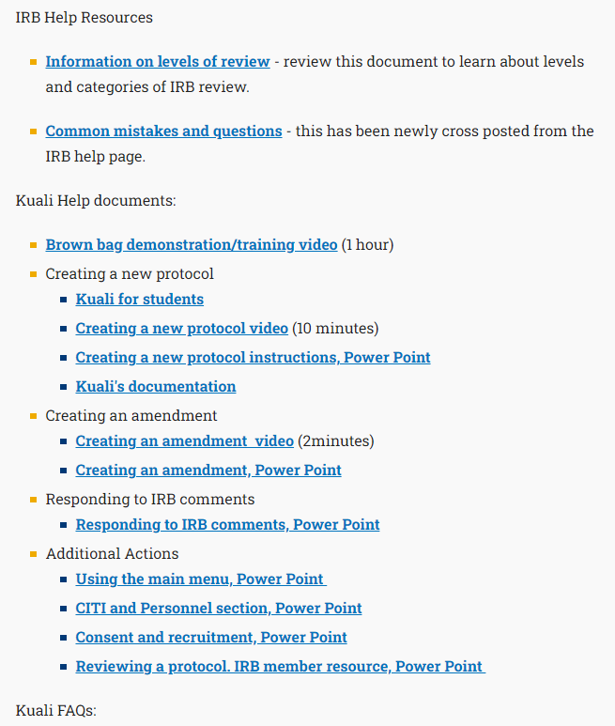
Review other resources
See the IRB forms page for…
IRB Help Resources
Kuali Help Docs
FAQs

Slide 19
Thank You.
www.kent.edu

