Slide 1

Being a TA in a Science Lab
Rajlakshmi Ghosh (rghosh2@kent.edu)
Cadey Korson (ckorson@kent.edu )
Notes:
Hello, our names are Raj and Cadey. We will be talking with you about being a teaching assistant in a science lab.

Slide 2

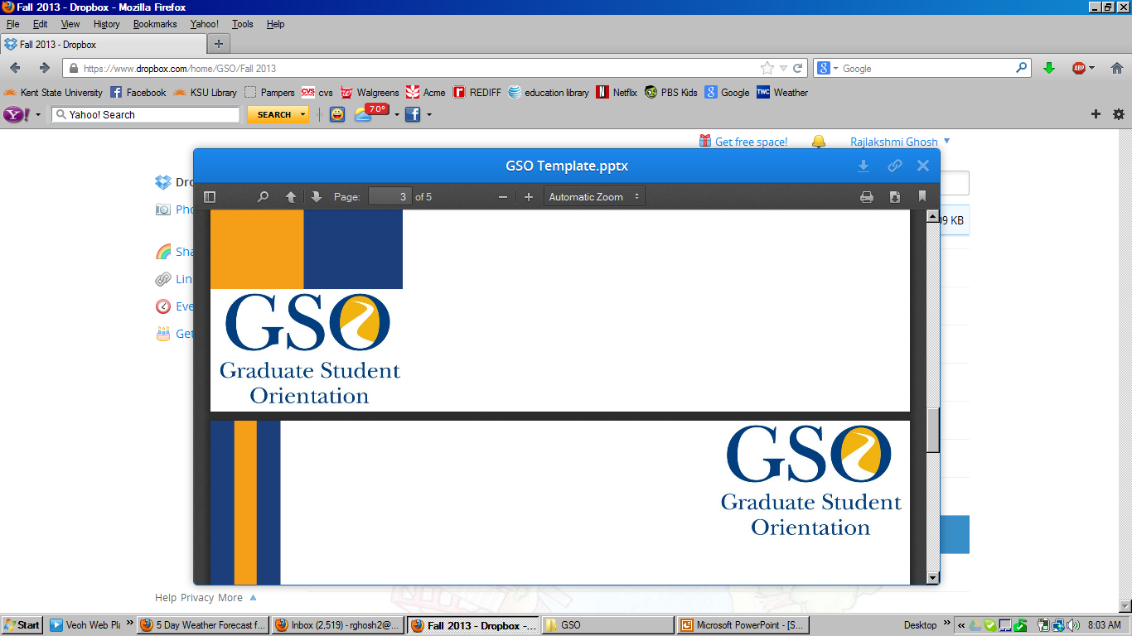
Overview of Assistantships
TA (Teaching Assistant)
  Teach labs or lecture sessions (undergraduate or graduate level)
RA (Research Assistant)
  Work in research projects
GA (Graduate Assistant)
  Duties other than teaching and research
  Assisting professors in various other projects
  Data management, office work, administrative work
Notes:
There are three types of assistantships at Kent State University:
TA (Teaching Assistant) - Teach labs or lecture sessions
RA (Research Assistant) - Work in research projects
GA (Graduate Assistant) - Duties other than teaching and research, assisting professors in various other projects, data management, office work, administrative work

Slide 3
General Science Class Structure
Lecture
  Taught by an instructor or professor
  Usually large student population
Labs
  Taught by Teaching Assistants (you!) (independently or co-taught)
  Smaller groups divided up from the larger lecture (20-30 students per lab)
  May have a Lead TA or Lab Coordinator
Notes:
Lectures are:
Taught by an instructor or professor
Usually large student population
Labs are:
Taught by Teaching Assistants (you!) (independently or co-taught)
Smaller groups divided up from the larger lecture (20-30 students per lab)
May have a Lead TA or Lab Coordinator

Slide 4
Some examples:
 | Geography | Geology | Biology | Chemistry | Physics
Types of TAs | Teach lab sections | Teach lab sections | Teach lab sections, proctor, grade, lab coordinator | Teach undergraduate labs** | Teaching, grading, proctoring, no lab coordinators
Courses with Labs | Field and Workshop Courses, GIS, Remote Sensing, LER courses (World Geography, Intro to Geography, Physical Geography) | 4 credit courses (CORE and Major required) | Classes with 100+ students, Cell Bio, Structure and Function, Bio Foundations. | General Chemistry I & II, Organic Chemistry I & II, Fundamentals of Chemistry, and Intro to Organic Chemistry* | Introductory physics classes for science majors (PHY 13101, 13102) and physics majors (23101, 23102)
TA Responsibilities | Teach, grade, proctor exams in labs, host office hours | CORE Labs: Teach, grade, host office hour. Major Labs: assist instructor | TAs are evaluated through course evaluations and soon peer-reviews | 20hrs/week, teaching, grading, office hours, lab development; evaluated by professor | Faculty evaluation of TAs
# Of lab sections and # of students | Physical Geography: 10 in class/ 30 students (TA teaches 2 sections) – meet twice a week 2 online/60 students (TA teaches 1 section) | 15-24 students per section. PhD teach 3 labs/week or 1 lecture, Masters teach 2 labs/week | 2 sections/20 students per section | 2 sections/24 students each (1 section if advanced class) | 20 hours
TA lab Manual? | 2-3 hour orientation, weekly meetings | Orientation, Faculty lab facilitators meet weekly with TAs | TA Workshop | Manual and additional training provided
Notes:
Here are some examples of the roles and responsibilities of assistants in STEM departments.

Slide 5
Duties of a Science Lab TA
Varies from department to department!
Include one or more of the following :
  Teaching two or three lab sections (most common)
  Grading exams and assignments
  Proctoring exams
  Tutoring
  Data entry and analysis
  Leading discussions and seminars
  Preparation work (setting up) and cleanup in labs
Notes:
Duties of a Science Lab TA - Varies from department to department! Include one or more of the following :
Teaching two or three lab sections (most common)
Grading exams and assignments
Proctoring exams
Tutoring
Data entry and analysis
Leading discussions and seminars
Preparation work (setting up) and cleanup in labs

Slide 6
Purpose of Science Labs
Your goals as a lab TA include:
  Connect lecture topics to the practical world.
  Explore concepts presented during lecture.
  Understand scientific method(s) involved.
  Promote hands-on learning.
Notes:
Your goals as a lab TA include:
Connect lecture topics to the practical world.
Explore concepts presented during lecture.
Understand scientific method(s) involved.
Promote hands-on learning.

Slide 7
Before the semester begins …
Get as much information as possible!
Meet the Graduate Coordinator, Instructor, Lab Coordinator or even other TAs in your department!
  Know your duties! (Sign and understand CONTRACT)
Attend the Departmental Orientation (if applicable)
Familiarize yourself with your department
    Location of lab/rooms
    Lab equipments and safety procedures
    Teaching Assistant manual (TA manual)
Get your keys – ask Dept Secretary for assistance!
Prepare your syllabus
Get a copy of the roster (student list)
  Faculty tools under FlashLine
Notes:
Meet the graduate coordinator and get to know the courses you will be teaching (RAs meet advisor).
Meet the instructor and get to know your specific duties.
Get a clear understanding of what your role is and the expectations the instructor has of you
Contact other TAs who have taught the course before (RAs contact others in the same lab).
They are a great resources for advice, class materials, etc and can save you a lot of prep time
Meet your head TA / Lab coordinator
Get a copy of the lab manual
Talk with them about what your experience will be like
Understand what to expect in teaching this lab
Get as much information as possible!
Familiarize yourself with the:
Lab
Equipment
Safety procedures:
Know the University safety policies and regulations
Take lab safety training
Know location of all safety equipments and how to operate them
Determine any hazard contained in the lab
Get your keys!!!
Prepare your syllabus !!! (ask for an existing one from office or from a student who has taught this class previously)
Clearly state the rules and policies for your course
Mention your policies about LATE SUBMISSIONS, ABSENCE and MAKE-UP.
Attend GSO workshop on Syllabus and Scheduling recommended.
Or at least see materials available online in GSO website.
Get a copy of the Roster (student list) – this can be found on flashline or blackboard

Slide 8
Before your first class …
Find a contact for additional resources
Go over the assigned lab manual or exercise
  Familiarize yourself with the equipment and materials involved
  DO THE LAB YOURSELF IF NECESSARY
  Determine all safety measures
  Attend a lab that’s early in the week
Plan your teaching strategy – time management
Notes:
Before your first class …
Go over the assigned lab manual or exercise
Familiarize yourself with the equipment and materials involved
DO THE LAB YOURSELF IF NECESSARY
Determine all safety measures
Attend a lab that’s early in the week

Slide 9
During Every Class (Lab Structure) …
Dress properly – Stand out from your students ☺
Arrive early and greet students
Lab Structure
  Preview:
    Give an introduction to the lab or provide an overview of the experiment/goals for that lab
  View:
    Perform the exercise or experiment
    Keep students on track and be aware of time
  Review:
    Relate the exercise or experiment to the theory or topics presented in lecture
    Leave time for questions
After lab: disposal and clean up
Notes:
During Every Class (Lab Structure) …
Dress properly – Stand out from your students ☺
Arrive early and greet students.
Lab Structure
Preview:
Give an introduction to the lab or provide an overview of the experiment/goals for that lab
View:
Perform the exercise or experiment
Keep students on track and be aware of time
Review:
Relate the exercise or experiment to the theory or topics presented in lecture
Leave time for questions
After lab: disposal and clean up

Slide 10
Your first class …
Introduce yourself
Clarify the connection between lab and lecture (think about the “goals of a lab TA”)
Get to know your students
Review the syllabus and be VERY clear on your policies :
  Dress code
  Late work
  Missed class
  Attendance
  Grading
Notes:
Your first class …
Introduce yourself
Clarify the connection between lab and lecture (think about the “goals of a lab TA”)
Get to know your students
Review the syllabus and be VERY clear on your policies : Dress code, Late work, Missed class, Attendance, Grading, Participation, Student Conduct.

Slide 11
Grading lab assignments and proctoring
Types of evaluation:
  Shorter assignments - Quizzes, homework assignments
  Longer assignments - Essays, lab reports, journal reviews
Strategies for grading
  Give the grading criteria in advance (provide a rubric)
  Clearly state your policies about LATE SUBMISSIONS, ABSENCE and MAKE-UP in the syllabus and do not deviate from them
  Read a few assignments before you begin assigning grades
  Be consistent
  Be prepared to answer questions about grading or justify your grading to the student
What is Proctoring?
  Responsibilities
  Know the University’s policies and Professor’s policies on cheating
Notes:
Grading lab assignments and proctoring
Types of evaluation:
Shorter assignments - Quizzes, homework assignments
Longer assignments - Essays, lab reports, journal reviews
Strategies for grading
Give the grading criteria in advance (provide a rubric)
Clearly state your policies about LATE SUBMISSIONS, ABSENCE and MAKE-UP in the syllabus and do not deviate from them
Read a few assignments before you begin assigning grades
Be consistent
Be prepared to answer questions about grading or justify your grading to the student
Know the University’s policies and Professor’s policies on cheating

Slide 12
End of Semester …
Clarify the date of final exam
Submit grades on time
  Faculty tools in FlashLine or
  Submit to instructor responsible
Student Evaluations
Notes:
End of Semester …
Clarify the date of final exam
Submit grades on time
Faculty tools in FlashLine or Submit to instructor responsible
Student Evaluations

Slide 13
Questions?
CONTACT INFORMATION
    Rajlakshmi Ghosh
    School of Teaching, Learning & Curriculum Studies
    rghosh2@kent.edu
    Cadey Korson
    Department of Geography
    ckorson@kent.edu
Notes:
Thank you for attending our session. Please contact us via email if you have any questions or would like to talk more about the topics we covered in this session.

